Slide 1
Lincoln and the Law
Amber Featherston

Slide 2
Lincoln
Title: Abraham Lincoln while a traveling lawyer, taken in Danville, Illinois
Creator(s): Joslin, Amon T., photographer
Date Created/Published: 1857 May 27
http://hdl.loc.gov/loc.pnp/cph.3a18603

Slide 3
Lincoln
Title: [Abraham Lincoln, head-and-shoulders portrait, facing slightly left, taken in Pittsfield, Illinois, two weeks before the final Lincoln-Douglas debate in Lincoln's unsuccessful bid for the Senate, October 1, 1858]
Creator(s): Jackson, Calvin, fl. 1858-1882, photographer
Date Created/Published: [printed between 1900 and 1911]
http://hdl.loc.gov/loc.pnp/cph.3a18600

Slide 4
Lincoln’s House
Title: Shenandoah Valley. The Lincoln family originally came from the Shenandoah Valley. This substantial farm house belonged to Abraham Lincoln's grandfather and here the President's father was born
Creator(s): Vachon, John,photographer
http://hdl.loc.gov/loc.pnp/fsa.8b09001

Slide 5
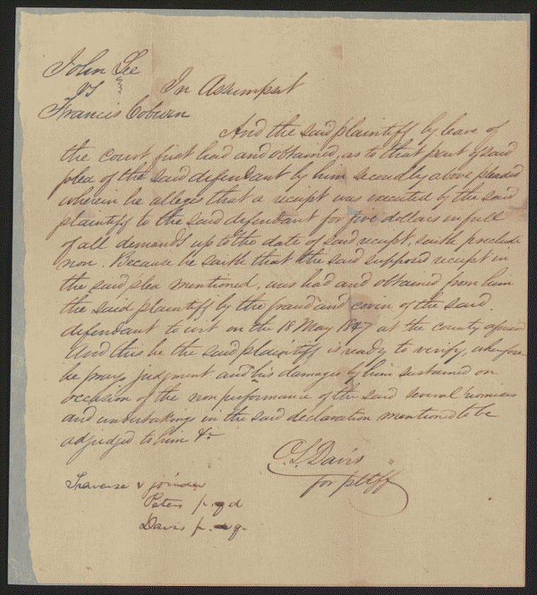
Lee vs. Coburn

Slide 6
Lee vs. Coburn
Created/Published: May 08, 1850
Summary: Lee sued Coburn to collect $600 for five years of labor as a servant. There was no written contract, guarantee, or promise between the parties, and Lee refused to prosecute the case further after the jury heard the evidence. Lincoln represented Coburn.
http://hdl.loc.gov/loc.rbc/lprbscsm.scsm1438

Slide 7
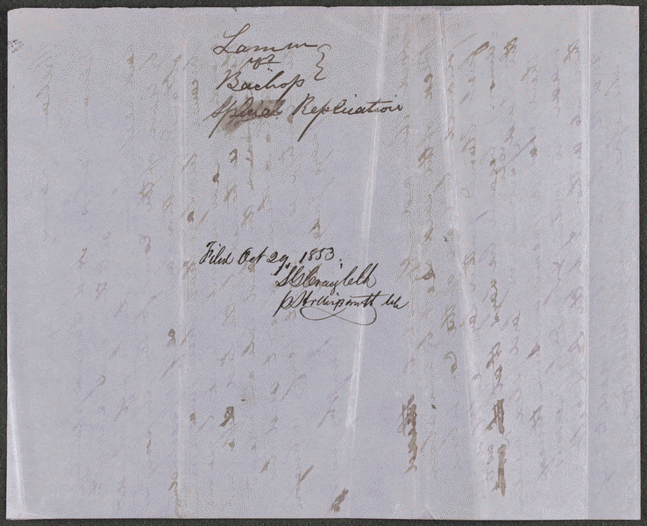
Lamm vs. Bachop

Slide 8
Lamm vs. Bachop
Created/Published: October 29, 1853
Summary: Lamm and Bachop attempted to settle a dispute through arbitration. Lamm agreed to relinquish a quitclaim deed on 360 acres of land in return for a $125 promissory note from Bachop. Lamm sued after Bachop failed to pay the note. Bachop retained Lincoln and pleaded that he had made no written agreement with Lamm. The court ruled for Bachop.
http://hdl.loc.gov/loc.rbc/lprbscsm.scsm1565

Slide 9
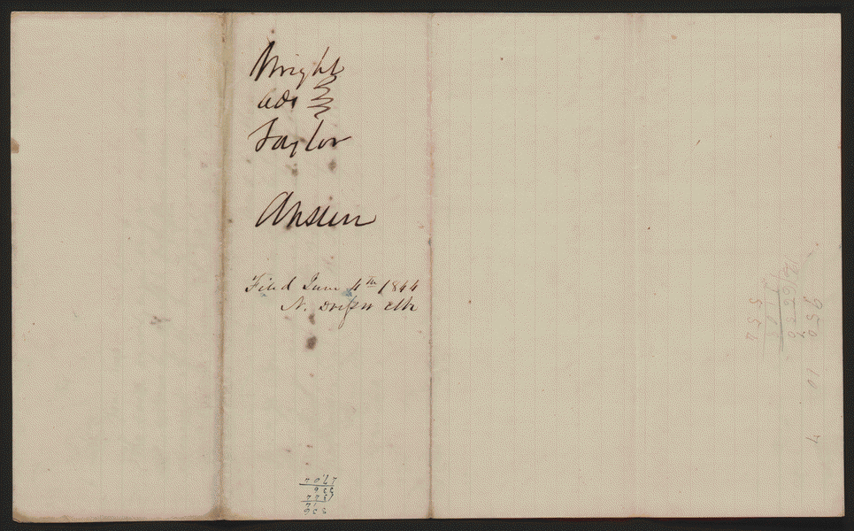
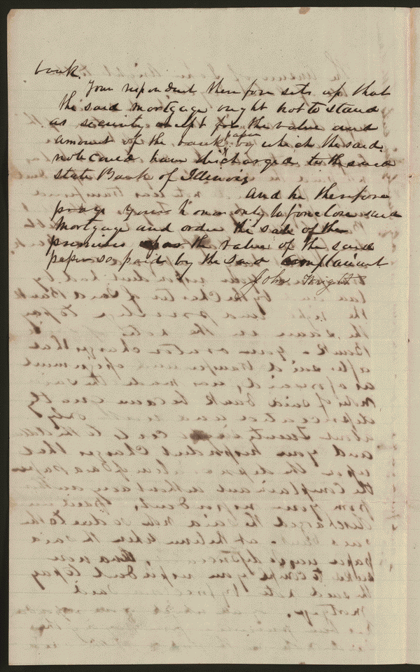
Wright vs. Taylor

Slide 10
Wright vs. Taylor
Created/Published: June 04, 1844
Summary: Wright gave Taylor three promissory notes for $672.08 each and secured the notes with a mortgage on 282 acres of land. Wright paid the first note but defaulted on the second. Taylor retained Logan and Lincoln and sued to foreclose the mortgage. However, Wright answered that Taylor had assigned the note to the State Bank of Illinois to pay a debt and had paid in the liquidated bank's depreciated currency of $0.26 on the dollar. Taylor then tried to have Wright pay the full value of the note. The court ruled for Taylor and decreed that Wright pay $722.48 or the court would sell the land. Wright appealed to the Illinois Supreme Court, which reversed and remanded the decree. Justice Purple stated that Wright was not liable for the full amount of the note, but rather for the depreciated amount that Taylor had paid the bank. Taylor only succeeded to the rights of the bank and could not have superior equity. Purple reasoned that the case "is plain and easy of solution. The general doctrine of the law relative to the transfer, and indorsement of promissory notes, has necessarily but little application to the question, and the controversy may be settled equitably and legally without the slightest interference with any known or established principle." In the remanded case, the court ruled for Taylor and decreed the foreclosure of the mortgage.
http://hdl.loc.gov/loc.rbc/lprbscsm.scsm1417

Slide 11
Wordle

