Slide 1
Lincoln as a Lawyer

Slide 2
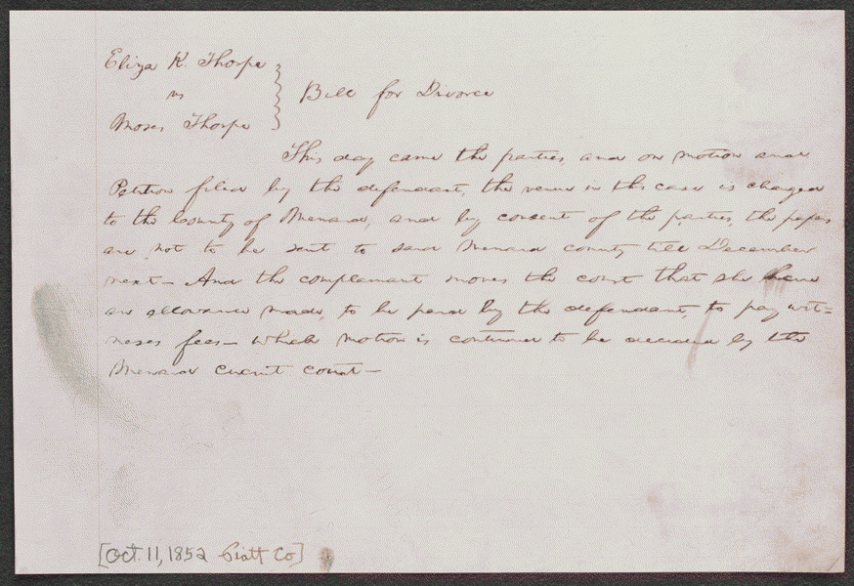
October 11, 1852 Platt, County Illinois
Summary: Eliza Thorpe retained Lincoln and Herndon and sued Moses Thorpe in the Piatt County Circuit Court for divorce on the grounds of adultery. Moses Thorpe requested a change of venue, and the court granted a change to the Menard County Circuit Court. Eliza charged that Moses had committed adultery with Emily Cox and entered a letter from Cox as evidence. Moses denied the charge and complained that his ungrateful wife had verbally abused him and schemed to drive him to divorce to obtain a large property settlement. He argued that she should be denied alimony because of that scheme. He also claimed that the neighborhood shunned her because of her unchaste and inebriate behavior. Moses presented witnesses, including his son from a previous marriage, to substantiate his allegations. Lincoln and Herndon countered by producing several witnesses, including the Thorpes' physician, who testified to Eliza's chaste and sober character. The court sustained Moses Thorpe's motion to strike the case from the docket and dismissed the case.

Slide 3
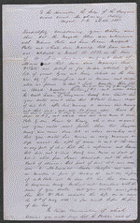
August 11,1851 Sangamon County,Illinois
Summary: Before his death, William Porter sold a lot in Springfield, Illinois, which Sangamon County eventually purchased and on which it built the courthouse. Margaret Porter, William Porter's widow, had not released her right to dower in the lot. Porter retained Lincoln and Herndon and sued Sangamon County, Illinois, for her dower. The county claimed that Margaret Porter had relinquished her dower right, but that if she had not, she should receive dower from an adjacent lot owned by Andrew Porter. The parties reached an agreement in which Sangamon County paid Porter $350 and Porter released her interest in the lot. The court dismissed the case

Slide 4
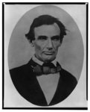
Notes:
Copy of an ambrotype made by Calvin Jackson. Print is reversed from original ambrotype.
Illus. in: The Photographs of Abraham Lincoln / Frederick Hill Meserve. New York, Privately printed, 1911, p. 47.
· Title: [Abraham Lincoln, head-and-shoulders portrait, facing slightly left, taken in Pittsfield, Illinois, two weeks before the final Lincoln-Douglas debate in Lincoln's unsuccessful bid for the Senate, October 1, 1858]
· Creator(s): Jackson, Calvin, fl. 1858-1882, photographer
· Date Created/Published: [printed between 1900 and 1911]
·
http://hdl.loc.gov/loc.pnp/cph.3a18600

Slide 5
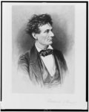
Lincoln as lawyer
Title: Lincoln the lawyer / Frederick T. Stuart. Creator(s): Stuart, Frederick T., 1837-1913,
etcher Date Created/Published: [between 1865 and 1910. Summary: Abraham Lincoln, head-and-shoulders portrait, facing right.

Slide 6
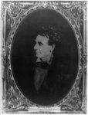

Slide 7
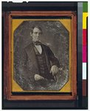
Lincoln as Congressman
Title: [Abraham Lincoln, Congressman-elect from Illinois. Three-quarter length portrait, seated, facing front] Creator(s): Shepherd, Nicholas H., photographer Date Created/Published: [Springfield, Ill., 1846 or 1847]
http://hdl.loc.gov/loc.pnp/cph.3g02439

Slide 8
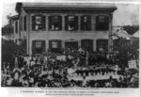
Lincoln’s House

Slide 9
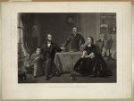
Title: Lincoln and his family / painted by S.B. Waugh ; engraved by William Sartain.
Creator(s): Sartain, William, 1843-1924, engraver
Related Names: Waugh, Samuel Bell , artist Bradley & Company , publisher
Date Created/Published: Philadelphia : Published by Bradley & Co. 66 N. Fourth St., c1866 ( Printed by Irwin & Sartain)
Summary: Print showing Abraham Lincoln, full-length portrait, sitting in chair at the left end of a table with Thomas sitting next to him, Mary Todd is sitting on the right, and Robert Todd is standing behind the table.

Slide 10
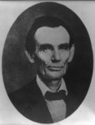
Title: [Abraham Lincoln while a traveling lawyer, taken in Danville, Illinois
Creator(s): Joslin, Amon T., photographer
Date Created/Published: 1857 May 27 [printed later]
http://hdl.loc.gov/loc.pnp/cph.3a18603

Slide 11
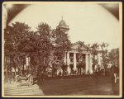
Title: The Coles County Court House in Charleston, Ills., in which Lincoln often practiced law and before which he made a short speech in the evening after his fourth joint debate with Douglas, Sept. 18, 1858
Date Created/Published: [between 1860 and 1898?]
http://hdl.loc.gov/loc.pnp/ppmsca.19197

