Slide 1
Lincoln Lawyer
By: Ashley Hoerr

Slide 2
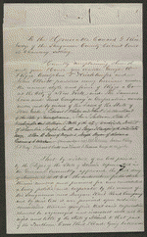
Farmer’s Loan & Trust Co. vs. Great Western Railroad Company
In 1853, the Great Western Railroad Company borrowed $1,000,000 and issued bonds in various denominations to pay back the loan. To secure these bonds, the Great Western Railroad issued a deed trust transferring a portion of the railroad line to the Farmers' Loan and Trust Company. The railroad failed to pay the first series of bonds and interest. The Farmers' Loan and Trust Co. retained Lincoln and sued the railroad. The Farmers' Loan and Trust Co. asked the court to obtain an accounting of the railroad's records, to appoint a receiver to take control of the railroad, and to issue an injunction to stop the railroad from paying any other debts before repaying the bank. The Farmers' Loan and Trust Co. added other defendants upon discovering that the railroad had mortgaged some of its land to others. Lamb, one of the defendants, motioned the court to dismiss the case because of a lack of proper parties. The Farmers' Loan and Trust Co. later dismissed the case.
http://memory.loc.gov/cgi-bin/query/D?scsmbib:52:./temp/~ammem_Cy2n

Slide 3
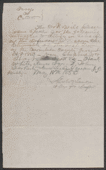
Order for Subpoenas in Devors vs. Catlett
Devors sued Catlett in JP court to recover $30. The court ruled for Catlett and awarded him $6.06 for costs. Devors appealed to the circuit court, where the jury found Catlett guilty, and the court awarded Devors $25. Lincoln represented Catlett in the appeal.
http://memory.loc.gov/cgi-bin/query/D?scsmbib:38:./temp/~ammem_FIqY

Slide 4
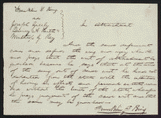
Plea in Greely, Keith, & Ray vs. King
King owed Greely, Keith, and Ray some money apparently on an account. Greely, Keith, and Ray feared that King would leave the state without paying his debt to them. They sued King in an action of attachment to recover the debt, and King retained Logan and Lincoln. King pleaded in abatement and claimed that he had not left the state with the intention of taking all of his assets with him. The court ruled for King and quashed the writ of attachment.
http://memory.loc.gov/cgi-bin/query/D?scsmbib:36:./temp/~ammem_FIqY

Slide 5
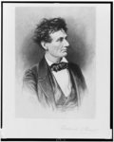
Lincoln the Lawyer
Created by Fredrick T. Stuart
1865-1910
http://www.loc.gov/pictures/item/98517810/

Slide 6
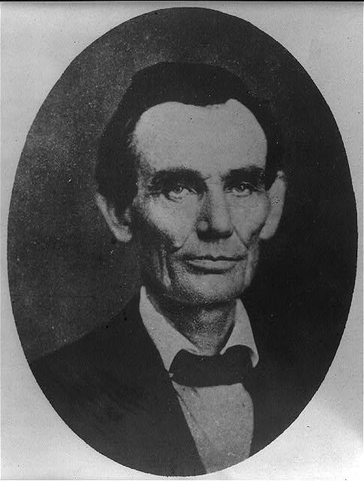
Abraham Lincoln Traveling Lawyer
Danville, IL.
May 27, 1857
http://www.loc.gov/pictures/item/2008678328/resource/

Slide 7
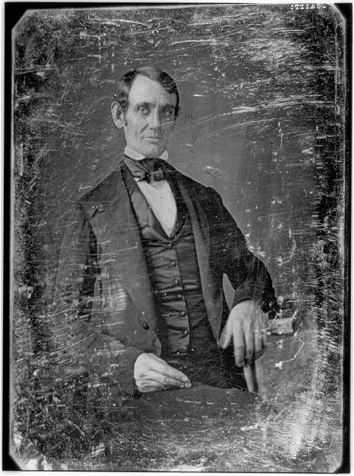
Abraham Lincoln, Congressman-elect from IL.
Springfield, IL.
1846-1847
http://www.loc.gov/pictures/item/2004664400/

Slide 8
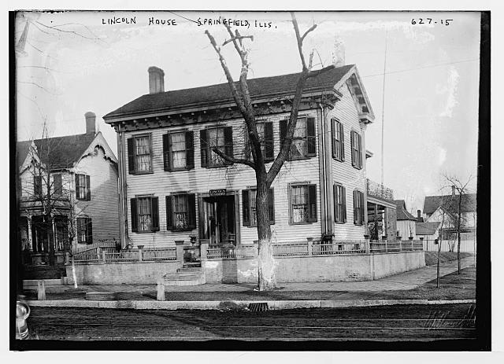
Lincoln’s House
Springfield, IL.
1900
http://www.loc.gov/pictures/item/ggb2004003052/

Slide 9
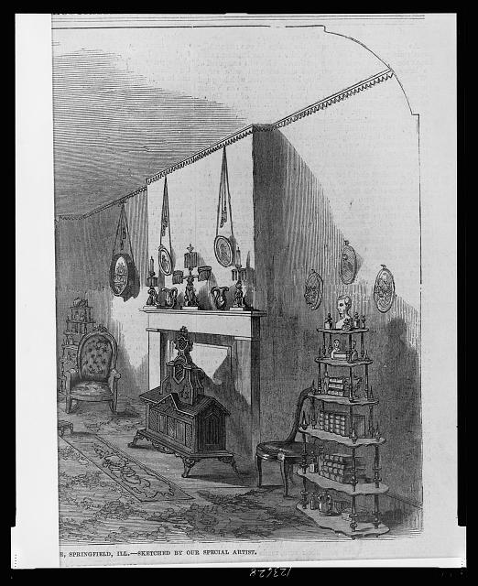
Front Parler in Lincoln’s House
Springfield, IL.
1861
http://www.loc.gov/pictures/item/99405207/

Slide 10
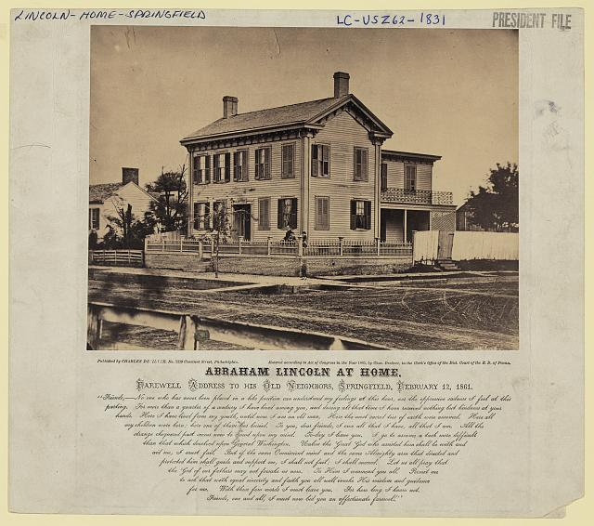
Lincoln at Home
Springfield, IL.
1860
http://www.loc.gov/pictures/resource/ppmsca.23724/

Slide 11
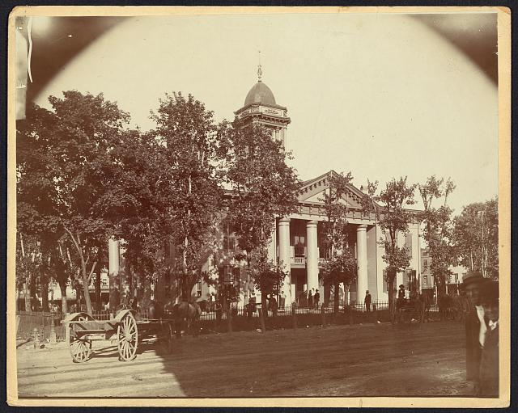
The Coles County Court House
Charleston, IL.
Lincoln often practiced law here and before which he made a short speech in the evening after his fourth joint debate with Douglas, September 18, 1858
1860
http://www.loc.gov/pictures/item/2008680974/

Slide 12
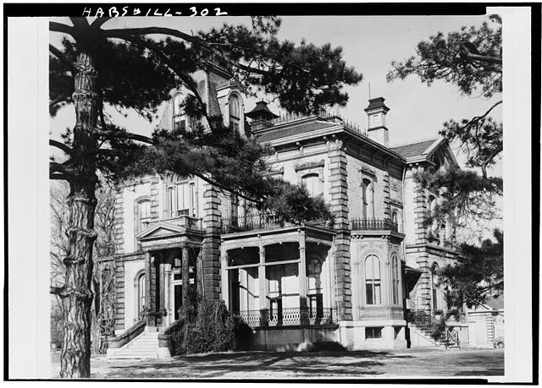
Historic American Buildings Survey Illinois State Historical Library
David Davis Mansion, Monroe & Davis Streets, Bloomington, McLean County, IL
http://www.loc.gov/pictures/item/il0078.photos.062895p/

Slide 13
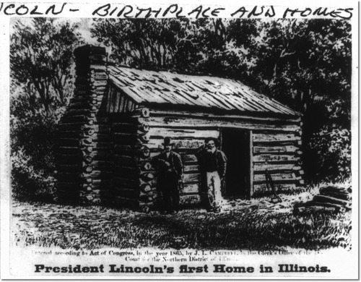
President Lincoln's first home in Illinois
Joseph Ward, 1865
http://www.loc.gov/pictures/item/2004680086/

Slide 14
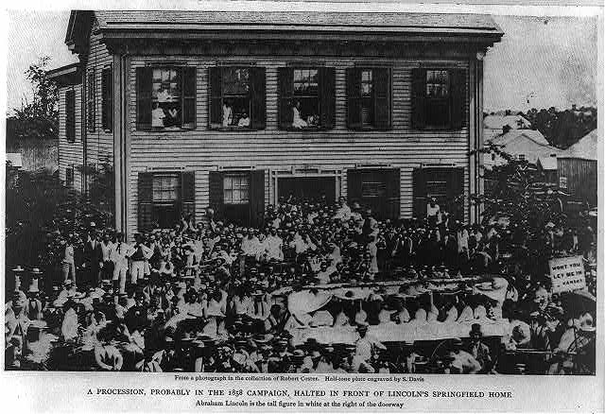
Abraham Lincoln at his home in Springfield, Illinois, with a large crowd of people gathered outside after a Republican rally
August 8, 1860
http://www.loc.gov/pictures/item/2009630655/

