Slide 1
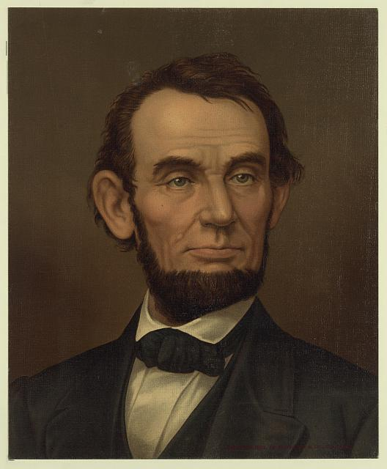
Abraham Lincoln
By: Austin Rehn

Slide 2
http://hdl.loc.gov/loc.rbc/lprbscsm.scsm1489
Digital ID
lprbscsm scsm1489 http://hdl.loc.gov/loc.rbc/lprbscsm.scsm1489
the State of Illinois sued Moore and his eleven sureties to collect $200,000 for the breach of a tax collector's bond.

Slide 3
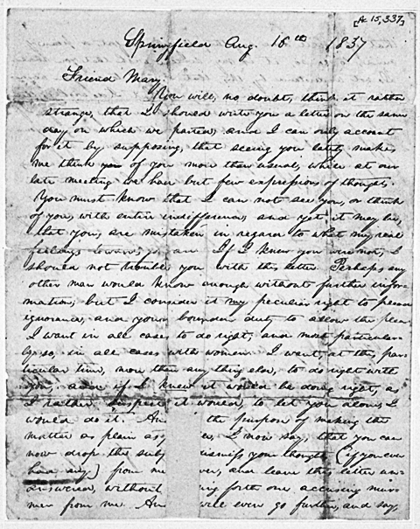
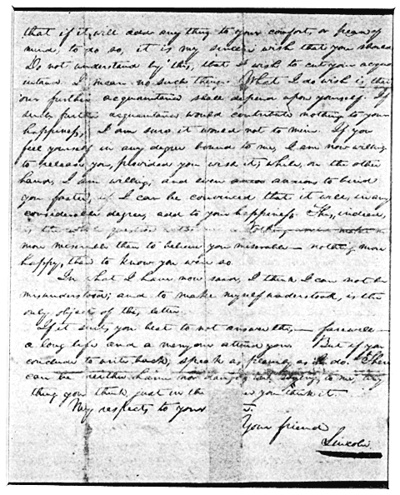
In autumn 1836, Abraham Lincoln (1809-1865), then a twenty-seven-year-old Illinois representive studying law, agreed to marry Mary S. Owen. Who he had met three years before when she was visiting her sister in New Salem, Illinois.

Slide 4
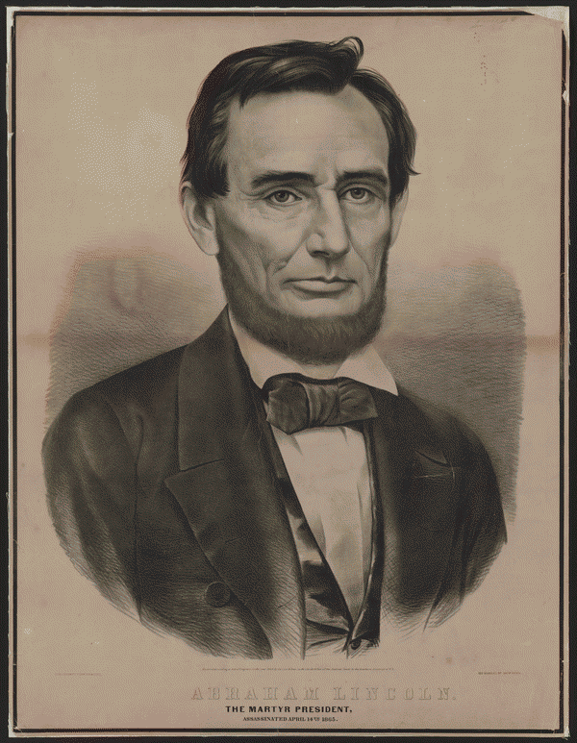
Abraham Lincoln, from Springfield Illinois who was a lawyer, and then became a president afterwards.
Digital ID
lprbscsm scsm0666 http://hdl.loc.gov/loc.rbc/lprbscsm.scsm0666
http://memory.loc.gov/cgi-bin/query/r?ammem/scsmbib:@field(DOCID+@lit(scsm000666))

Slide 5
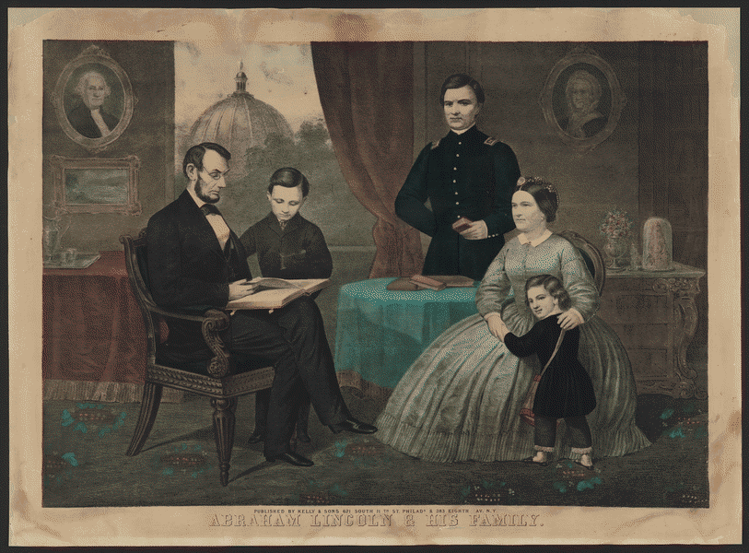
Digital ID
lprbscsm scsm0687 http://hdl.loc.gov/loc.rbc/lprbscsm.scsm0687
http://memory.loc.gov/cgi-bin/query/r?ammem/scsmbib:@field(DOCID+@lit(scsm000687))
Mr. and Mrs. Lincoln and three sons

Slide 6
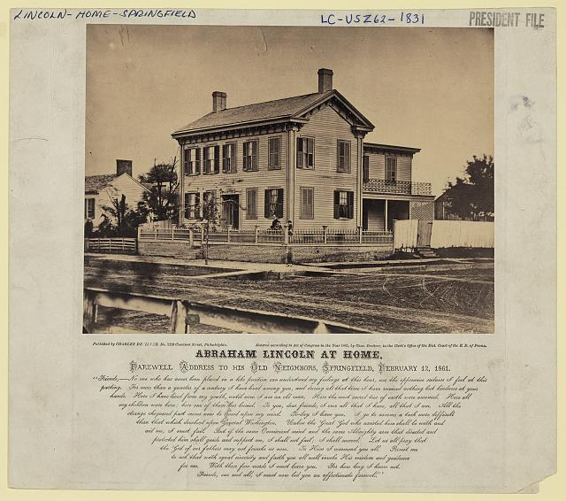
http://hdl.loc.gov/loc.pnp/ppmsca.23724
the house where Abraham Lincoln lived in Springfield, Illinois, with presidential candidate Abraham Lincoln standing on the terrace, with his sons Willie and Tad.

Slide 7
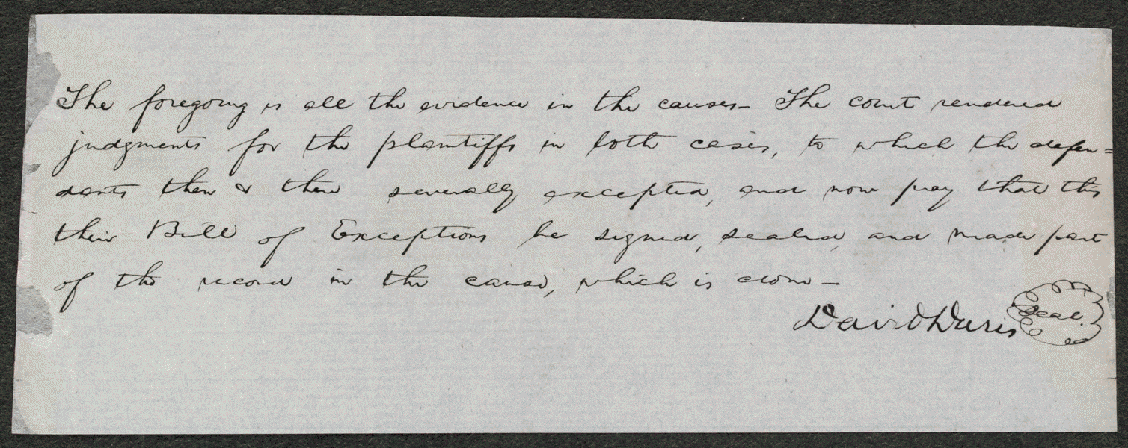
http://hdl.loc.gov/loc.rbc/lprbscsm.scsm1506 http://memory.loc.gov/cgi-bin/query/h?ammem/scsmbib:@field(DOCID+@lit(scsm001507))
An unknown plaintiff sued an unknown defendant, who retained Lincoln. The court ruled for the plaintiff. The defendant apparently planned to appeal the case because Lincoln wrote a bill of exceptions for the defendant.

Slide 8
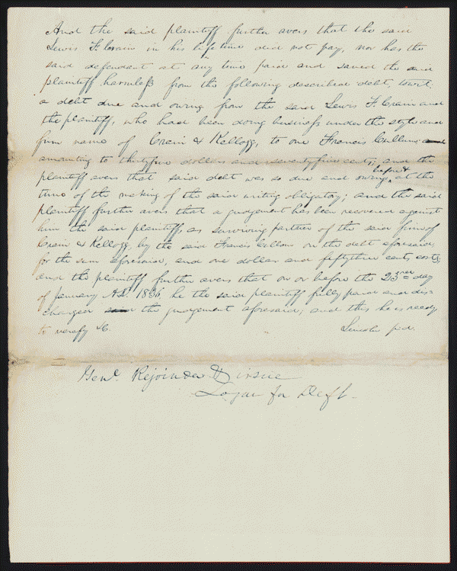
lprbscsm scsm1374 http://hdl.loc.gov/loc.rbc/lprbscsm.scsm1374
Kellogg and Lewis Crain dissolved their business partnership, but Crain owed Kellogg $16,000 to pay off the business's debts. Crain died before paying, and Kellogg sued James Crain, who served as surety for Lewis Crain, in an action of debt for $16,000. The court granted a change of venue to Peoria County, but the court there remanded the case back to Tazewell County. Kellogg retained Lincoln but failed to appear, and the court dismissed the case. Kellogg motioned to reinstate the case because he was ill and could not attend court. The court set aside the dismissal and ruled for Kellogg for $16,000.

Slide 9
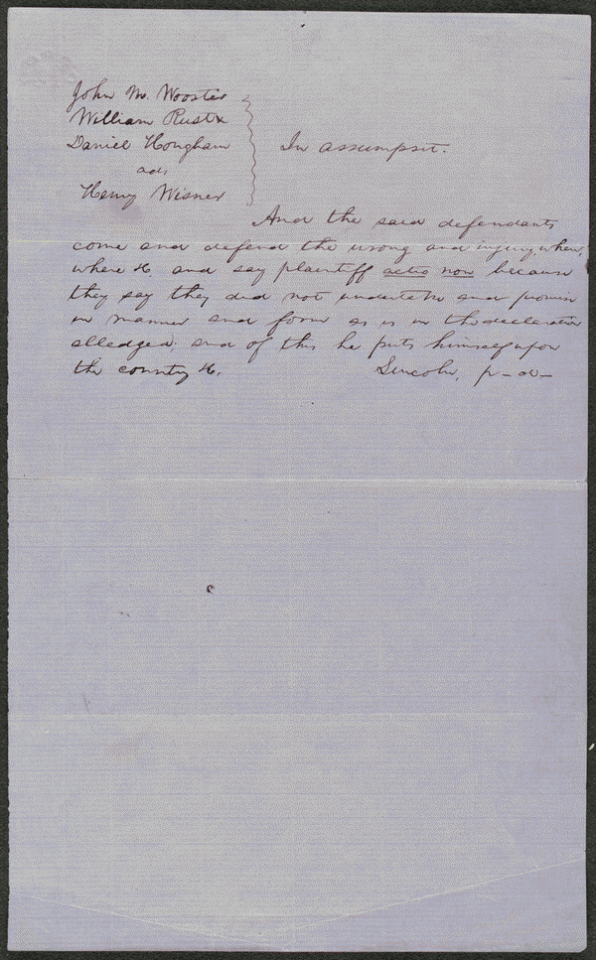
http://hdl.loc.gov/loc.rbc/lprbscsm.scsm1512 lprbscsm scsm1512
Wooster owed Wisner $3,000 for goods and merchandise. Wooster failed to pay, and Wisner sued in an action of assumpsit seeking $3,000. Wooster retained Lincoln and pleaded non-assumpsit. Apparently, the parties reached an agreement, and the court dismissed the case.

Slide 10
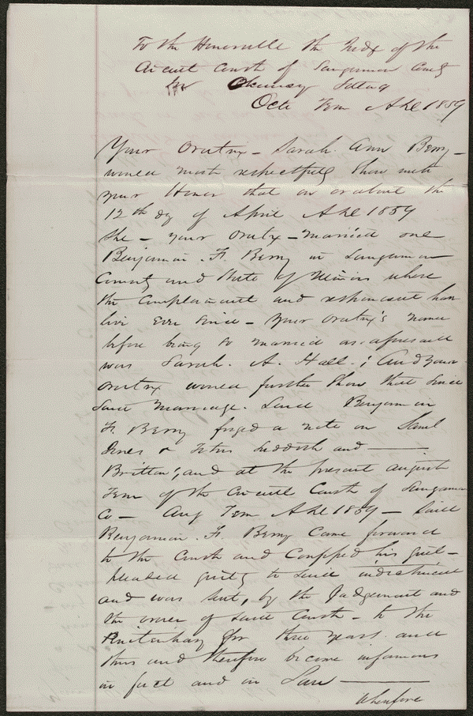
http://hdl.loc.gov/loc.rbc/lprbscsm.scsm1499 lprbscsm scsm1499
Benjamin Berry pleaded guilty in a forgery case, and the court sentenced him to three years in the penitentiary. Sarah Berry retained Lincoln and Herndon and sued Benjamin Berry for divorce on the grounds that he was a convicted felon. Benjamin Berry failed to appear, and the court granted the divorce.

