Slide 1
LINCOLN AND THE LAW

Slide 2
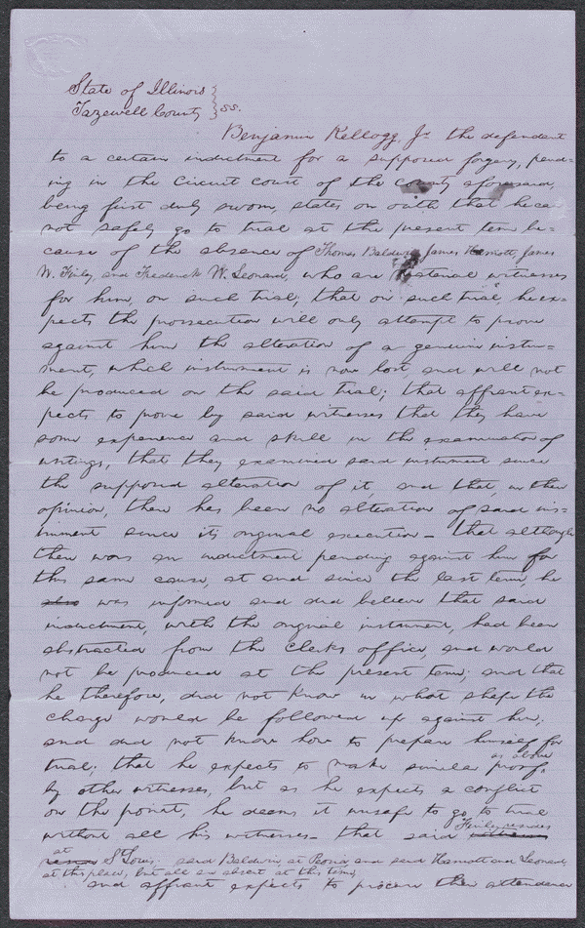
This is the affidavits for the People vs. Kellogg which Lincoln was the lawyer for Kellogg. 1853
http://hdl.loc.gov/loc.rbc/lprbscsm.scsm1578

Slide 3
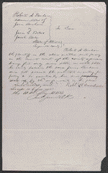
This is the affidavit for the Dunham v. Bale & Bale case.
http://memory.loc.gov/cgi-bin/ampage?collId=lprbscsm&fileName=scsm1575/lprbscsmscsm1575.db&recNum=0&itemLink=h?ammem/scsmbib:@field(DOCID+@lit(scsm001577))
Item Title
Affidavit in Dunham v. Bale & Bale, [Law papers].
Created/Published
May 10, 1854
Tazewell County, Illinois
Notes
Appears to be in Lincoln's hand.
Summary: Robert Dunham, as administrator of James Dunham's estate, retained Lincoln and sued James Bale and Jacob Bale in an action of trover. Dunham dismissed his suit against the Bales. Lincoln and his co-counsel received $10 for their legal services.

Slide 4
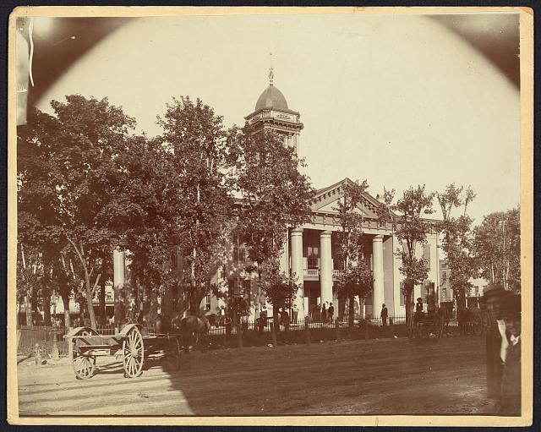
Cole County Court House
The Coles County Court House in Charleston, Ills. In which Lincoln often practiced law and before which he made a short speech in the evening after his fourth joint debate with Douglas, Sept. 18, 1858
http://www.loc.gov/pictures/resource/ppmsca.19197/

Slide 5
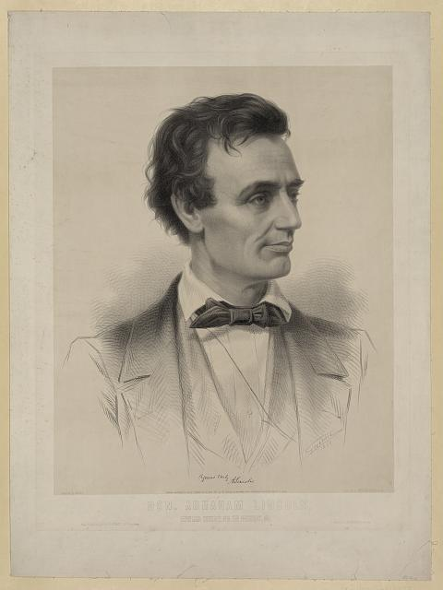
Abe Lincoln Portriat
http://www.loc.gov/pictures/resource/pga.00380/

Slide 6
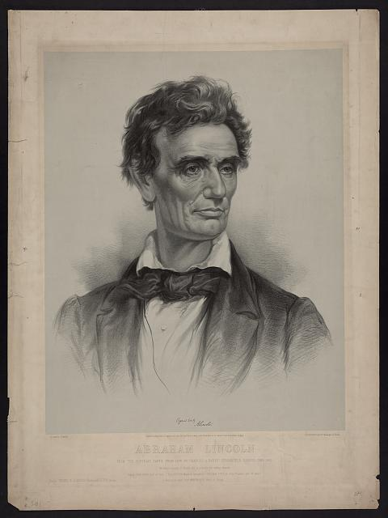
Abraham Lincoln from a portrait taken from life by Charles A. Barry, Springfield, Illinois, June 1860
http://www.loc.gov/pictures/resource/pga.03472/

Slide 7
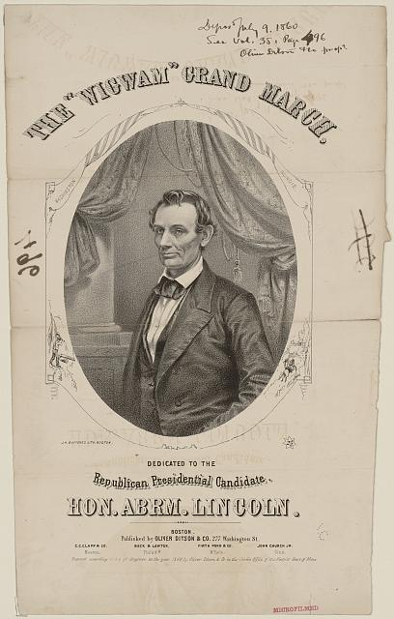
The "wigwam" grand march
http://www.loc.gov/pictures/resource/ppmsca.07598/
Boston : Published by Oliver Ditson & Co. 277 Washington Street, c1860 (Boston : J.H. Bufford's Lith.)

Slide 8
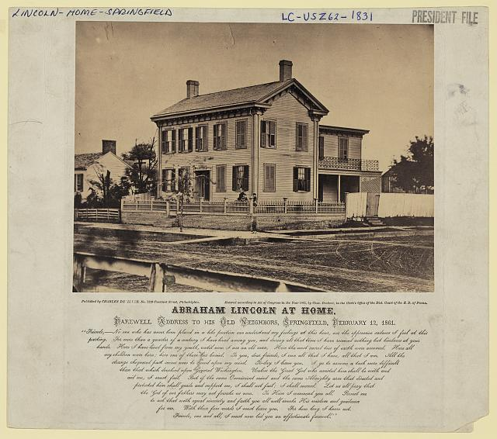
Abraham Lincolns House
http://www.loc.gov/pictures/resource/ppmsca.23724/
Original photo was "Copyright and published by Charles DeSilver, no. 1229 Chestnut Street, Philadelphia, 1865."

Slide 9
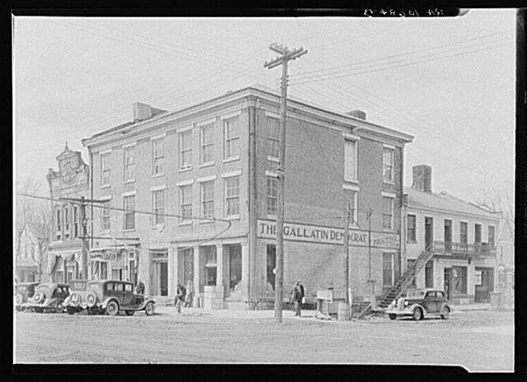
The Posey Building of Shawneetown, Illinois. In which Abraham Lincoln and Robert Ingersoll had law offices
http://www.loc.gov/pictures/resource/fsa.8c51242/

Slide 10
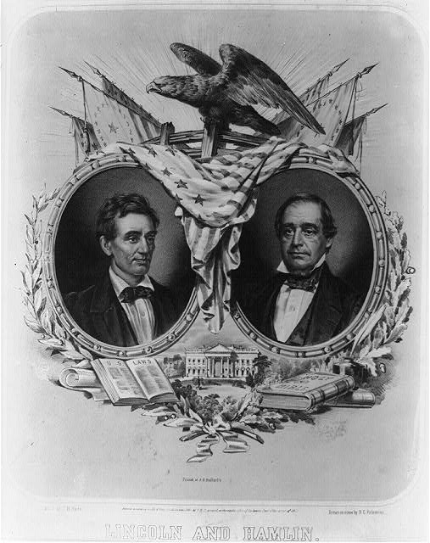
Lincoln and Hamlin
Lincoln and Hamlin / designed by J.N. Hyde ; drawn on stone by D[ominique] C. Fabronious.
http://www.loc.gov/pictures/resource/cph.3a07412/

Slide 11
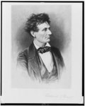
Lincoln the lawyer
Lincoln the lawyer / Frederick T. Stuart.
http://www.loc.gov/pictures/item/98517810/

Slide 12
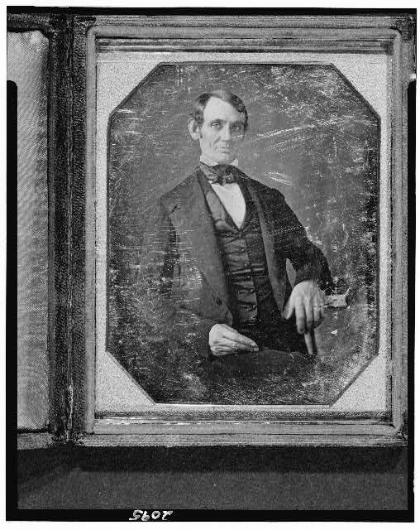
Lincoln as a lawyer
Abraham Lincoln, Congressman-elect from Illinois. Three-quarter length portrait, seated, facing front
http://www.loc.gov/pictures/resource/cph.3g02439/

Slide 13
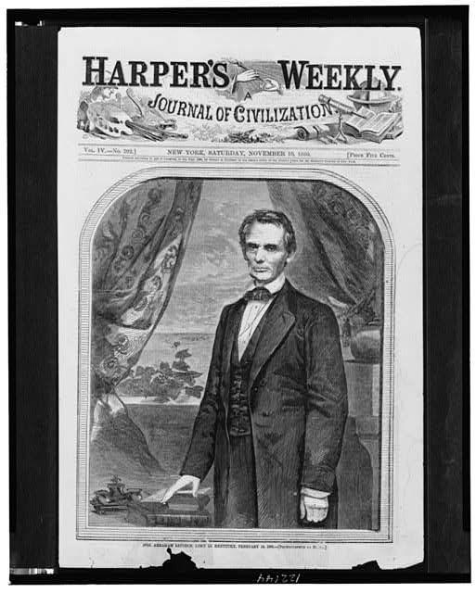
Hon. Abraham Lincoln
Hon. Abraham Lincoln, photographed by Brady.
http://www.loc.gov/pictures/resource/cph.3c22144/

Slide 14
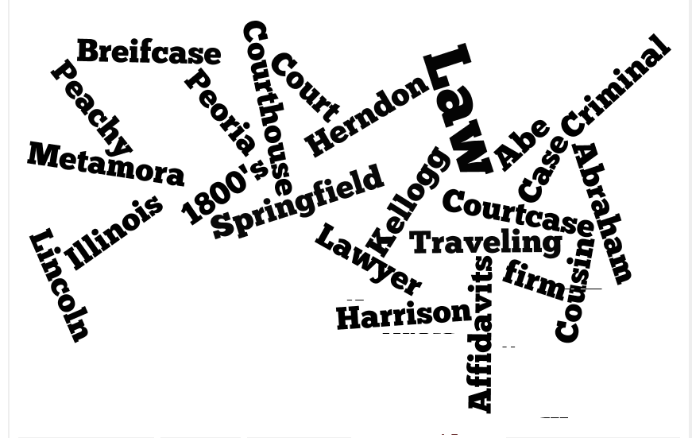
Wordle

Slide 15
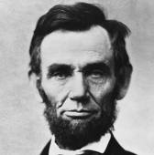
The End

