Slide 1
Lincoln Lawyer
Breana Dieckow
2nd hour

Slide 2
Abraham Lincoln
Taken in Danville, Illinois, while he was a lawyer.
http://www.loc.gov/pictures/item/2008678328/

Slide 3
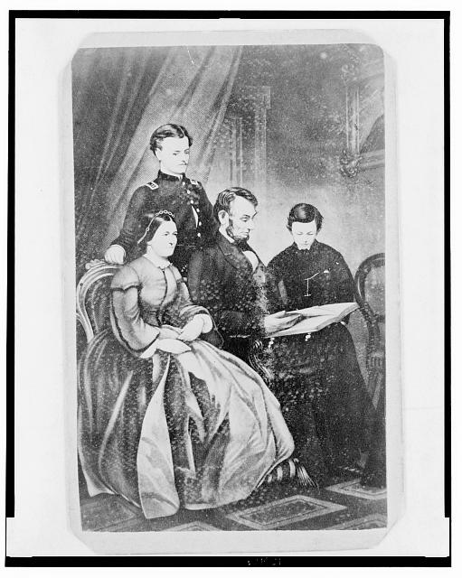
Abraham Lincoln and family
http://www.loc.gov/pictures/item/2004680050/

Slide 4
Jury Instructions in Roberts v. Harkness, [Law papers].
Harkness gave Isaiah Roberts three promissory notes in 1834 totaling $1,080. Isaiah assigned the notes to Henry Roberts, who sued Harkness in the Peoria County Circuit Court after Harkness failed to pay. Harkness argued that Roberts for $1,440 sold him an idea for an invention to manufacture bricks. Harkness refused to pay because he discovered that the invention was useless, which broke the consideration of the promissory notes. The court granted a change of venue to Tazewell County Circuit Court, and Harkness retained Lincoln. The first jury failed to reach a verdict, but a second jury found for Harkness. Roberts motioned for a new trial, but the court overruled the motion.
http://hdl.loc.gov/loc.rbc/lprbscsm.scsm1466

Slide 5
Affidavit in P. Weyrich & Co. v. Allsup & Allsup, [Law papers]
Thomas Allsup and William Allsup gave Springer a promissory note for $336.39. Springer assigned the note to P. Weyrich and Company, who sued in an action of assumpsit after Allsup and Allsup failed to pay. Allsup and Allsup retained Lincoln and argued that the note was for the last payment for a saw mill but that the mill had not been completed on time. Springer had said that the mill could saw three thousand feet per day, but once finished, it could not saw even two thousand feet per day. Allsup and Allsup argued that the consideration of the note had failed. The jury found for Weyrich and Co. and awarded $356.
http://hdl.loc.gov/loc.rbc/lprbscsm.scsm1465

Slide 6
Motion in Cooper v. Crosby & Robbins, [Law papers].
http://hdl.loc.gov/loc.rbc/lprbscsm.scsm1428
In 1843, Crosby gave Cooper a promissory note for $450 and secured the note with a mortgage on thirteen lots in Springfield, Illinois. Crosby also conveyed his equity of redemption to Robbins. After Crosby failed to pay the note, Cooper retained Lincoln and Herndon and sued to foreclose the mortgage. Robbins was made a defendant in the case. The court ruled for Cooper, awarded $608, and ordered that the lots be sold to pay the judgment. Cooper purchased the lots for $269.50 but later motioned the court to set aside the sale. Cooper claimed that he misunderstood Lincoln's bidding instructions and now feared that Robbins would redeem the property for $269.50. The court overruled the motion, and Cooper appealed to the Illinois Supreme Court on the grounds that the court erred in not setting aside the sale. The supreme court affirmed the judgment, and Justice Purple wrote that another sale could occur only if there had been "injurious mistake, misrepresentation or fraud." None occurred in the case, and Lincoln's instructions had been "plain and simple."
The court feared that reopening the sale would create an "unsafe and dangerous precedent" that might lead land speculators at auctions to buy below market value and, if the land was about to be redeemed, plead ignorance of the law to the court and ask for another sale so that they might bid a larger sum like Cooper tried to do. Lincoln and Herndon received $10 for their legal services.

Slide 7
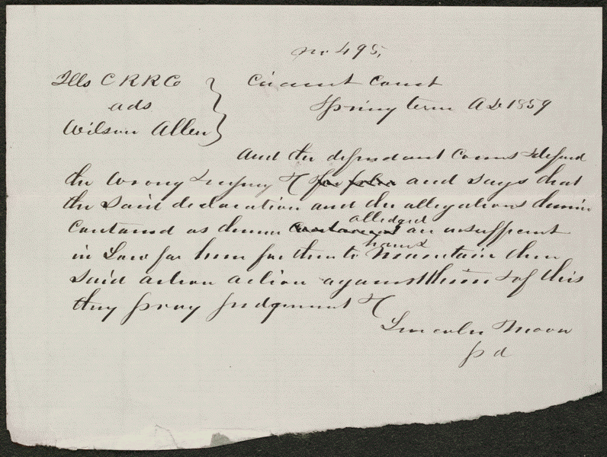
Demurrer in Allen v. Illinois Central Railroad, [Law papers].
Allen sued the Illinois Central Railroad and requested $300 in damages. The railroad retained Lincoln, who demurred to Allen's declaration. The court sustained the demurrer and dismissed the case.
http://hdl.loc.gov/loc.rbc/lprbscsm.scsm1495

Slide 8
Practicing Law
The Coles County Court House in Charleston, Ills., in which Lincoln often practiced law and before which he made a short speech in the evening after his fourth joint debate with Douglas, Sept. 18, 1858
http://www.loc.gov/pictures/item/2008680974/

Slide 9
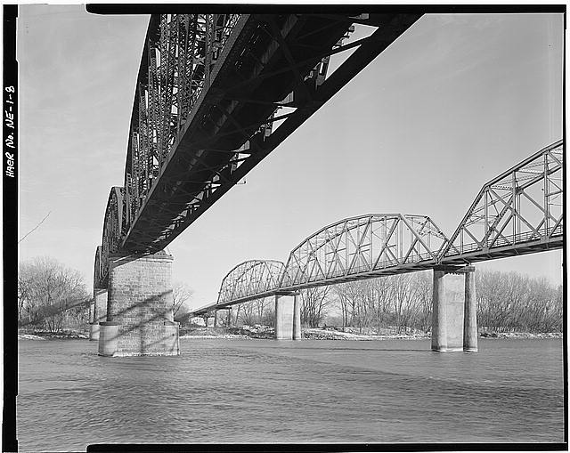
MeAbraham Lincoln Memorial Bridge
http://www.loc.gov/pictures/item/ne0041.photos.103689p/

Slide 10
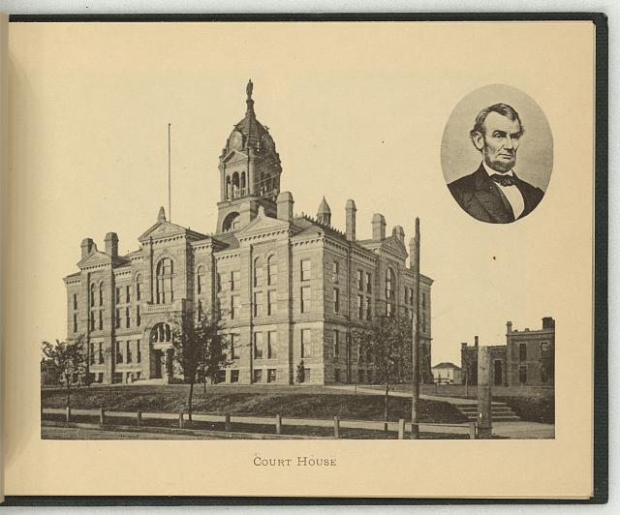
Courthouse in Lincoln
http://www.loc.gov/pictures/item/2009630142/

Slide 11
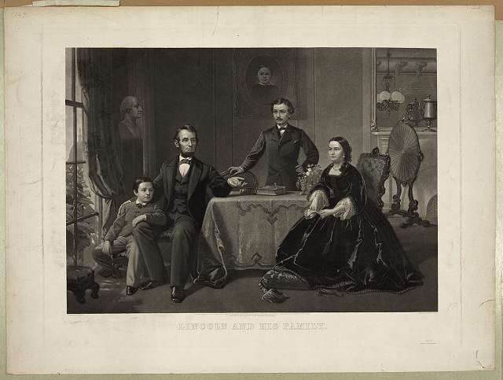
Lincoln and his family
http://www.loc.gov/pictures/item/2006678603/

