Slide 1
Abraham Lincoln
Carly Sweeter

Slide 2
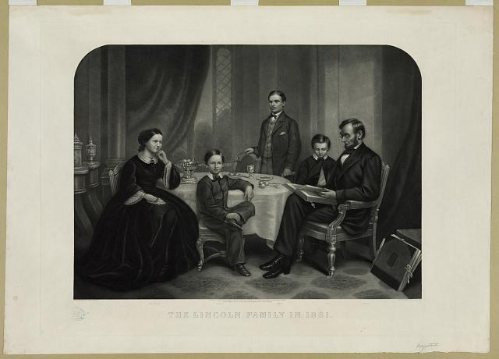
Title: Lincoln and his family / painted by S.B. Waugh ; engraved by William Sartain.
Summary: Print showing Abraham Lincoln, full-length portrait, sitting in chair at the left end of a table with Thomas sitting next to him, Mary Todd is sitting on the right, and Robert Todd is standing behind the table. 1861.
http://www.loc.gov/pictures/item/2006678603/
Creator(s): Sartain, William, 1843-1924, engraver

Slide 3
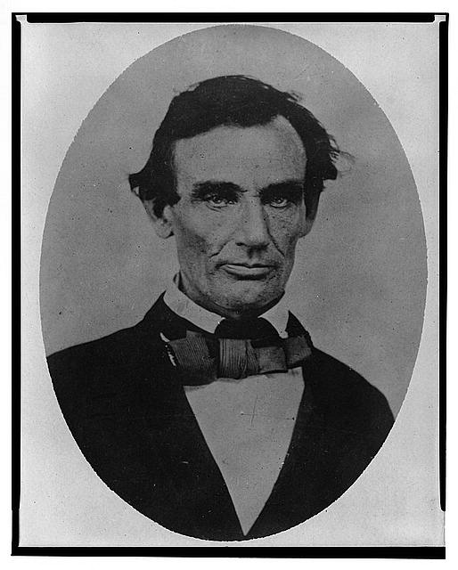
Title: [Abraham Lincoln, head-and-shoulders portrait, facing slightly left, taken in Pittsfield, Illinois, two weeks before the final Lincoln-Douglas debate in Lincoln's unsuccessful bid for the Senate, October 1, 1858]
http://www.loc.gov/pictures/item/98504517/
Creator(s): Jackson, Calvin, fl. 1858-1882, photographer

Slide 4
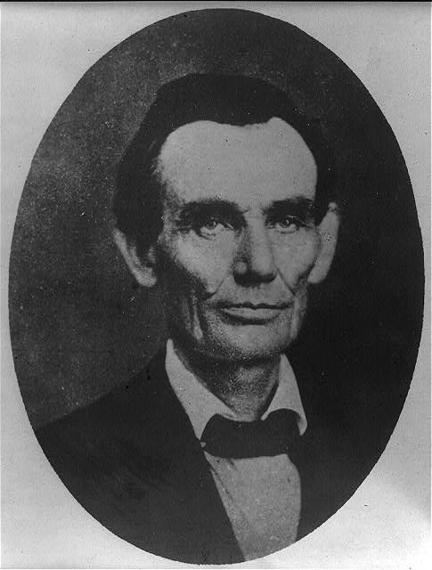
Title: [Abraham Lincoln while a traveling lawyer, taken in Danville, Illinois 1857
http://www.loc.gov/pictures/item/2008678328/
Creator(s): Joslin, Amon T., photographer

Slide 5
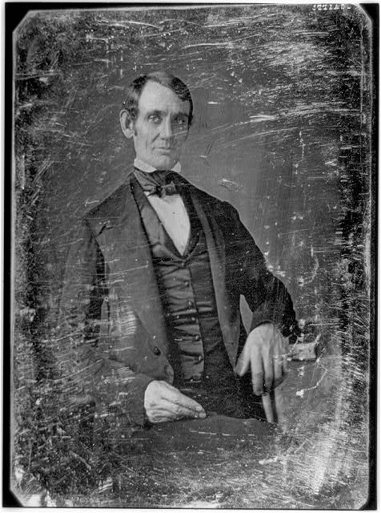
Title: [Abraham Lincoln, Congressman-elect from Illinois. Three-quarter length portrait,
Summary: This daguerreotype is the earliest-known photograph of Abraham Lincoln, taken at age 37 when he was a frontier lawyer in Springfield and Congressman-elect from Illinois. (Source: Ostendorf, p. 4)
http://www.loc.gov/pictures/item/2004664400/
Creator(s): Shepherd, Nicholas H., photographer

Slide 6
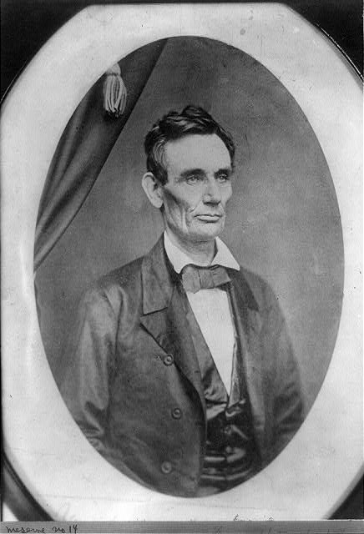
Title: [Abraham Lincoln, half-length portrait, facing right]
Summary: Photo shows Abraham Lincoln in an image that was widely reproduced on presidential campaign ribbins in 1860. Lincoln reportedly liked the photograph and often signed prints for admirers. (Source: Ostendorf, p. 29)
http://www.loc.gov/pictures/item/2009630650/

Slide 7
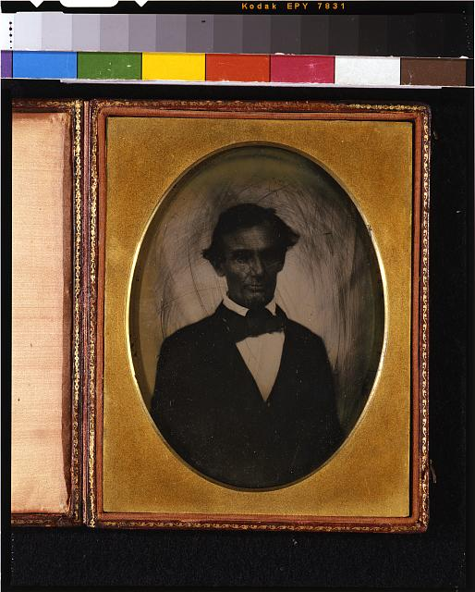
Title:[Abraham Lincoln, head-and-shoulders portrait, facing slightly left, taken in Pittsfield, Illinois, two weeks before the final Lincoln-Douglas debate in Lincoln's unsuccessful bid for the Senate, October 1, 1858]
Summary: Photograph showing Abraham Lincoln taken in Pittsfield, Illinois, after delivering a speech.
http://www.loc.gov/pictures/item/2009632130/
Creator(s): Jackson, Calvin, fl. 1858-1882, photographer

Slide 8
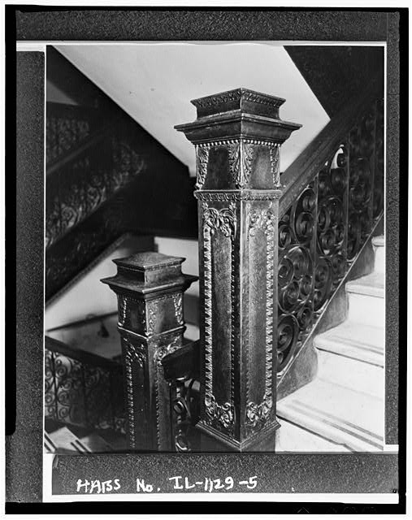
Title: 5. Interior, staircase newel post - Peoria City Hall, 419 Fulton Street, Peoria, Peoria County, IL
1855
http://www.loc.gov/pictures/item/il0436.photos.063411p/

Slide 9
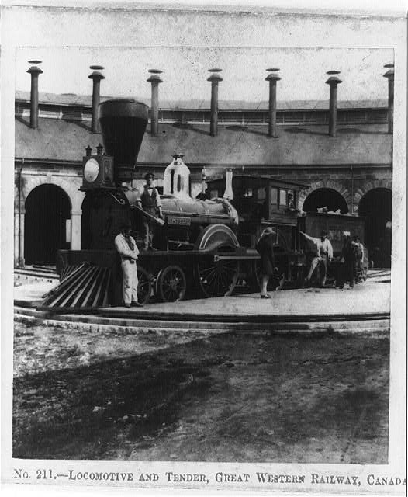
Title: Locomotive and tender, Great Western Railway, Canada. 1859
Summary: Photograph shows the locomotive "Spitfire" and tender.
http://www.loc.gov/pictures/item/93508154/
Creator(s): England, William, 1830-1896, photographer

Slide 10
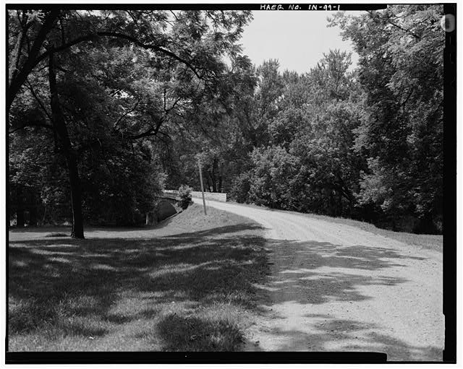
Title: 1. View of north approach, looking south. - Patrick Ford Bridge, Spanning Vermillion River on County Road 315 North, Humrick, Vermilion County, IL
http://www.loc.gov/pictures/item/in0429.photos.319208p/

Slide 11
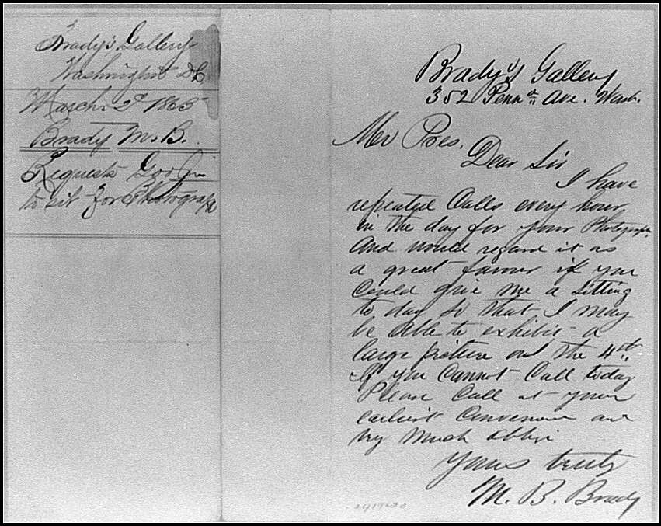
Title: [Letter from Mathew Brady to President Abraham Lincoln, asking Lincoln to sit for a photograph]
http://www.loc.gov/pictures/item/cwp2003001117/PP/
Creator(s): Brady, Mathew B., ca. 1823-1896, author

Slide 12
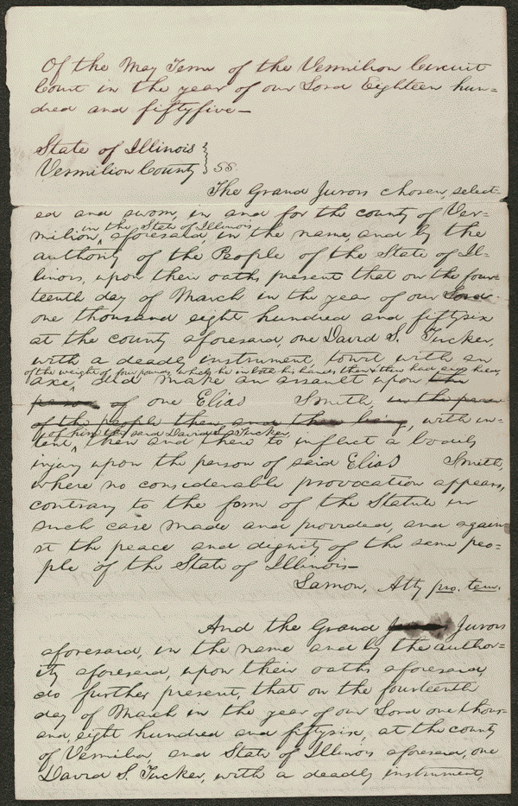
Indictment in People v. Tucker, [Law papers].
Summary: The state's attorney indicted Tucker for assaulting Smith with a four-pound axe. Tucker pleaded guilty, and the court fined him $75. Lincoln wrote the indictment for state's attorney Lamon.
Vermillion county, Il
http://hdl.loc.gov/loc.rbc/lprbscsm.scsm1468

Slide 13
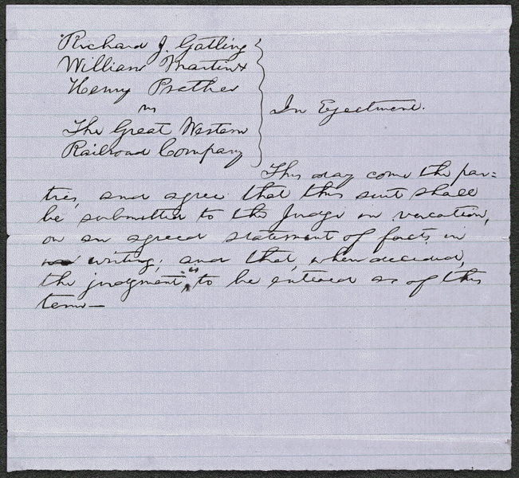
Order in Gatling et al. v. Great Western Railroad, [Law papers].
Summary: Gatling, Martin, and Prather retained Lincoln and sued the Great Western Railroad for unlawful detention of five acres of their land. The railroad's depot, built on the property, had burned, and Gatling requested $500 in damages. Gatling dismissed the suit. Gatling later invented the rapid fire "Gatling gun."
http://hdl.loc.gov/loc.rbc/lprbscsm.scsm1457

Slide 14
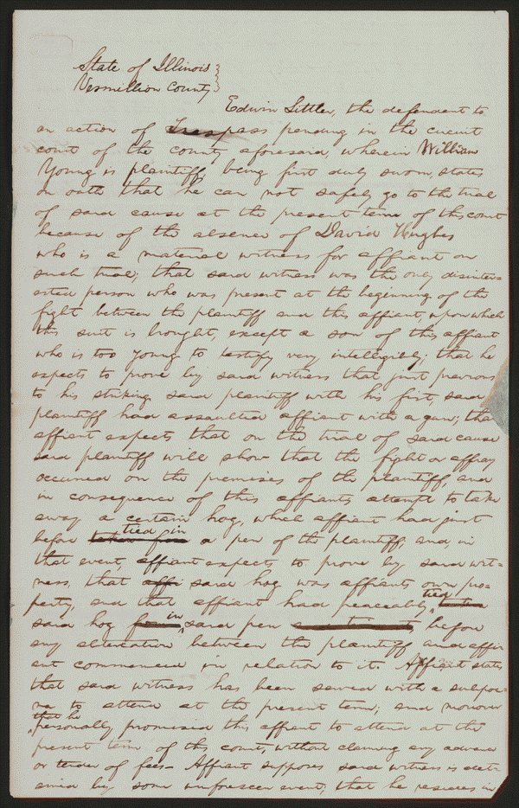
Affidavit in Young v. Littler, [Law papers].
Summary: Young sued Littler for $1,000 for assault and battery. The fight occurred on Young's property after Littler claimed that a hog belonged to him. Littler, represented by Lincoln, pleaded self-defense and claimed that Young had tried to assault him with a gun and a club. Young died, and his attorney abated the case.
Vermillion county, Il
http://hdl.loc.gov/loc.rbc/lprbscsm.scsm1440

