Slide 1
Lincoln laws
By Devin Gray

Slide 2
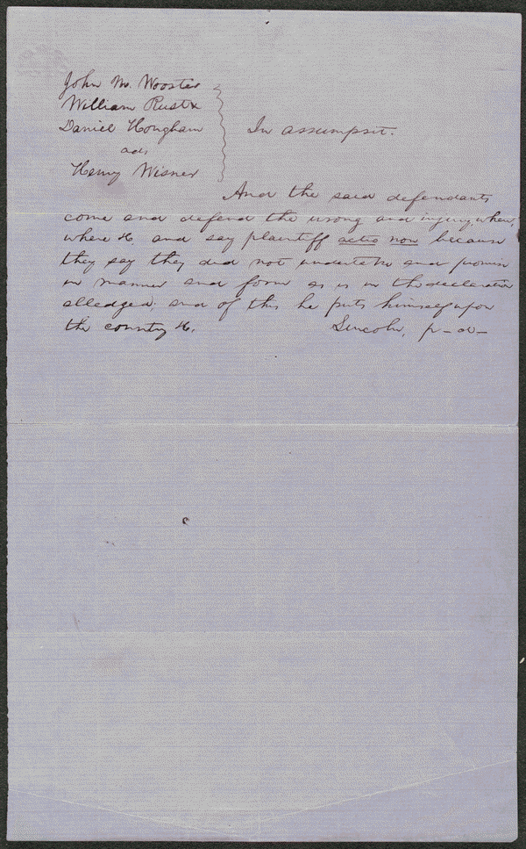
Winser vs Wooster
lprbscsm scsm1512
http://hdl.loc.gov/loc.rbc/lprbscsm.scsm1512
Wooster owed Winser up to 3000 dollars in unpaid merchandise, when he talked to Lincoln he plead non-assumpsit and the court was able to make an arrangement where the two parties came to an agreement.

Slide 3
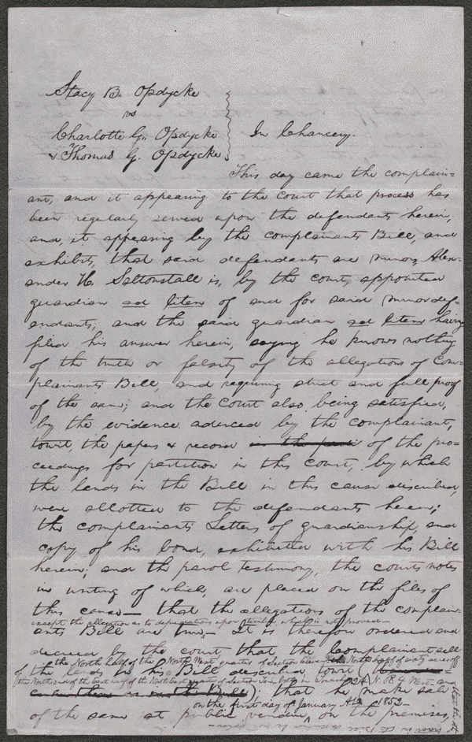
Opdycke vs Opdycke and Opdycke
lprbscsm scsm1449
http://hdl.loc.gov/loc.rbc/lprbscsm.scsm1449
Summary: The court appointed Stacy Opdycke as guardian of minors Charlotte and Thomas Opdycke. Charlotte and Thomas jointly owned 190 acres. Stacy retained Lincoln and petitioned the court to partition the land in order better to reinvest the proceeds for the minors. The court ordered Stacy Opdycke to sell the thirty-acre tract and one eighty-acre tract, but not the other eighty-acre tract. Greely bought the thirty-acre tract for $360, but the eighty-acre tract did not sell due to lack of bidders. Charlotte became of age and married Keedy. The court amended the order to include the other eighty-acre tract. Davis bought eighty-acre tract for $1,440, and Landis bought the other eighty-acre tract for $880. Lincoln received at least $37.50 for his legal services.

Slide 4
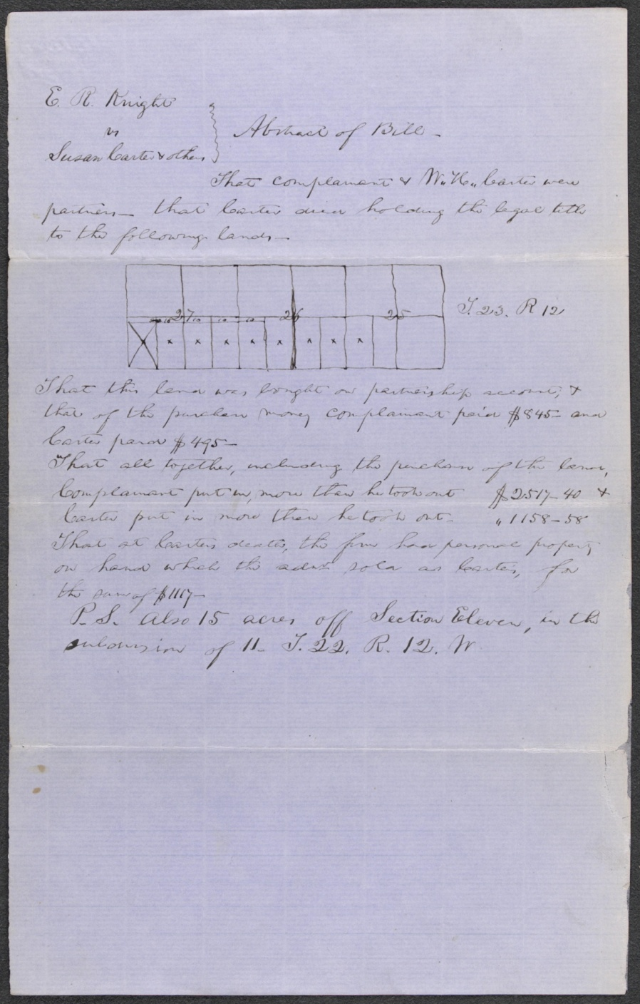
Knight Vs Carter
lprbscsm scsm1555
http://hdl.loc.gov/loc.rbc/lprbscsm.scsm1555
Summary: Knight retained Lincoln and sued the heirs of Washington Carter to settle a partnership. Carter and Knight had been partners in selling land and livestock and in farming. The court appointed three commissioners to partition the estate's 615 acres. The commissioners assigned dower to Carter's widow, Susan Boardman; gave Knight one-half of the land; and partitioned the remaining land in equal shares for Carter's three minor heirs.

Slide 5
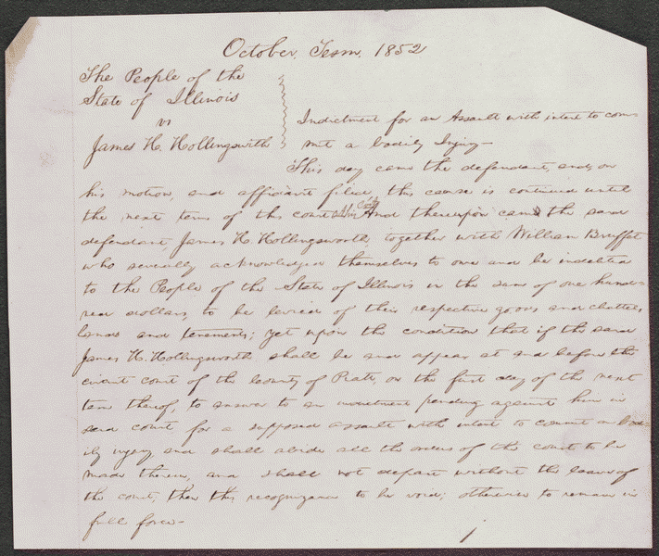
People vs Hollingsworth
lprbscsm scsm1540
http://hdl.loc.gov/loc.rbc/lprbscsm.scsm1540
Summary: Hollingsworth asked Deborah Ater to care for his sick wife at his home while he was away. Jacob Ater insisted that Deborah Ater leave town with him, and when she refused, Jacob Ater assaulted her. Hollingsworth intervened, he and Jacob Ater began to fight, and Deborah Ater fled to another house. Hollingsworth again asked Deborah Ater to care for his wife, and as they were returning to Hollingsworth's house, Jacob Ater approached them "in a menacing attitude." Hollingsworth aimed a pistol at Ater and pulled the trigger, but the pistol did not fire. The state's attorney indicted Hollingsworth for assault with intent to commit bodily injury, and Hollingsworth retained Lincoln. The parties reached an agreement in which the state's attorney would cease prosecution and Hollingsworth would pay all costs, and the court dismissed the case.

Slide 6
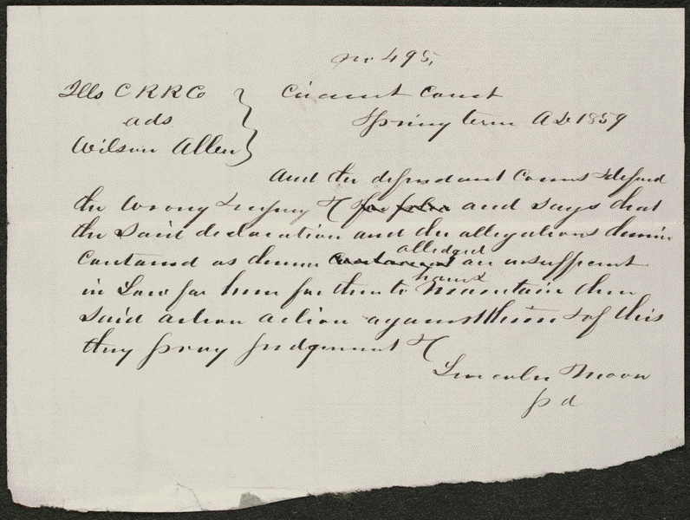
Allen vs Illinois Central Railroad
lprbscsm scsm1495
http://hdl.loc.gov/loc.rbc/lprbscsm.scsm1495
Summary: Allen sued the Illinois Central Railroad and requested $300 in damages. The railroad retained Lincoln, who demurred to Allen's declaration. The court sustained the demurrer and dismissed the case.

Slide 7
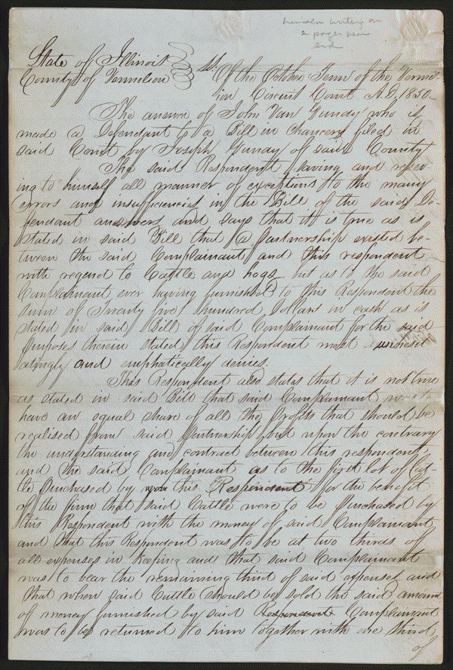
Grundy vs Grundy
lprbscsm scsm1444
http://hdl.loc.gov/loc.rbc/lprbscsm.scsm1444
Summary: Joseph Gundy and John Gundy entered into the business of selling hogs and cattle in the fall of 1847, and decided to dissolve the partnership in December 1848. Joseph Gundy sued John Gundy in a chancery action to settle the partnership. Joseph Gundy also sued John Gundy in a separate common law action (Gundy v. Gundy). In this case, Joseph Gundy claimed that John Gundy owed him $200 for 1,000 bushels of corn; $200 for 110 hogs sold; and an additional amount for twenty-four steers. John Gundy retained Lincoln and answered that Joseph Gundy owed him money from the partnership and filed a cross-bill to obtain the sum. The parties reached a settlement in which the court ruled for Joseph Gundy and awarded $415.

Slide 8
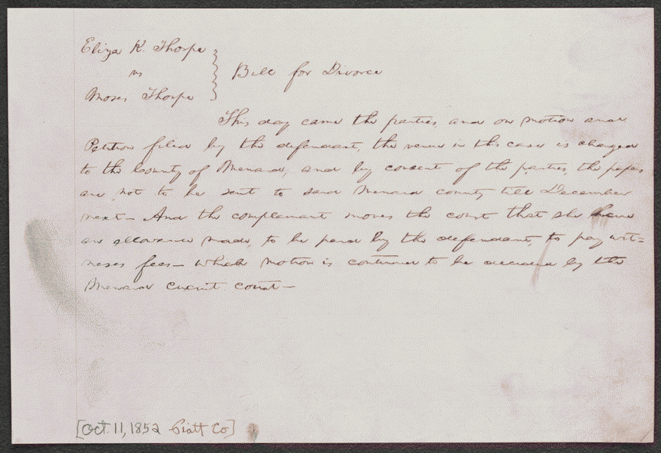
Thorpe vs Thorpe
lprbscsm scsm1539
http://hdl.loc.gov/loc.rbc/lprbscsm.scsm1539
Summary: Eliza Thorpe retained Lincoln and Herndon and sued Moses Thorpe in the Piatt County Circuit Court for divorce on the grounds of adultery. Moses Thorpe requested a change of venue, and the court granted a change to the Menard County Circuit Court. Eliza charged that Moses had committed adultery with Emily Cox and entered a letter from Cox as evidence. Moses denied the charge and complained that his ungrateful wife had verbally abused him and schemed to drive him to divorce to obtain a large property settlement. He argued that she should be denied alimony because of that scheme. He also claimed that the neighborhood shunned her because of her unchaste and inebriate behavior. Moses presented witnesses, including his son from a previous marriage, to substantiate his allegations. Lincoln and Herndon countered by producing several witnesses, including the Thorpes' physician, who testified to Eliza's chaste and sober character. The court sustained Moses Thorpe's motion to strike the case from the docket and dismissed the case.

Slide 9
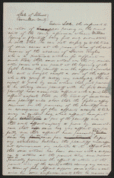
Young vs littler
lprbscsm scsm1440
http://hdl.loc.gov/loc.rbc/lprbscsm.scsm1440
Summary: Young sued Littler for $1,000 for assault and battery. The fight occurred on Young's property after Littler claimed that a hog belonged to him. Littler, represented by Lincoln, pleaded self-defense and claimed that Young had tried to assault him with a gun and a club. Young died, and his attorney abated the case.

Slide 10
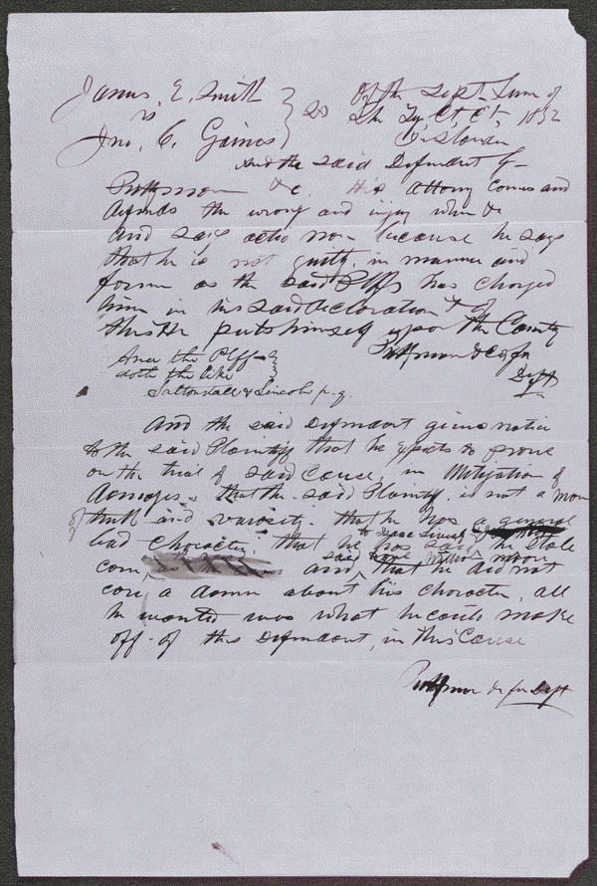
Smith vs Gaines
lprbscsm scsm1537
http://hdl.loc.gov/loc.rbc/lprbscsm.scsm1537
Gaines claimed that Smith stole some of his corn. Smith retained Lincoln and sued Gaines in an action of trespass on the case for slander seeking $1,000 in damages. Gaines pleaded not guilty, but a jury found for Smith and awarded $100.

Slide 11
