Slide 1
Lincoln the Lawyer
A presentation of Abraham Lincoln, as a lawyer. First hand sources from the Library of Congress.
Emily Bassett

Slide 2
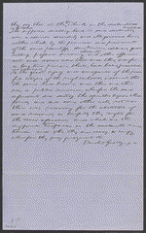
CASE 1
Pleas in Pearl & Pearl v. Graham et al, [Law papers]. (Lincoln’s writing) Summary: Graham and twenty other men broke into a grocery store owned by Frederick Pearl and Sylvester Pearl and destroyed everything, including large amounts of liquor. Pearl and Pearl sued them in an action of trespass and requested $5,000 in damages. Graham retained Lincoln and pleaded not guilty because the grocery was actually a disorderly house where "drunkenness, idleness, quarrelling, profane swearing, obscenity, and other offensive acts" occurred. Graham and the other defendants claimed that they were peaceful citizens who became annoyed at the public nuisance and destroyed the liquor to stop the problem. Pearl and Pearl motioned for a change of venue, and the case moved to the Woodford County Circuit Court. Once in Woodford County, Lincoln motioned the court to change the venue again, and the case returned to the Tazewell County Circuit Court. Pearl and Pearl decided not to prosecute four defendants. The jury found eleven defendants not guilty, six defendants guilty, and awarded Pearl and Pearl $50 in damages. Lincoln received $25 for defending this suit and the criminal suit (People v. Sickler et al.). lprbscsm scsm1571 http://hdl.loc.gov/loc.

Slide 3
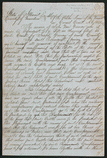
CASE 2
Gundy vs. Gundy, [Law papers].
10/24/18?
Vermilion County, Illinois
Summary: Joseph Gundy and John Gundy entered into the business of selling hogs and cattle in the fall of 1847, and decided to dissolve the partnership in December 1848. Joseph Gundy sued John Gundy in a chancery action to settle the partnership. Joseph Gundy also sued John Gundy in a separate common law action (Gundy v. Gundy). In this case, Joseph Gundy claimed that John Gundy owed him $200 for 1,000 bushels of corn; $200 for 110 hogs sold; and an additional amount for twenty-four steers. John Gundy retained Lincoln and answered that Joseph Gundy owed him money from the partnership and filed a cross-bill to obtain the sum. The parties reached a settlement in which the court ruled for Joseph Gundy and awarded $415.
lprbscsm scsm1444
http://hdl.loc.gov/loc.rbc/lprbscsm.scsm1444

Slide 4
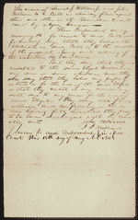
CASE 3
May 18, 1842 Summary: In 1840, A. Cameron and Company had received a $2,548.95 judgment against Williams, but the sheriff found no property upon which to execute the judgment. A. Cameron and Co. then sued Williams and twenty-five others, charging that Williams had fraudulently concealed his property by establishing trusts with the other defendants. The court ruled for A. Cameron and Co. and garnished the defendants' funds to pay the original judgment. Lincoln represented the defendants. lprbscsm scsm1398 http://hdl.loc.gov/loc.rbc/lprbscsm.scsm1398

Slide 5
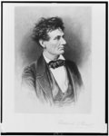
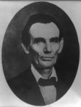
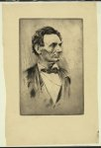
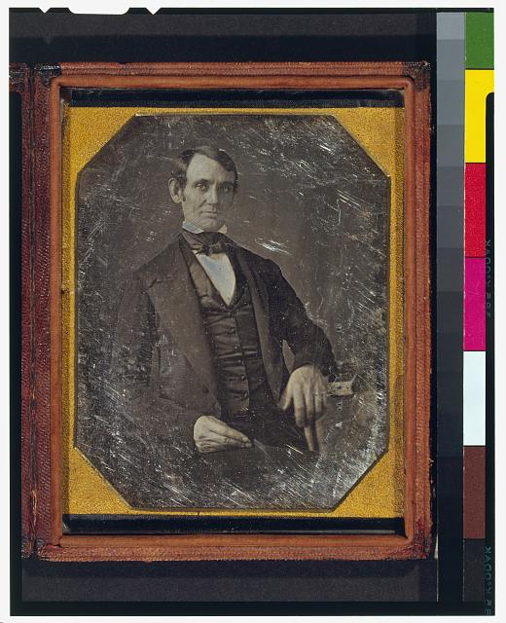
Young Lincoln loved having his picture taken 1857 Illus. in E457.6 M58 [P&P]
A photo of a Young, Stressed Lincoln 1865 BIOG FILE - Lincoln, Abraham--Etch., engr. and wood engr.--Bust <item> [P&P]
Earliest known photograph of Lincoln, age 37. 1864 DAG no. 1224 (Cabinet A) http://www.loc.gov/pictures/resource/cph.3g02439/?co=dag
A pose Lincoln was known for, showing his odd proportioned face. ppmsca-19246 June 3, 1860 http://www.loc.gov/pictures/item/2008680913/

Slide 6
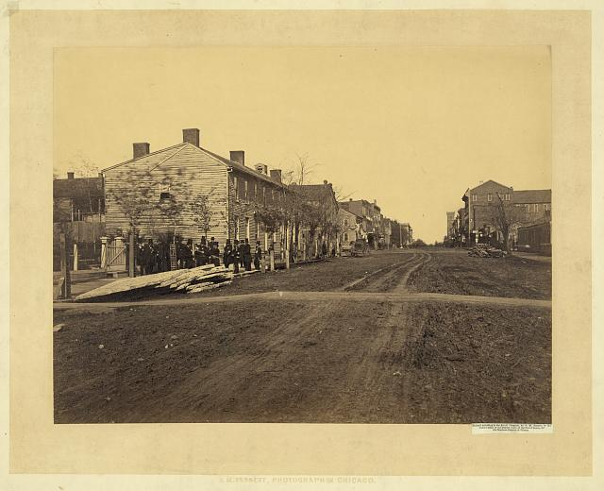
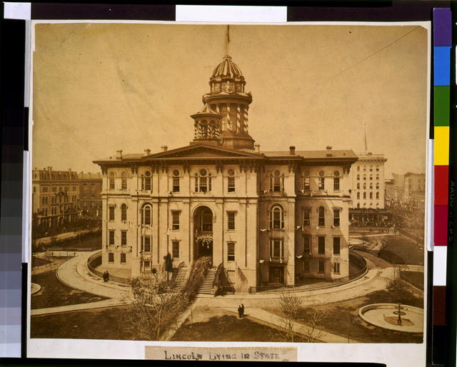
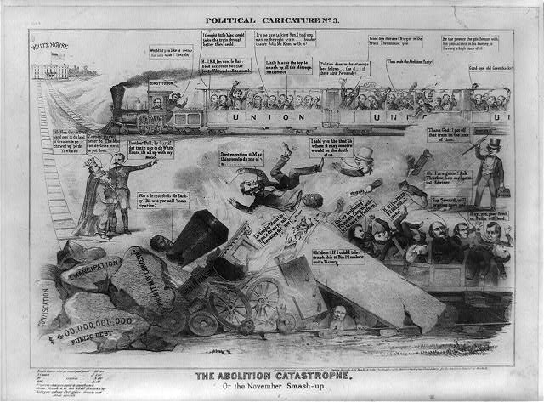
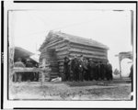
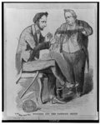
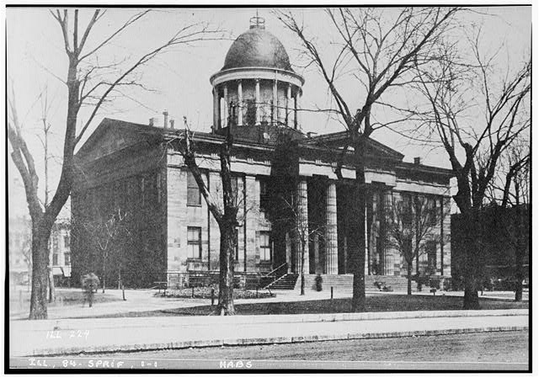
Lincoln's first home, near Globe Tavern. Birthplace of Robert Lincoln. Taken between 1860 and 1870. http://hdl.loc.gov/loc.pnp/ppmsca.19258
Lincoln lying in state 1865
Lincoln loved to walk around it’s circular pavement while he thought. http://hdl.loc.gov/loc.pnp/cph.3g01835
Political caricature. No. 3, The abolition catastrophe. Or the November smash-up.
Lincoln was known for arguing with the railroad. 1864 http://hdl.loc.gov/loc.pnp/cph.3a12905
Hand built Log cabin of Abraham Lincoln Taken between 1920 and 1930 http://www.loc.gov/pictures/item/90712467/
Political cartoon of Lincoln untangling a ball of yarn labeled, "Union", from a man's hands. 1861 March 30 http://www.loc.gov/pictures/item/00652044/
Old State House, Springfield, Sangamon . Lincoln’s second home. County, IL 1898 http://www.loc.gov/pictures/item/il0202.photos.064076p/resource/

Slide 7
