Slide 1
Abe “The Man” Lincoln
By Griffin “The Other Man” Georges

Slide 2
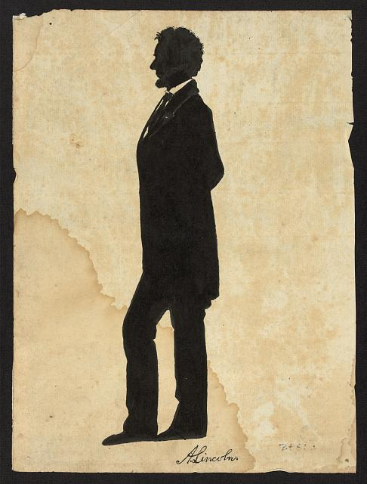
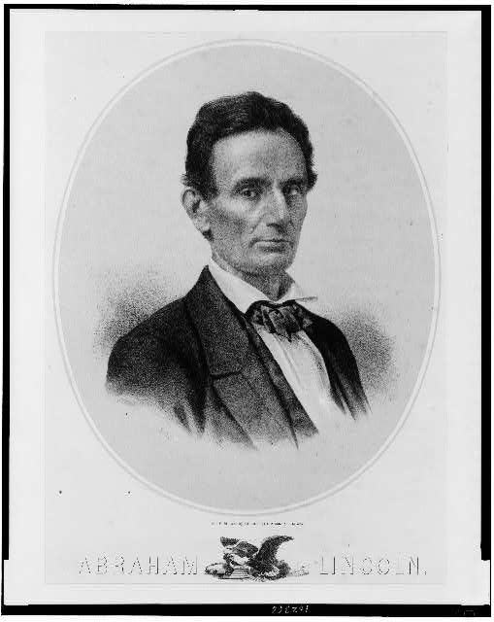
Abe Lincoln was a total bro
ppmsca 22950
cph 3b38591

Slide 3
Illinois v. Overholt & Squier
Overholt and Squier set up a deal with three judges from Christian County, Illinois, to build an awesome a courthouse. Judge Vandeveer refused to pay because the job failed to meet agreed specifications. Overholt and Squier stopped construction and sued to recover the anticipated profits. The jury found for Overholt and Squier and awarded $657.87. The Christian County officials, who had retained Lincoln, appealed to the Illinois Supreme Court, which reversed and remanded the appeal. Lincoln received a $50 fee for his work in the trial and the appeal.

Slide 4
Illinois v. Overholt & Squier
lprbscsm scsm1473

Slide 5
Thompson et ux. V Broadwell
Moses Broadwell wished to give his deceased son's children, Mary Jane Broadwell and William Broadwell, land if they lived to adulthood. He deeded four hundred acres to his other son, John B. Broadwell, to hold in trust. John B. Broadwell gave a bond to guarantee the conveyance. Mary Jane Broadwell later married Michael Thompson, and they sued John B. Broadwell to obtain their two-hundred-acre share, one-half of the accrued rent, and damages for cutting timber. John B. Broadwell pleaded that he had received an absolute deed to the land and had the option of conveying the property or paying the bond's $500 penalty. John B. Broadwell chose to pay the $500 penalty rather than convey the land. The court ordered John B. Broadwell to pay $500 to the Thompsons, who appealed to the Illinois Supreme Court because the bond was meant for conveyance of land, not payment of money. The supreme court reversed and remanded the judgment. Justice Caton stated that the "explicit declaratory clause" in the bond proved that the true intent of the obligation was that the two grandchildren receive equal shares of the land. Caton remarked that it was "very remarkable" that John B. Broadwell would plead that he had the option of paying the penalty instead of conveying the land. At the trial of the remanded case, the court ordered John B. Broadwell to give Mary Jane Thompson and William Broadwell two hundred acres of land each. Lincoln represented John B. Broadwell in the trial, the appeal, and the remanded case. Lincoln and Herndon received $20 for their legal services.

Slide 6
Thompson et ux. V Broadwell
lprbscsm scsm1410

Slide 7
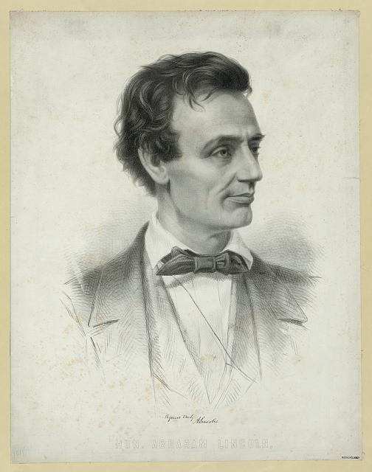
Such A Bro
pga 03411
pga 00352

Slide 8
PIONEER OF FACIAL HAIR
cph 3a18217

Slide 9
EVEN MEXICAN PEOPLE LIKED HIM!
A”bro”ham
Lincoln
lprbscsm scsm0485

Slide 10
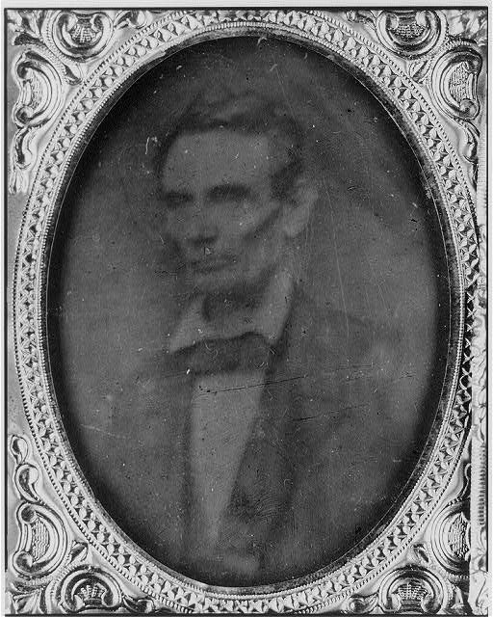
Abe Threw the craziest parties
cph 3a55056
cph 3a25451

Slide 11
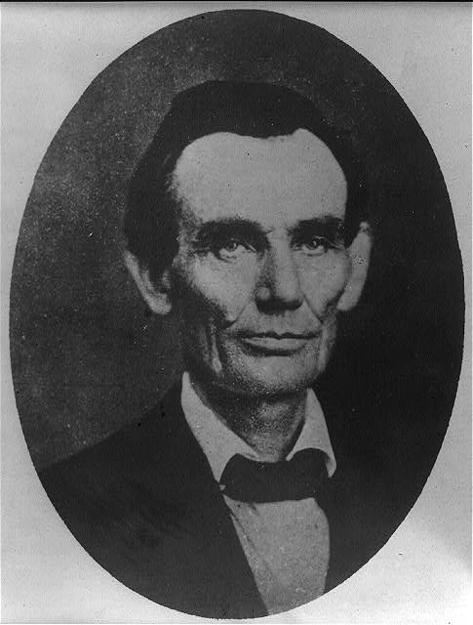
Best looking man of all time? I think yes.
ppmsca 19246
cph 3a18603

Slide 13
Wordle
http://www.wordle.net/show/wrdl/6062159/Abe_Lincoln_The_Man

