Slide 1
Holden Christopher Robbins
Lincoln & The Law

Slide 2
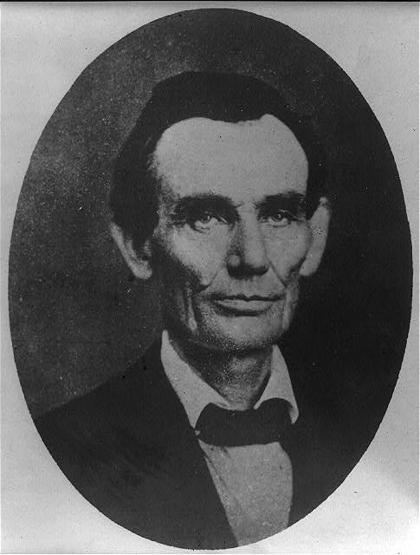
http://www.loc.gov/pictures/item/2008678328/
Abraham Lincoln while a traveling lawyer, taken in Danville, Illinois

Slide 3
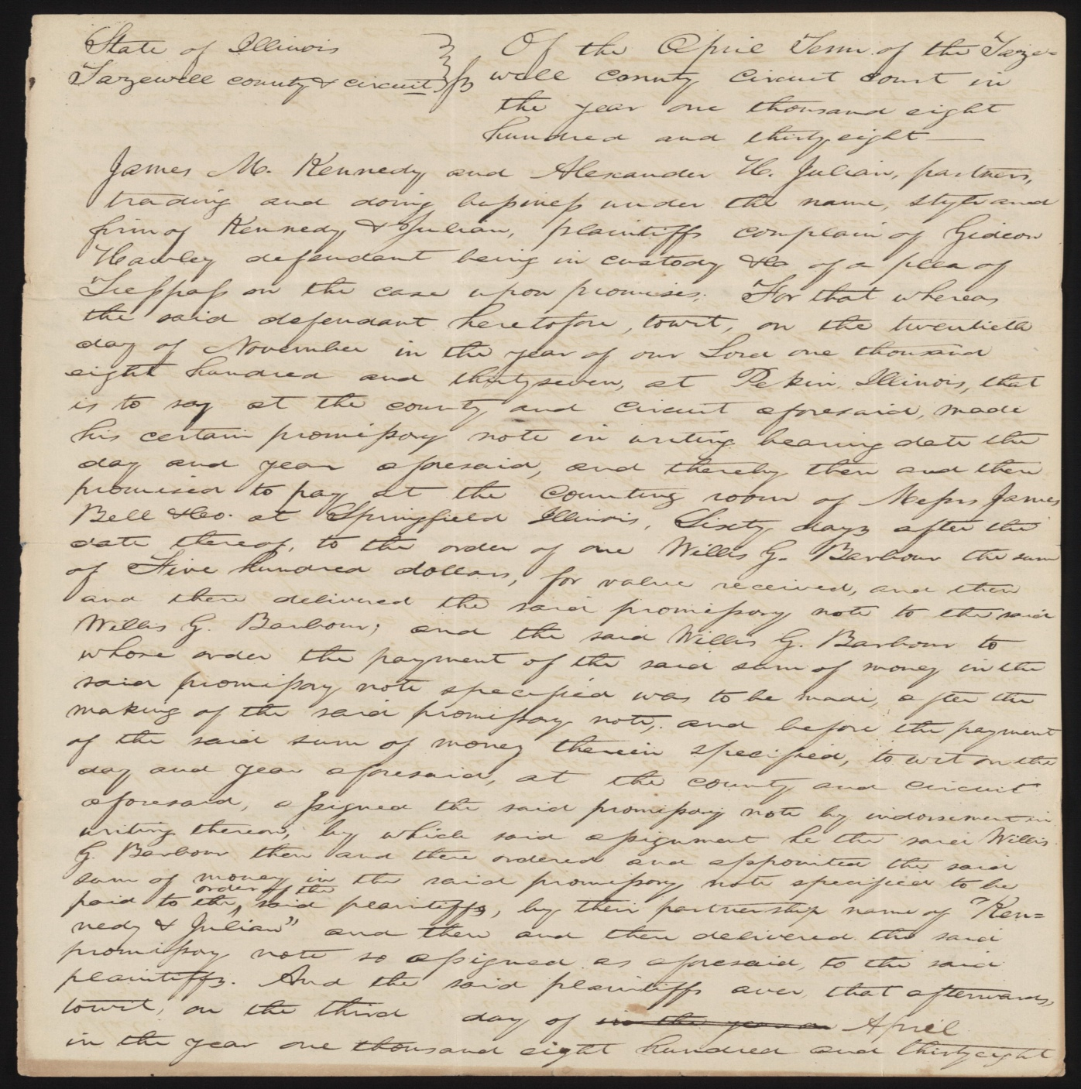
James M. Kennedy and Alexander H. Julian vs. Gideon Hawley
April 10, 1838 Tazewell County, Illinois
Hawley gave Barbour a promissory note for $500. Barbour assigned the note to Kennedy and Julian. Hawley failed to pay, and Kennedy and Julian retained Lincoln and sued in an action of assumpsit seeking $700. Apparently, the parties reached a settlement, and the court dismissed the case.
lprbscsm scsm1373 http://hdl.loc.gov/loc.rbc/lprbscsm.scsm1373

Slide 4
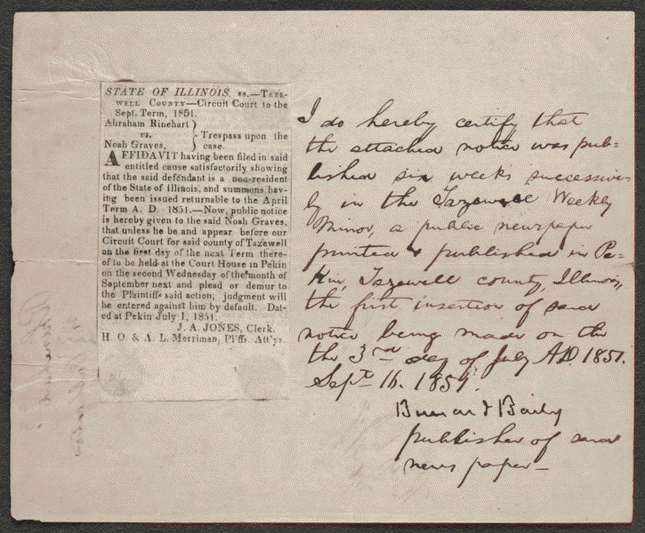
Publisher's Certificate in Rinehart v. Graves
September 16, 1851 Tazewell County, Illinois
Graves owed Rinehart $120 in rent but failed to pay. Rinehart sued Graves in an action of distress for rent to recover the debt. Graves failed to appear, and the court ruled for Rinehart and awarded $120. The court sold eight hundred bushels of corn, twenty bushels of wheat, and four tons of hay for $193.52 to satisfy the judgment. Lincoln role is unclear, but he wrote the publisher's certificate.
lprbscsm scsm1524 http://hdl.loc.gov/loc.rbc/lprbscsm.scsm1524

Slide 5
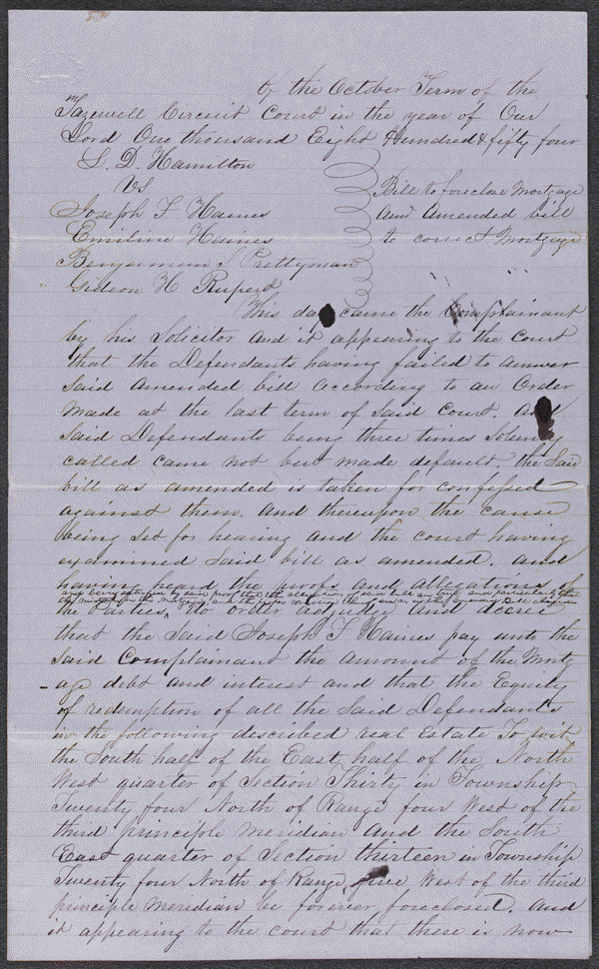
Decree in Hamilton v. Haines et al
October 12, 1854 Tazewell County, Illinois
Haines gave Hamilton a promissory note for $2,000 and secured the note with a mortgage on two hundred acres. Hamilton sued to foreclose the mortgage after Haines failed to pay. Haines defaulted, and the court ruled for foreclosure. Hamilton noticed an error in the deed, retained Lincoln, and motioned to vacate the judgment and amend his bill to correct the error. The court set aside the judgment. Haines again defaulted, and the court ordered Haines to pay $2,412.33 or it would sell the land. Hamilton assigned the judgment to Rupert. Haines failed to pay, and the court sold the land to Rupert for $2,604.32.
lprbscsm scsm1579 http://hdl.loc.gov/loc.rbc/lprbscsm.scsm1579

Slide 6
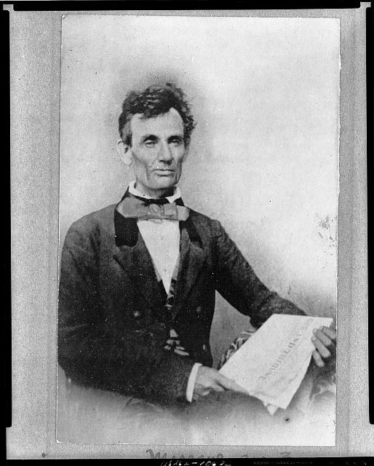
http://www.loc.gov/pictures/item/2008678330/
Abraham Lincoln while campaigning for the U.S. Senate, taken in Chicago, Illinois

Slide 7
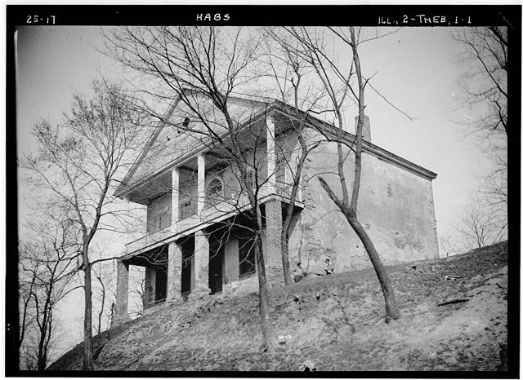
http://www.loc.gov/pictures/item/il0139/
Thebes Courthouse, Thebes, Alexander County, IL

Slide 8
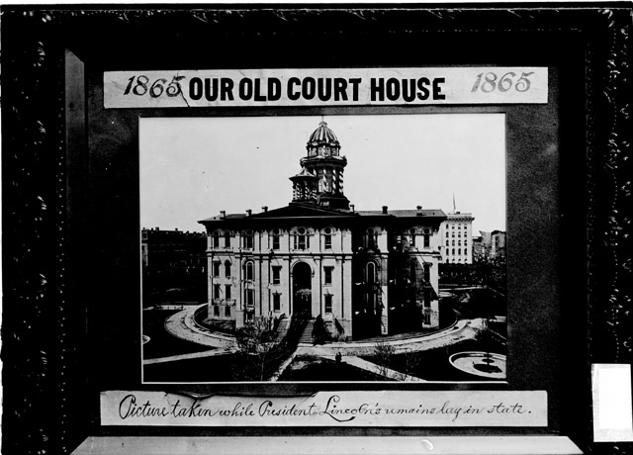
CREATED/PUBLISHED 1903 Sept. 20.
SUMMARY Image of a photograph and corresponding caption cards of the County Building and Courthouse in Chicago, Illinois, taken in 1865 while President Lincoln's remains lay in state.
http://hdl.loc.gov/loc.ndlpcoop/ichicdn.n001291

Slide 9
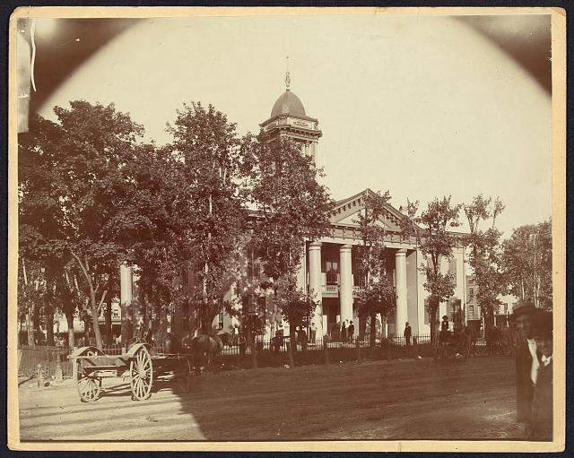
http://www.loc.gov/pictures/item/2008680974/
The Coles County Court House in Charleston, Ills., in which Lincoln often practiced law and before which he made a short speech in the evening after his fourth joint debate with Douglas, Sept. 18, 1858

Slide 10
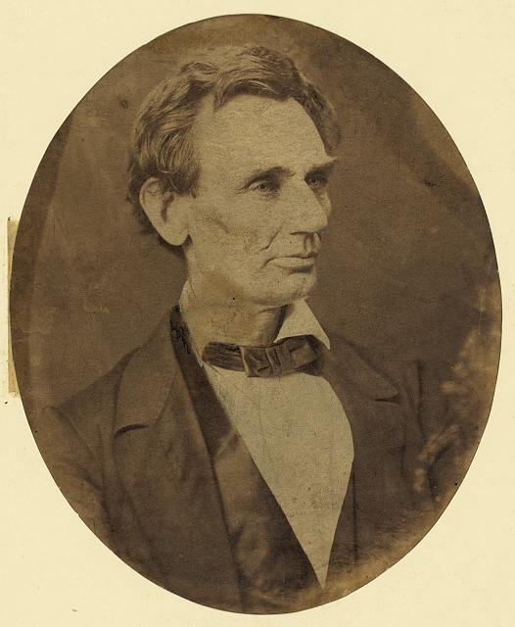
[Abraham Lincoln, candidate for U.S. president. Head-and-shoulders portrait, facing right, June 3, 1860]
http://www.loc.gov/pictures/item/2008680253/

Slide 11
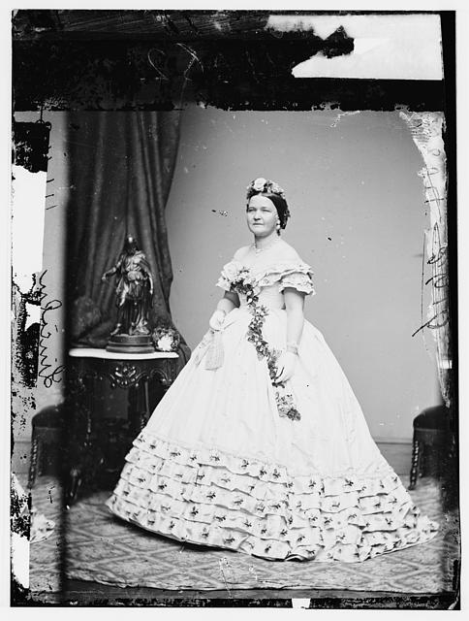
Mrs. Abraham Lincoln
http://www.loc.gov/pictures/item/brh2003003272/PP/

Slide 12
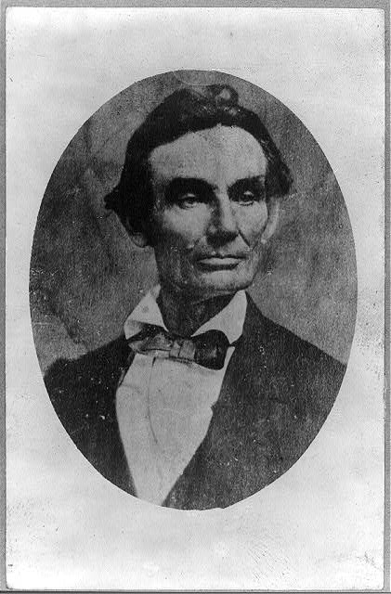
Abraham Lincoln, bust-length portrait, facing right
http://www.loc.gov/pictures/item/2008678331/

Slide 13
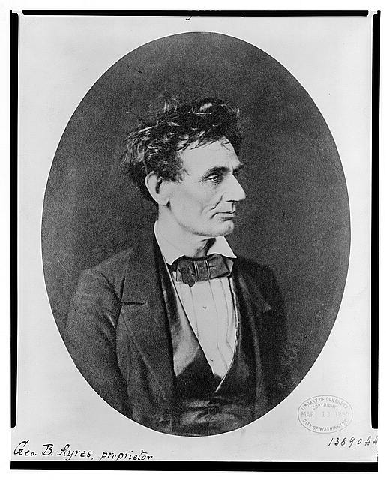
Abraham Lincoln: Immediately prior to Senate nomination, Chicago, Illinois
http://www.loc.gov/pictures/item/98504484/

Slide 14
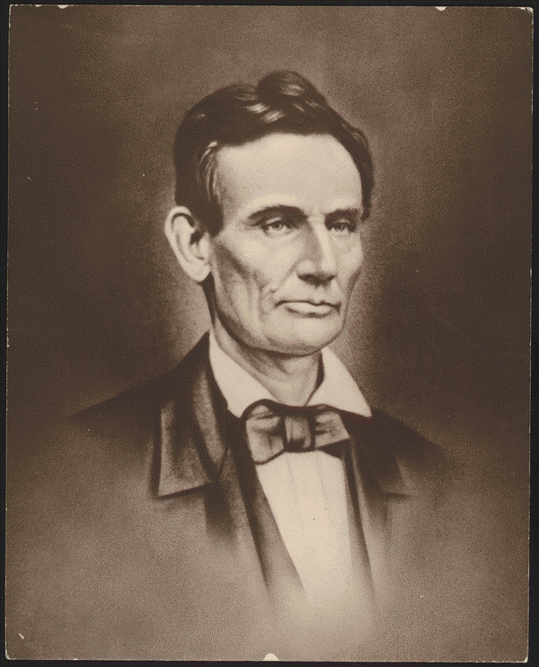
Created/Published
c1853
Notes
Written in pencil on back: This is the photograph from the original ambertype owned by the Latham family of Lincoln, Illinois. It was posed for Mr. Lincoln at the time the city of Lincoln was named for him. The photographer is unknown and is called the lost ambrotype. [Signed] Gillespie, 7/5/35.
http://hdl.loc.gov/loc.rbc/lprbscsm.scsm0987

