Slide 1
Lincoln as a lawyer

Slide 2
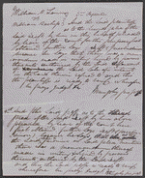
October 29, 1853 Summary: Lamm and Bachop attempted to settle a dispute through arbitration. Lamm agreed to relinquish a quitclaim deed on 360 acres of land in return for a $125 promissory note from Bachop. Lamm sued after Bachop failed to pay the note. Bachop retained Lincoln and pleaded that he had made no written agreement with Lamm. The court ruled for Bachop.

Slide 3
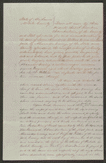
Chamberlain vs. Ewing, [Law papers]. June 15, 1850 Mobile County, Alabama

Slide 4
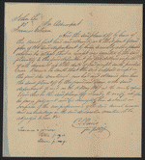
Lee sued Coburn to collect $600 for five years of labor as a servant. There was no written contract, guarantee, or promise between the parties, and Lee refused to prosecute the case further after the jury heard the evidence. Lincoln represented Coburn.

Slide 5
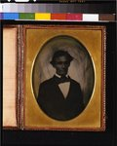
: [Abraham Lincoln, head-and-shoulders portrait, facing slightly left, taken in Pittsfield, Illinois, two weeks before the final Lincoln-Douglas debate in Lincoln's unsuccessful bid for the Senate, October 1, 1858] Photograph showing Abraham Lincoln taken in Pittsfield, Illinois, after delivering a speech. http://hdl.loc.gov/loc.pnp/cph.3g13901

Slide 6
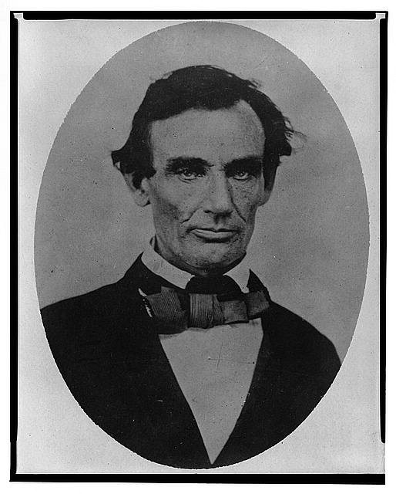
[Abraham Lincoln, head-and-shoulders portrait, facing slightly left, taken in Pittsfield, Illinois, two weeks before the final Lincoln-Douglas debate in Lincoln's unsuccessful bid for the Senate, October 1, 1858] http://hdl.loc.gov/loc.pnp/cph.3a18600

Slide 7
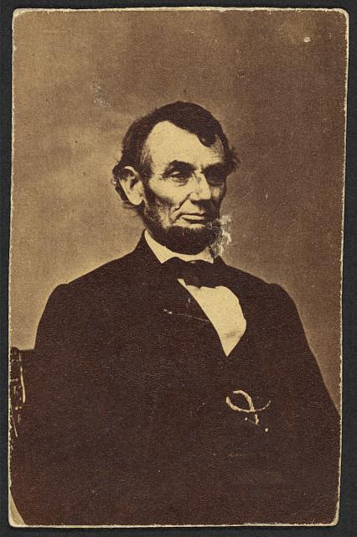
[Abraham Lincoln, three-quarter length portrait, seated, facing right; hair parted on Lincoln's right side] http://hdl.loc.gov/loc.pnp/ppmsca.19190

Slide 8
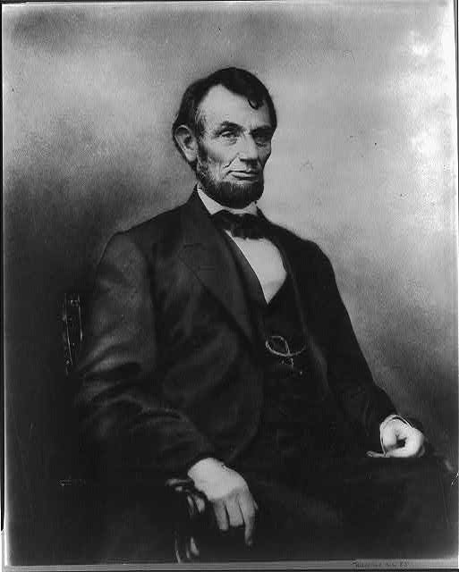
[Abraham Lincoln, three-quarter length portrait, seated, facing right; hair parted on Lincoln's right side] http://hdl.loc.gov/loc.pnp/cph.3a07486

Slide 9
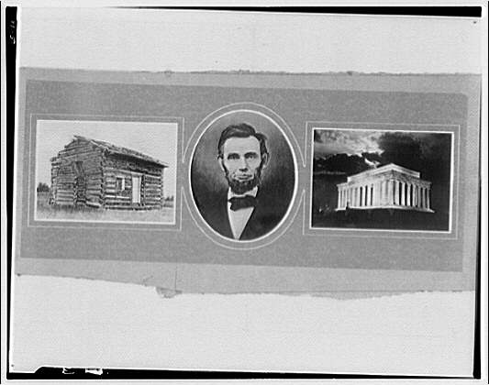
http://hdl.loc.gov/loc.pnp/thc.5a48029 Lincoln Memorial. Triptych comprised of portrait of Lincoln, cabin, and Lincoln Memorial

Slide 10
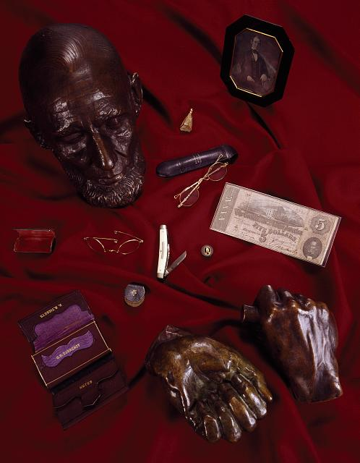
Abraham Lincoln death mask and what was in his pockets the night he died in 1865, kept at Ford's Theatre, Washington, D.C. http://hdl.loc.gov/loc.pnp/highsm.16054

