Slide 1
Lincoln project
Mr.caruso
jacobjaynes

Slide 2
Created/Published
December 13, 1855 Sangamon County, Illinois
Summary: Sarah Correll, Mary Ann Herrin, and Martha McIntyre, the three married daughters of William McDaniel, and their husbands, sued their brothers, James McDaniel and Joseph McDaniel, and the other heirs of William McDaniel in a chancery action to set aside William McDaniel's will. William McDaniel dictated his will to the attending physician, Dr. Randall, to dispose his real and personal property, valued at $15,000 to $20,000. McDaniel died eleven days later. William McDaniel bequeathed the land to his sons, James McDaniel and Joseph McDaniel, and to his grandsons, William Sutcliff, Rufus McDaniel, and Robert McDaniel. The daughters and the remaining grandchildren were to receive equal shares of the personal property. Correll and others charged that William McDaniel was not mentally competent to dispose of his property, and that his two sons took advantage of their infirm father, plied him with wine, and dictated a will favorable to their interests. The daughters also stated that McDaniel's widow had renounced the will's provisions and had received her dower at an earlier term of court. They claimed that, if competent, their father would have divided the estate equally among his heirs. James McDaniel and others retained Lincoln and Herndon. The jury found for the Correll and others and declared the will void on the grounds of William McDaniel's mental incompetency. McDaniel and others continued to employ Lincoln and Herndon and appealed to the Illinois Supreme Court on the grounds that the non-resident minor defendants were neither properly summoned nor represented in the proceedings. The supreme court reversed and remanded the case. Chief Justice Caton ruled that the lower court had failed to bring all the defendants within its jurisdiction and must serve the non-residents with a summons. The supreme court refused to rule on the will's legality, choosing to leave that issue to another jury. At the trial of the remanded case, the jury found for James McDaniel and others and validated the will.
Digital ID
lprbscsm scsm1462 http://hdl.loc.gov/loc.rbc/lprbscsm.scsm1462

Slide 3
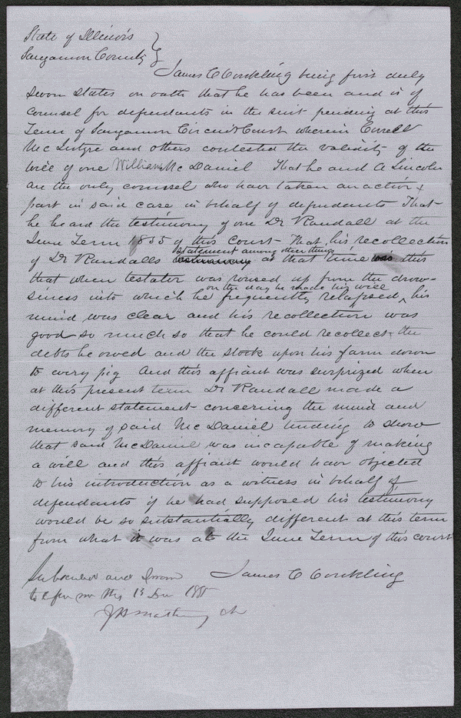

Slide 4
Created/Published
October, 1852
Notes
Summary: Hollingsworth asked Deborah Ater to care for his sick wife at his home while he was away. Jacob Ater insisted that Deborah Ater leave town with him, and when she refused, Jacob Ater assaulted her. Hollingsworth intervened, he and Jacob Ater began to fight, and Deborah Ater fled to another house. Hollingsworth again asked Deborah Ater to care for his wife, and as they were returning to Hollingsworth's house, Jacob Ater approached them "in a menacing attitude." Hollingsworth aimed a pistol at Ater and pulled the trigger, but the pistol did not fire. The state's attorney indicted Hollingsworth for assault with intent to commit bodily injury, and Hollingsworth retained Lincoln. The parties reached an agreement in which the state's attorney would cease prosecution and Hollingsworth would pay all costs, and the court dismissed the case.
Summary: Thorp sued Swords in the JP court to recover a debt of $48.77. The jury found for Thorp and awarded $36.17. Swords appealed the judgment to the circuit court. Thorp failed to prosecute his case, and the court ordered a nonsuit. Lincoln represented one of the parties in the case
Digital ID
lprbscsm scsm1540 http://hdl.loc.gov/loc.rbc/lprbscsm.scsm1540

Slide 5
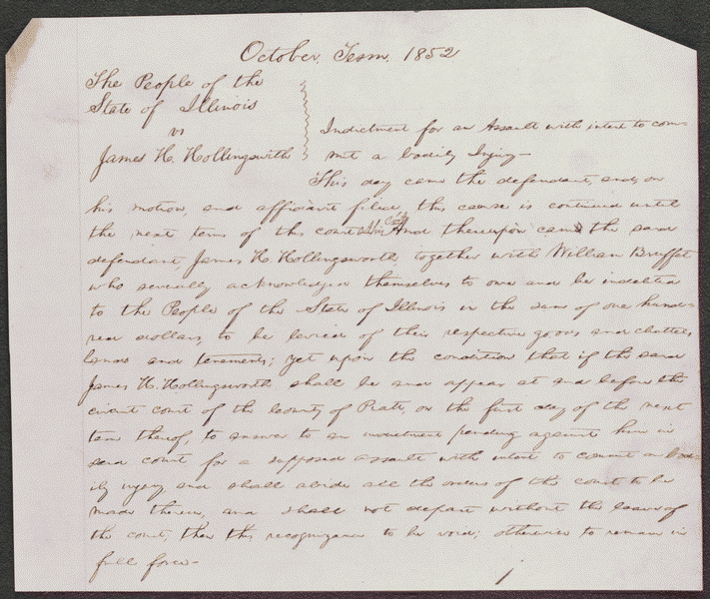

Slide 6
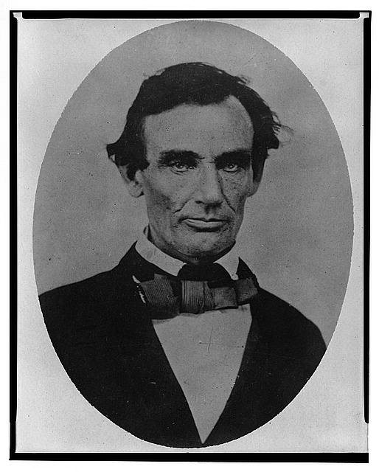
Title: [Abraham Lincoln, head-and-shoulders portrait, facing slightly left, taken in Pittsfield, Illinois, two weeks before the final Lincoln-Douglas debate in Lincoln's unsuccessful bid for the Senate, October 1, 1858]
http://www.loc.gov/pictures/item/98504517/

Slide 7
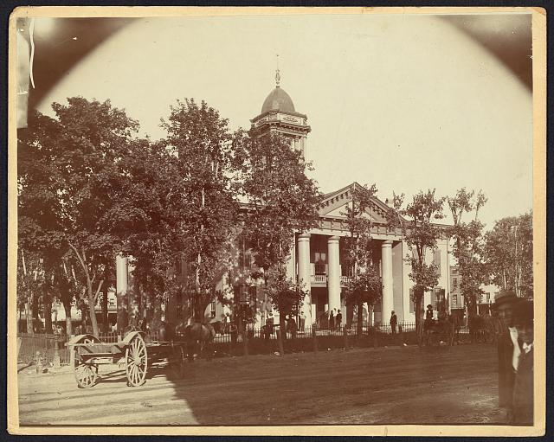
Title: The Coles County Court House in Charleston, Ills., in which Lincoln often practiced law and before which he made a short speech in the evening after his fourth joint debate with Douglas, Sept. 18, 1858
http://www.loc.gov/pictures/item/200868097
4
Date Created/Published: [between 1860 and 1898?]

Slide 8
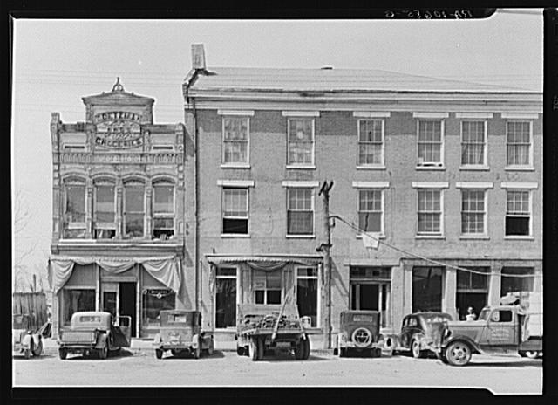
Title: An old grocery building and the Posey Building where Abraham Lincoln and Robert Ingersoll had law offices. Shawneetown, Illinois
Date Created/Published: 1937 Apr.
http://www.loc.gov/pictures/item/fsa1998022
487/PP/

Slide 9
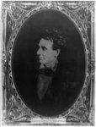
Title: [Abraham Lincoln, immediately prior to Senate nomination, Chicago, Illinois]
Date Created/Published: [1857 February 28, printed later]
http://www.loc.gov/pictures/item/200867833
2/

Slide 10
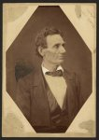
Title: [Abraham Lincoln, presidential candidate, half-length portrait, facing right]
Date Created/Published: [1894, from a photo taken in 1860]
http://www.loc.gov/pictures/item/200868097
1/

Slide 11
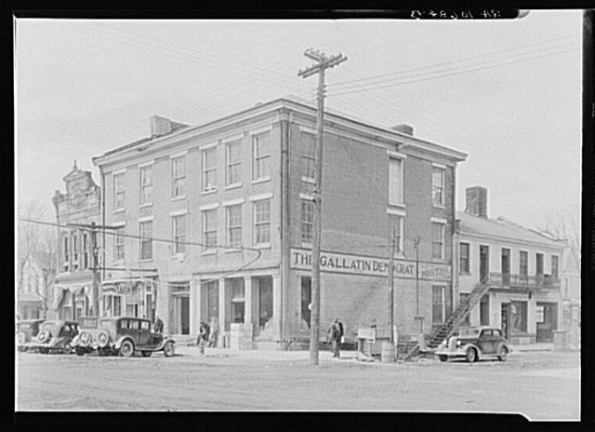
Title: The Posey Building of Shawneetown, Illinois, in which Abraham Lincoln and Robert Ingersoll had law offices
Date Created/Published: 1937 Apr.
http://www.loc.gov/pictures/item/fsa1998022
486/PP/

Slide 12
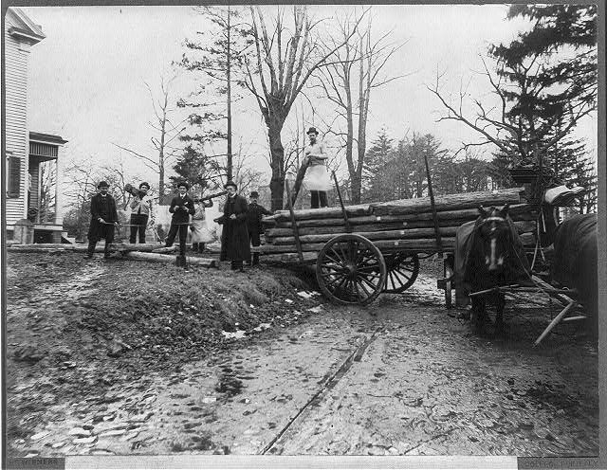
Title: [Men loading logs on a horse-drawn wagon, from the original Abraham Lincoln log cabin, at College Point, N.Y., on Feb. 21, 1906, to be re-erected on the Lincoln Farm at Hodgenville, Kentucky, the birthplace of Lincoln]
http://www.loc.gov/pictures/item/2006678042/
Date Created/Published: c1906
http://www.loc.gov/pictures/item/200667804
2/

Slide 13
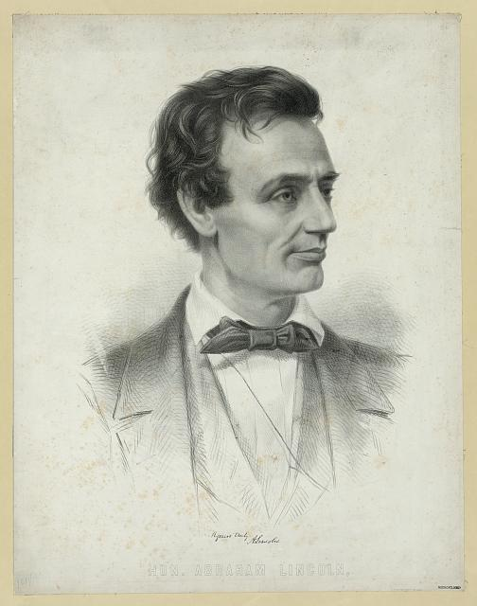
Title: Hon. Abraham Lincoln,
Date Created/Published: Boston : Printed at J.H. Bufford's, [1860]
http://www.loc.gov/pictures/item/200667830
5/

Slide 14
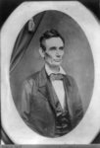
Title: [Abraham Lincoln, half-length portrait, facing right]
Date Created/Published: [probably 1858, printed later]
http://www.loc.gov/pictures/item/200963065
0/

Slide 15
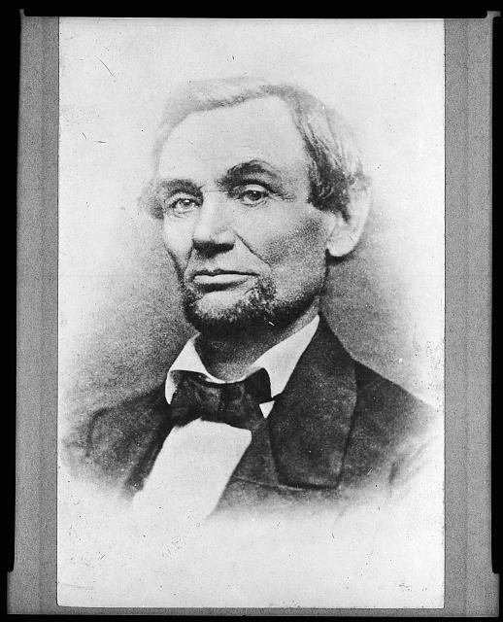
Title: [Abraham Lincoln: President-elect]
Date Created/Published: [Chicago, Ill. : 1860 November 25, printed later]
http://www.loc.gov/pictures/item/98504532/

Slide 16
