Slide 1
Lincoln & The Law

Slide 2
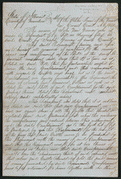
Court Cases
Title: Gundy vs. Gundy
Summary: Joseph Gundy and John Gundy entered into the business of selling hogs and cattle in the fall of 1847, and decided to dissolve the partnership in December 1848. Joseph Gundy sued John Gundy in a chancery action to settle the partnership. Joseph Gundy also sued John Gundy in a separate common law action (Gundy v. Gundy). In this case, Joseph Gundy claimed that John Gundy owed him $200 for 1,000 bushels of corn; $200 for 110 hogs sold; and an additional amount for twenty-four steers. John Gundy retained Lincoln and answered that Joseph Gundy owed him money from the partnership and filed a cross-bill to obtain the sum. The parties reached a settlement in which the court ruled for Joseph Gundy and awarded $415.
http://hdl.loc.gov/loc.rbc/lprbscsm.scsm1444

Slide 3
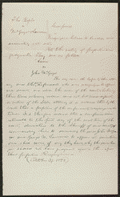
Court Cases
Title: Attorney's Notes in People v. McGregor & Lawrence
Summary: The state's attorney indicted McGregor for forgery. Lawrence signed as a surety on McGregor's recognizance bond. McGregor failed to appear, and the court ruled that McGregor had forfeited the recognizance. The state's attorney sued McGregor and Lawrence to recover the $100 penalty on the bond. Lawrence retained Lincoln and claimed that there was a variance between the record of judgment and the writ of scire facias. The court quashed the writ of scire facias and continued the case. The resolution of the case is unknown.
http://hdl.loc.gov/loc.rbc/lprbscsm.scsm1488

Slide 4
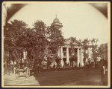
Title: The Coles County Court House in Charleston, Ills., in which Lincoln often practiced law and before which he made a short speech in the evening after his fourth joint debate with Douglas, Sept. 18, 1858
Date:1860
http://www.loc.gov/pictures/item/2008680974/

Slide 5
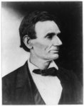
Title: Abraham Lincoln, presidential candidate, half-length portrait, facing right
Date:1860
http://www.loc.gov/pictures/item/2009630674/

Slide 6
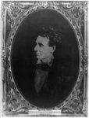
Title: Abraham Lincoln, immediately prior to Senate nomination, Chicago, Illinois
Date: 1857
http://www.loc.gov/pictures/item/2008678332/

Slide 7
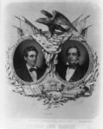
Title: Lincoln And Hamlin
Date:1860
http://www.loc.gov/pictures/item/2003689294/

Slide 8
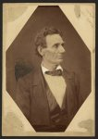
Title: Abraham Lincoln, presidential candidate, half-length portrait, facing right Date:1860
http://www.loc.gov/pictures/item/2008680971/

Slide 9
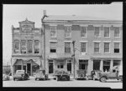
Title: An old grocery building and the Posey Building where Abraham Lincoln and Robert Ingersoll had law offices. Shawneetown, Illinois
Date:1937
http://www.loc.gov/pictures/item/fsa1998022487/PP/

Slide 10
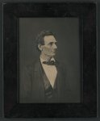
Title: Abraham Lincoln, presidential candidate, half-length portrait, facing right
Date:1860
http://www.loc.gov/pictures/item/2011645303/

Slide 11
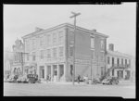
Title: The Posey Building of Shawneetown, Illinois, in which Abraham Lincoln and Robert Ingersoll had law offices
Date:1937
http://www.loc.gov/pictures/item/fsa1998022486/PP/

Slide 12
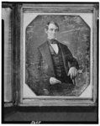
Title: Abraham Lincoln, Congressman-elect from Illinois. Three-quarter length portrait, seated, facing front
Date: 1846
http://www.loc.gov/pictures/item/2004664400/

Slide 13
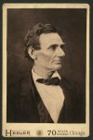
Title: Abraham Lincoln, presidential candidate, half-length portrait, facing right
Date:1860
http://www.loc.gov/pictures/item/2009630673/

Slide 14
