Slide 1
Lincoln & the Law

Slide 2
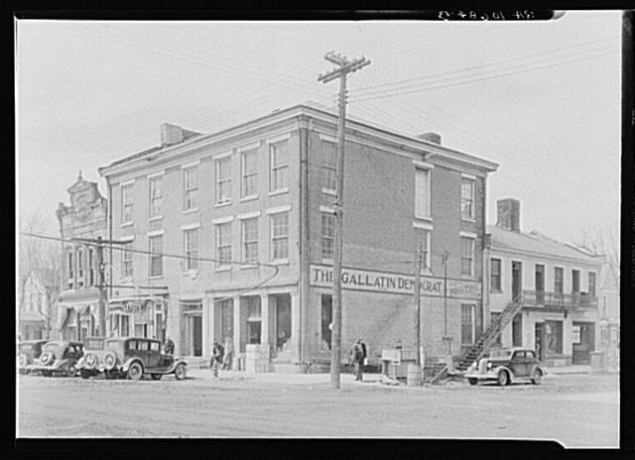
The Posey Building of Shawnee town, Illinois
Lincoln had a law office in Shawnee Illinois with Robert Ingersoll.
http://hdl.loc.gov/loc.pnp/fsa.8c51242

Slide 3
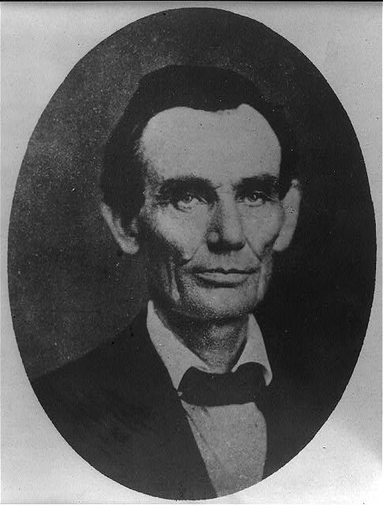
Abraham Lincoln while a traveling lawyer
Taken while Lincoln was a traveling lawyer.
This picture was taken in Danville Illinois.
http://hdl.loc.gov/loc.pnp/cph.3a18603

Slide 4
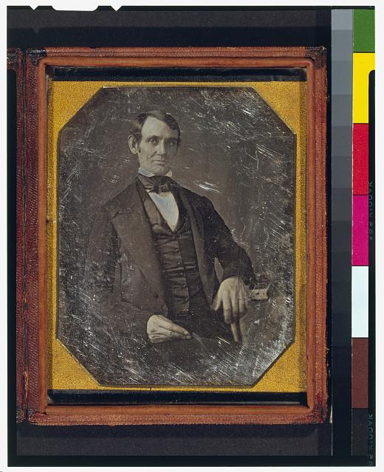
Earliest Known Photo
This daguerreotype is the earliest-known photograph of Abraham Lincoln, taken at age 37 when he was a frontier lawyer in Springfield.
http://hdl.loc.gov/loc.pnp/cph.3g02439

Slide 5
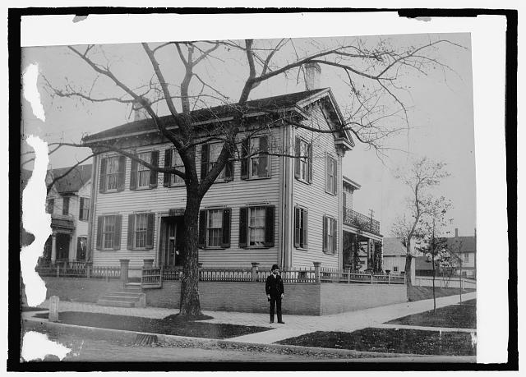
House
Lincoln House. Springfield, Illinois.
http://hdl.loc.gov/loc.pnp/npcc.19654

Slide 6
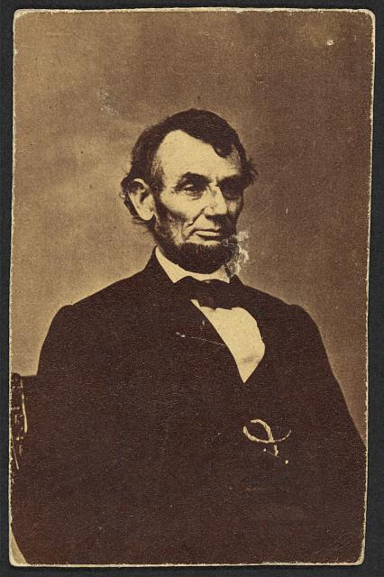
Lincoln
Title: Abraham Lincoln, three-quarter length portrait, seated, facing right; hair parted on Lincoln's right side
Taken February 6th 1964
Picture on the $5 bill
http://hdl.loc.gov/loc.pnp/ppmsca.19190

Slide 7
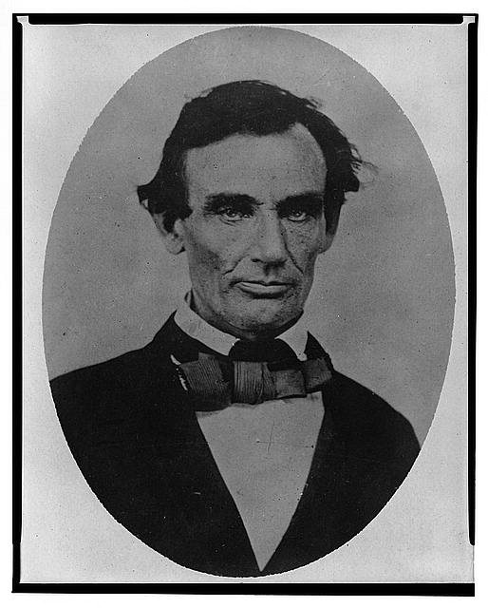
Lincoln
Abraham Lincoln, head-and-shoulders portrait, facing slightly left, taken in Pittsfield, Illinois
http://hdl.loc.gov/loc.pnp/cph.3a18600

Slide 8
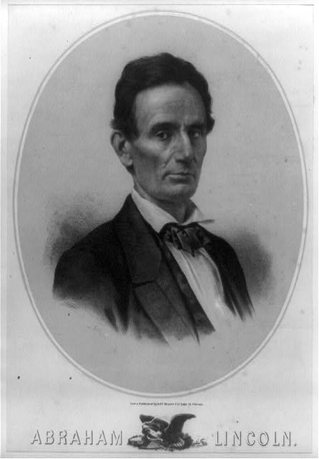
Lincoln
Taken in 1860
Before the election
http://hdl.loc.gov/loc.pnp/cph.3b38591

Slide 9
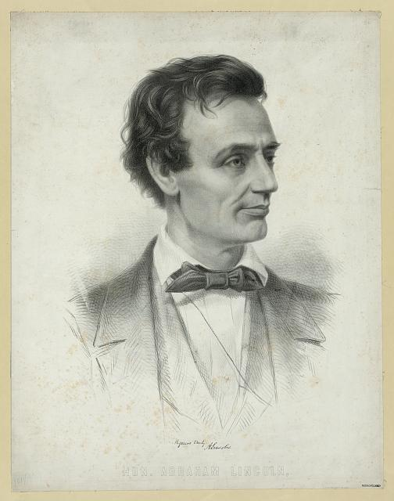
Lincoln
Young Lincoln
Taken 1860
http://hdl.loc.gov/loc.pnp/pga.03411

Slide 10
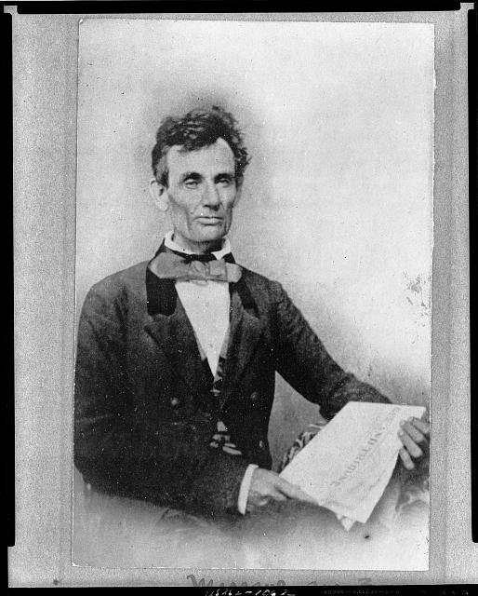
Lincoln
Taken October 27, 1854
Chicago, Illinois
As a traveling lawyer
http://hdl.loc.gov/loc.pnp/cph.3a13087

Slide 11
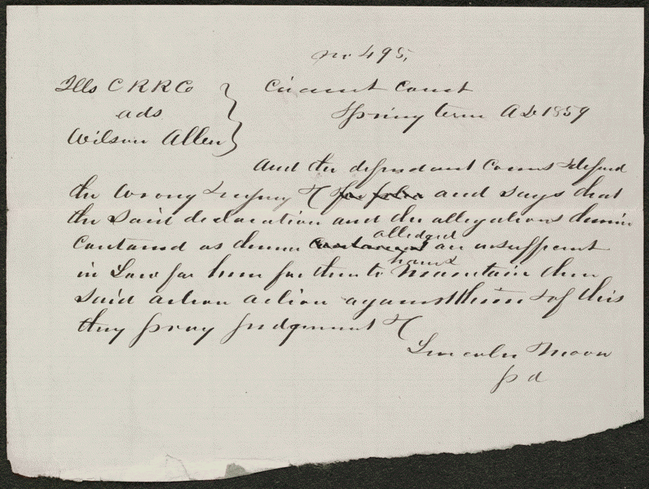
Court Case
Summary: Allen sued the Illinois Central Railroad and requested $300 in damages.
The railroad retained
Lincoln, who demurred to Allen's declaration.
The court sustained the demurrer and dismissed the case.

Slide 12
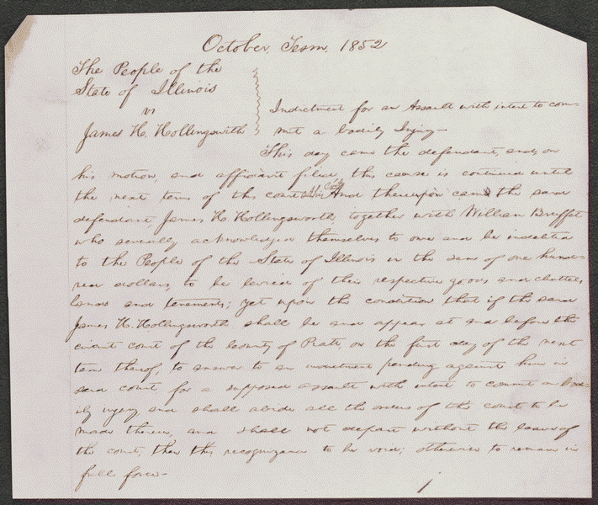
Court Case
Hollingsworth asked Deborah Ater to care for his sick wife at his home while he was away. Jacob Ater insisted that Deborah leave town with him, and when she refused, Jacob assaulted her. Hollingsworth intervened, he and Jacob began to fight, and Deborah fled to another house. Hollingsworth again asked Deborah to care for his wife, and as they were returning to Hollingsworth's house, Jacob approached them "in a menacing attitude." Hollingsworth aimed a pistol at and pulled the trigger, but the pistol did not fire. The state's attorney indicted Hollingsworth for assault with intent to commit bodily injury, and Hollingsworth retained Lincoln. The parties reached an agreement in which the state's attorney would cease prosecution and Hollingsworth would pay all costs, and the court dismissed the case.
http://hdl.loc.gov/loc.rbc/lprbscsm.scsm1540

