Slide 1
LINCOLN & THE LAW
Kelly Scharp

Slide 2
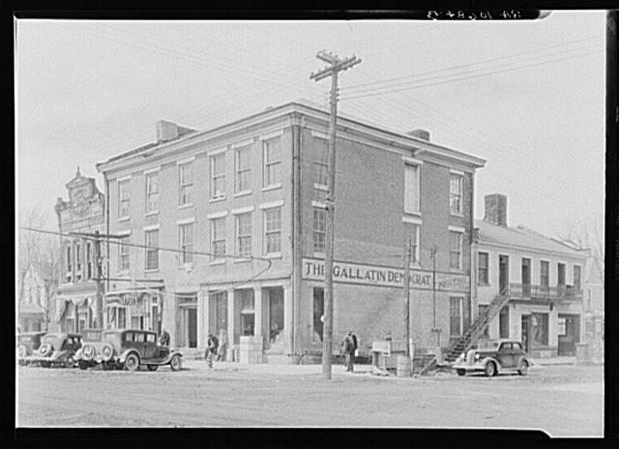
Bookmark This Record: http://www.loc.gov/pictures/item/fsa1998022486/PP/
Title: The Posey Building of Shawneetown, Illinois, in which Abraham Lincoln and Robert Ingersoll had law offices
Creator(s): Lee, Russell, 1903-1986, photographer
Date Created/Published: 1937 Apr.
Medium: 1 negative : safety ; 5 x 7 inches or smaller.

Slide 3
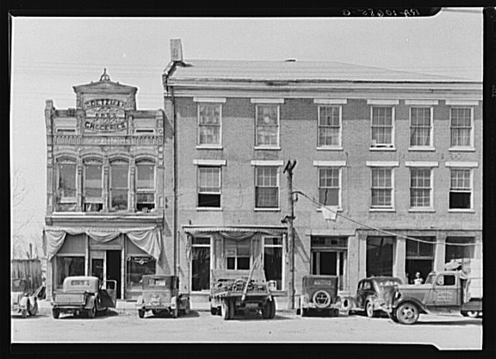
Title: An old grocery building and the Posey Building where Abraham Lincoln and Robert Ingersoll had law offices. Shawneetown, Illinois
Creator(s): Lee, Russell, 1903-1986, photographer
Date Created/Published: 1937 Apr.
Medium: 1 negative : safety ; 5 x 7 inches or smaller.
Bookmark This Record: http://www.loc.gov/pictures/item/fsa1998022487/PP/

Slide 4
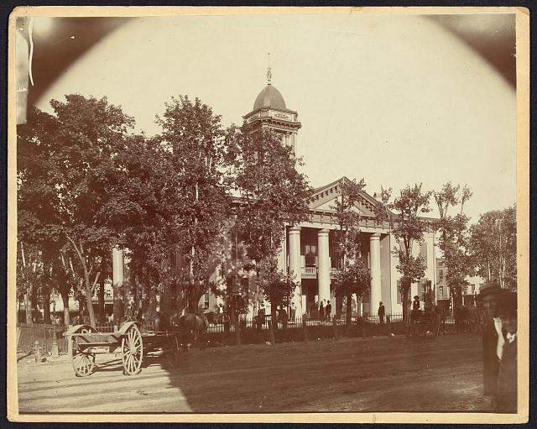
The Coles County Court House in Charleston, Ills., in which Lincoln often practiced law and before which he made a short speech in the evening after his fourth joint debate with Douglas, Sept. 18, 1858 [between 1860 and 1898?] | 1 photographic print Unprocessed in PR 13 CN 1972:140 [item] [P&P] | LC-DIG-ppmsca-19197 (digital file from original)
Bookmark This Record: http://www.loc.gov/pictures/item/2008680974/

Slide 5
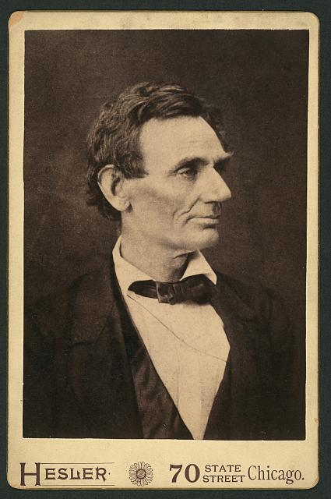
Title: [Abraham Lincoln, law, half-length portrait, facing right]
Creator(s): Hesler, Alexander, 1823-1895, photographer
Date Created/Published: [ca. 1894, from a photo taken in 1860]
Medium: 1 photographic print on cabinet card mount : albumen silver.
Summary: Photo of Lincoln made from a negative taken in Springfield, Illinois, by Alexander Hesler on June 3, 1860. One of several poses from that day. "Wrote Lincoln's law partner, William H. Herndon, 'There is the peculiar curve of the lower lip, the lone mole on the right cheek, and a pose of the head so essentially Lincolnian; no other artist has ever caught it.'" (Source: Ostendorf, p. 46) George B. Ayres bought Hesler's studio and later made prints from the Lincoln negatives.
Bookmark This Record: http://www.loc.gov/pictures/item/2010645957/

Slide 6
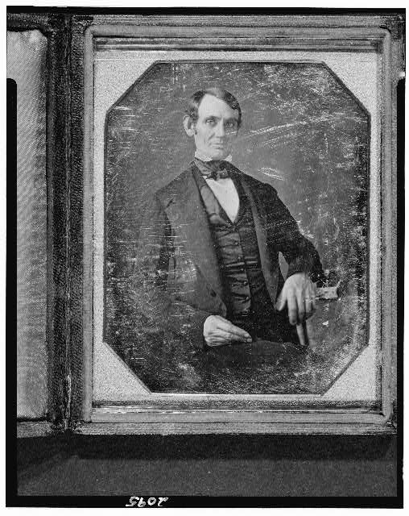
Title: [Abraham Lincoln, Congressman-elect from Illinois. Three-quarter length portrait, seated, facing front]
Creator(s): Shepherd, Nicholas H., photographer
Date Created/Published: [Springfield, Ill., 1846 or 1847]
Medium: 1 photograph : quarter plate daguerreotype ; plate 4 1/4 x 3 1/4 in.
Summary: This daguerreotype is the earliest-known photograph of Abraham Lincoln, taken at age 37 when he was a frontier lawyer in Springfield and Congressman-elect from Illinois. (Source: Ostendorf, p. 4)
Bookmark This Record: http://www.loc.gov/pictures/item/2004664400/

Slide 7
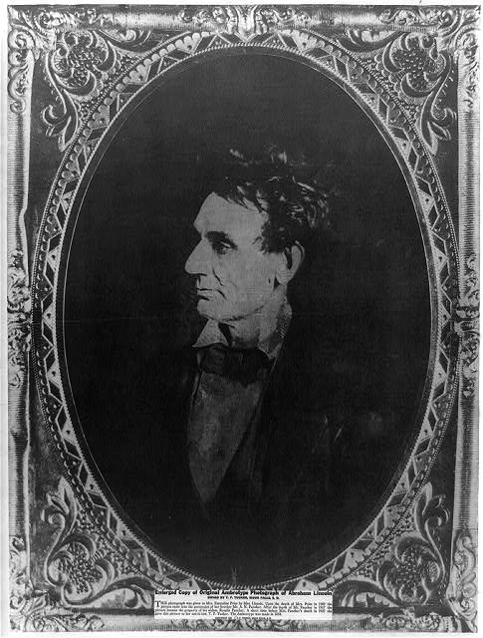
Title: [Abraham Lincoln, immediately prior to Senate nomination, Chicago, Illinois]
Creator(s): Hesler, Alexander, 1823-1895, photographer
Date Created/Published: [1857 February 28, printed later]
Medium: 1 photographic print : gelatin silver.
Summary: Abraham Lincoln while in law, head-and-shoulders portrait, facing right. According to Ostendorf, this portrait by Hessler was copied during Lincoln's campaign and further distributed.
Bookmark This Record: http://www.loc.gov/pictures/item/2008678332/

Slide 8
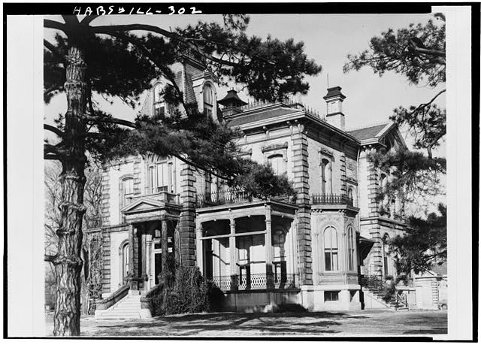
Built by Judge David Davis, and associate Abraham Lincoln in law and politics for more than twenty years, member of the United States Supreme Court (1862-1877), and U.S. Senator (1877-1883).
Digital ID: (None) hhh il0078.photos.062895p http://hdl.loc.gov/loc.pnp/hhh.il0078/photos.062895p

Slide 9
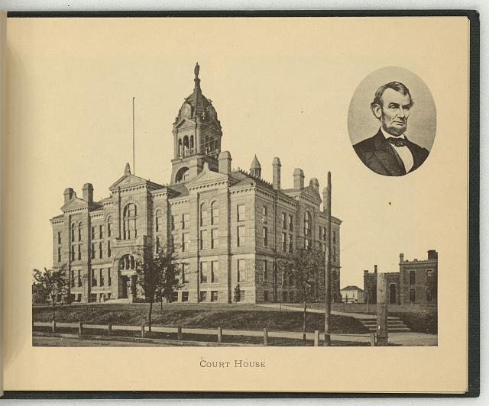
Summary: Print showing exterior view of the courthouse in Lincoln; includes a bust portrait of Abraham Lincoln, facing right, in oval, in upper right corner.
Digital ID: (digital file from original item) ppmsca 19594 http://hdl.loc.gov/loc.pnp/ppmsca.19594

Slide 10
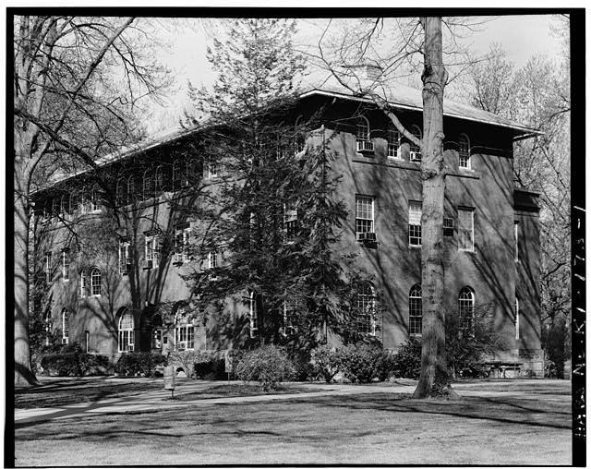
Repository: Library of Congress Prints and Photographs where Lincoln studied.
Digital ID: (None) hhh ky0189.photos.071527p http://hdl.loc.gov/loc.pnp/hhh.ky0189/photos.071527p

Slide 11
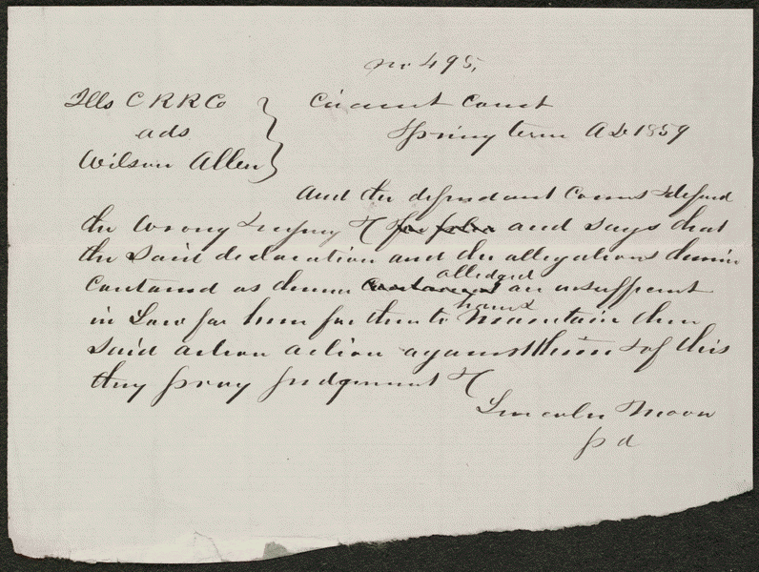
Created/Published
Spring, 1859
Summary: Allen sued the Illinois Central Railroad and requested $300 in damages. The railroad retained Lincoln, who demurred to Allen's declaration. The court sustained the demurrer and dismissed the case.
lprbscsm scsm1495 http://hdl.loc.gov/loc.rbc/lprbscsm.scsm1495

Slide 12
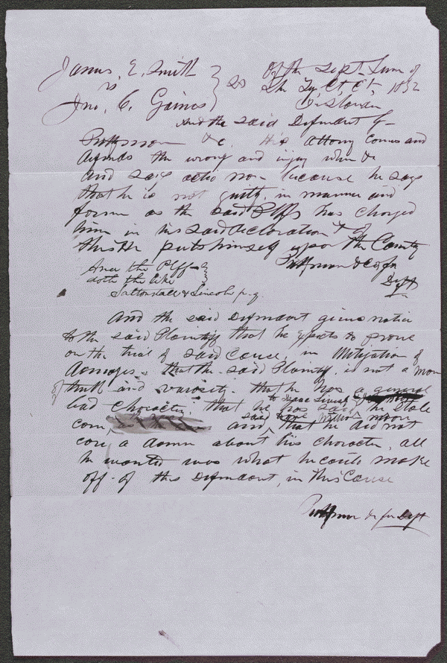
Summary: Gaines claimed that Smith stole some of his corn. Smith retained Lincoln and sued Gaines in an action of trespass on the case for slander seeking $1,000 in damages. Gaines pleaded not guilty, but a jury found for Smith and awarded $100.
Created/Published
September 18, 1852
lprbscsm scsm1537 http://hdl.loc.gov/loc.rbc/lprbscsm.scsm1537

Slide 13
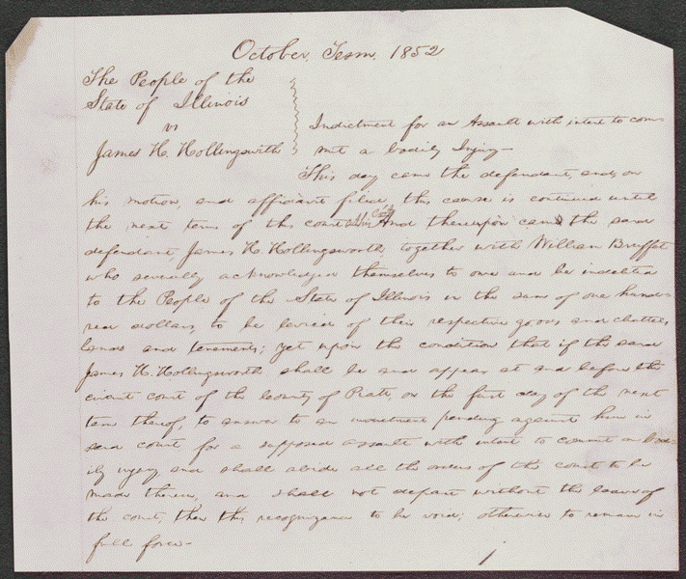
Summary: Hollingsworth asked Deborah Ater to care for his sick wife at his home while he was away. Jacob Ater insisted that Deborah Ater leave town with him, and when she refused, Jacob Ater assaulted her. Hollingsworth intervened, he and Jacob Ater began to fight, and Deborah Ater fled to another house. Hollingsworth again asked Deborah Ater to care for his wife, and as they were returning to Hollingsworth's house, Jacob Ater approached them "in a menacing attitude." Hollingsworth aimed a pistol at Ater and pulled the trigger, but the pistol did not fire. The state's attorney indicted Hollingsworth for assault with intent to commit bodily injury, and Hollingsworth retained Lincoln. The parties reached an agreement in which the state's attorney would cease prosecution and Hollingsworth would pay all costs, and the court dismissed the case
Created/Published
October, 1852
lprbscsm scsm1540 http://hdl.loc.gov/loc.rbc/lprbscsm.scsm1540

Slide 14
lprbscsm scsm1537 http://hdl.loc.gov/loc.rbc/lprbscsm.scsm1537
lprbscsm scsm1495 http://hdl.loc.gov/loc.rbc/lprbscsm.scsm1495
lprbscsm scsm1475 http://hdl.loc.gov/loc.rbc/lprbscsm.scsm1475
lprbscsm scsm1581 http://hdl.loc.gov/loc.rbc/lprbscsm.scsm1581
lprbscsm scsm1540 http://hdl.loc.gov/loc.rbc/lprbscsm.scsm1540
lprbscsm scsm1571 http://hdl.loc.gov/loc.rbc/lprbscsm.scsm1571
(digital file from b&w film copy neg.) cph 3a18603 http://hdl.loc.gov/loc.pnp/cph.3a18603

