Slide 1
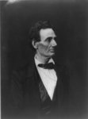
LINCOLN &THE LAW
By: KHARLEE WILLIAMS
Access to Original
Title: [Abraham Lincoln, presidential candidate, half-length portrait, facing right]
Creator(s): Hesler, Alexander, 1823-1895, photographer
Related Names: Ayres, George B.
http://www.loc.gov/pictures/item/2009630665/

Slide 2
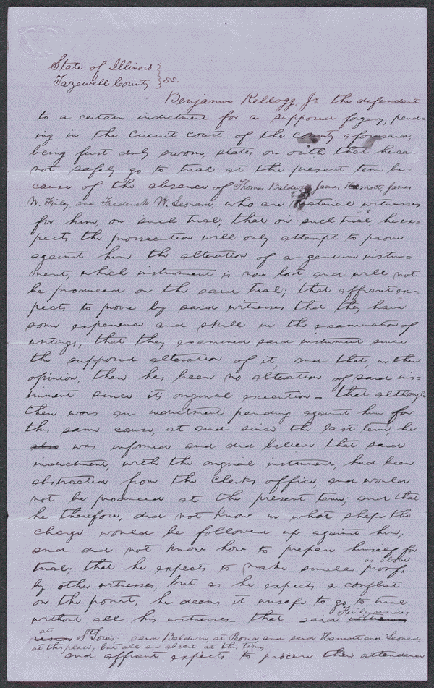
Summary: The state's attorney indicted Kellogg for forgery because he allegedly altered a document. Kellogg retained Lincoln and argued that he did not alter the document and produced many witnesses to testify to that effect. Lincoln motioned the court to quash the indictment; the court agreed and dismissed the case.
Digital ID
lprbscsm scsm1578 http://hdl.loc.gov/loc.rbc/lprbscsm.scsm1578

Slide 3
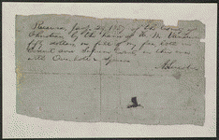
Summary: Overholt and Squier contracted with three judges from Christian County, Illinois, to construct a courthouse. The $15,000 contract was to be paid in installments upon completion of specific projects. Overholt completed the foundation, but Judge Vandeveer refused to pay because the job failed to meet agreed specifications. Overholt and Squier halted construction and sued in the Christian County Circuit Court to recover the anticipated profits. The court granted a change of venue to the Macon County Circuit Court. The jury found for Overholt and Squier and awarded $657.87. The Christian County officials, who had retained Lincoln, appealed to the Illinois Supreme Court, which reversed and remanded the appeal. The court ruled that Overholt and Squier could not sue for anticipated profits unless they were prevented from completing construction, which did not happen. Lincoln received a $50 fee for his work in the trial and the appeal
Digital ID
lprbscsm scsm1473 http://hdl.loc.gov/loc.rbc/lprbscsm.scsm1473

Slide 4
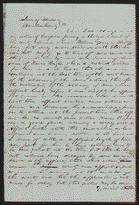
Summary: Young sued Littler for $1,000 for assault and battery. The fight occurred on Young's property after Littler claimed that a hog belonged to him. Littler, represented by Lincoln, pleaded self-defense and claimed t
hat Young had tried to assault him with a gun and a club. Young died, and his attorney abated the case
lprbscsm scsm1443 http://hdl.loc.gov/loc.rbc/lprbscsm.scsm1443

Slide 5
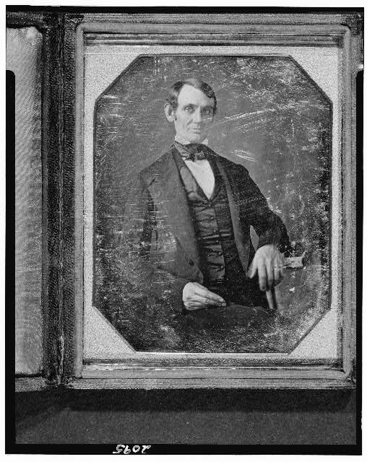
[Abraham Lincoln, Congressman-elect from Illinois. Three-quarter length portrait, seated, facing front]
Digital ID: (digital file from b&w film copy neg. post-1992) cph 3d02095 http://hdl.loc.gov/loc.pnp/cph.3d02095
Repository: Library of Congress Prints and Photographs Division Washington, D.C. 20540 USA http://hdl.loc.gov/loc.pnp/pp.print

Slide 6
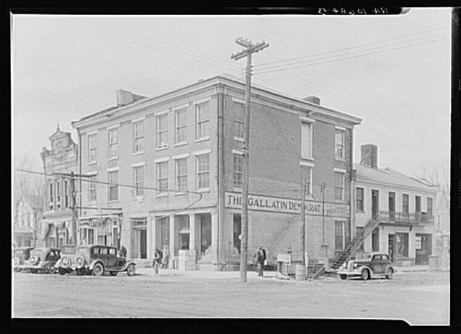
The Posey Building of Shawneetown, Illinois, in which Abraham Lincoln and Robert Ingersoll had law offices
Creator(s): Lee, Russell, 1903-1986, photographer
intermediary roll film http://hdl.loc.gov/loc.pnp/fsa.8c51242
Digital ID: (intermediary roll film) fsa 8c51242 http://hdl.loc.gov/loc.pnp/fsa.8c51242
Reproduction Number: LC-USF341-T01-010684-B (b&w film dup neg.)
Repository: Library of Congress Prints and Photographs Division Washington, DC 20540 USA http://hdl.loc.gov/loc.pnp/pp.print

Slide 7
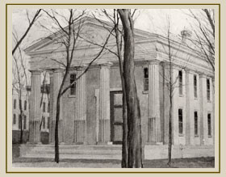
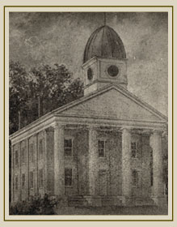
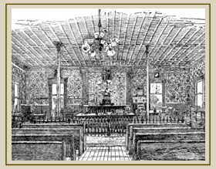
Tazewell Court Houses
www.lookingforlincoln.com

Slide 8
QUOTES
Discourage litigation. Persuade your neighbors to compromise whenever you can. Point out to them how the nominal winner is often a real loser -- in fees, expenses, and waste of time. As a peacemaker the lawyer has a superior opportunity of being a good man. There will still be business enough.
-- Abraham Lincoln Notes for a Law Lecture July 1, 1850

Slide 9
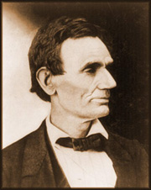
The leading rule for the lawyer, as for the man of every other calling, is diligence. Leave nothing for to-morrow which can be done to-day.
-- Abraham Lincoln Notes for a Law Lecture July 1, 1850
www.lookingforlincoln.com

