Slide 1
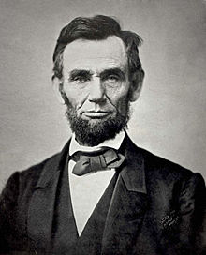
Abraham Lincoln
“The ballot is stronger than the bullet.”
Presentation by: Kiera Terrell

Slide 2
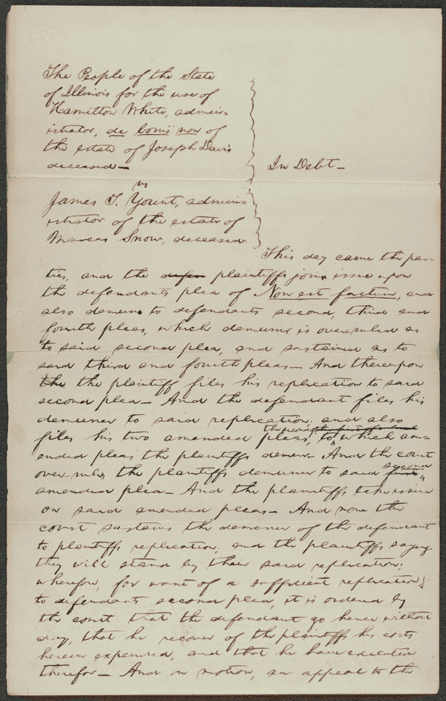
Order in People for use of White v. Yount, [Law papers].
Digital ID
http://hdl.loc.gov/loc.rbc/lprbscsm.scsm1510
Digital ID
http://hdl.loc.gov/loc.rbc/lprbscsm.scsm1510
Digital ID
http://hdl.loc.gov/loc.rbc/lprbscsm.scsm1510
Digital ID
http://hdl.loc.gov/loc.rbc/lprbscsm.scsm1510
Summary: The people of Illinois, for the use of White, retained Lincoln and sued Yount to collect a $12,000 debt. White, the administrator de bonis non of Joseph Davis's estate, charged that Yount, as administrator of Marcus Snow's estate, was liable for the $12,000 due to the Davis estate from Snow, who had been administrator de bonis non of Davis's estate until his death. White stated that the $12,000 debt
Digital ID
http://hdl.loc.gov/loc.rbc/lprbscsm.scsm1510

Slide 3
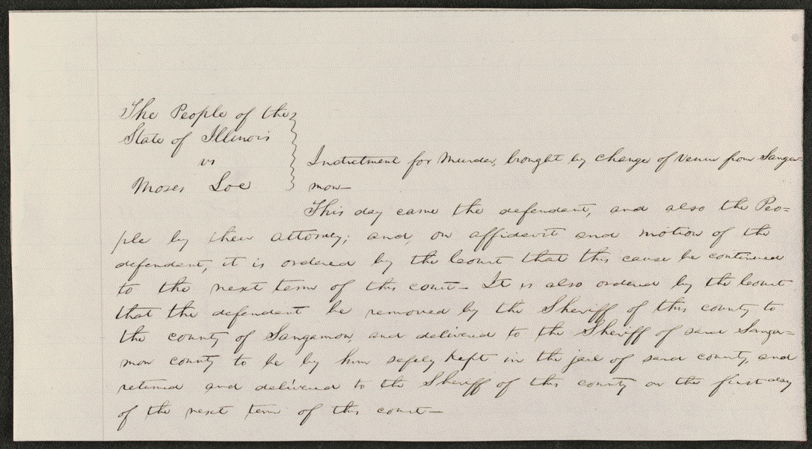
Order in People v. Loe, [Law papers].
Summary: First portion appears to be in Lincoln's hand.
Digital ID
http://hdl.loc.gov/loc.rbc/lprbscsm.scsm1598

Slide 4
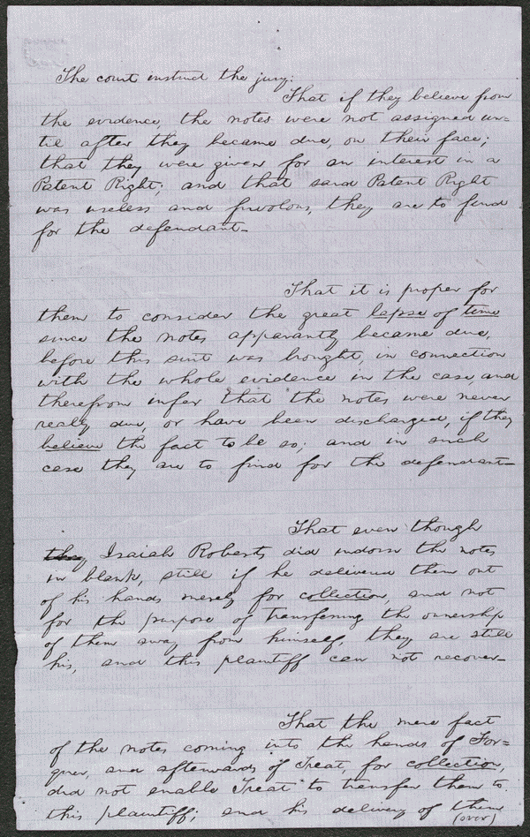
Jury Instructions in Roberts v. Harkness, [Law papers].
Summary: Harkness gave Isaiah Roberts three promissory notes in 1834 totaling $1,080. Isaiah assigned the notes to Henry Roberts, who sued Harkness in the Peoria County Circuit Court after Harkness failed to pay. Harkness argued that Roberts for $1,440 sold him an idea for an invention to manufacture bricks. Harkness refused to pay because he discovered that the invention was useless, which broke the consideration of the promissory notes. The court granted a change of venue to Tazewell County Circuit Court, and Harkness retained Lincoln. The first jury failed to reach a verdict, but a second jury found for Harkness. Roberts motioned for a new trial, but the court overruled the motion
Digital ID
http://hdl.loc.gov/loc.rbc/lprbscsm.scsm1466

Slide 5
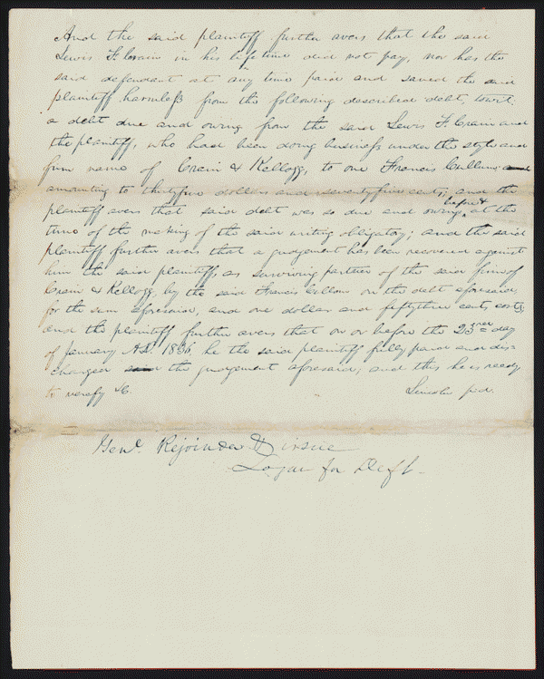
Amended Replication in Kellogg v. Crain, [Law papers].
Summary: Kellogg and Lewis Crain dissolved their business partnership, but Crain owed Kellogg $16,000 to pay off the business's debts. Crain died before paying, and Kellogg sued James Crain, who served as surety for Lewis Crain, in an action of debt for $16,000. The court granted a change of venue to Peoria County, but the court there remanded the case back to Tazewell County. Kellogg retained Lincoln but failed to appear, and the court dismissed the case. Kellogg motioned to reinstate the case because he was ill and could not attend court. The court set aside the dismissal and ruled for Kellogg for $16,000.
Digital ID
http://hdl.loc.gov/loc.rbc/lprbscsm.scsm1374

Slide 6
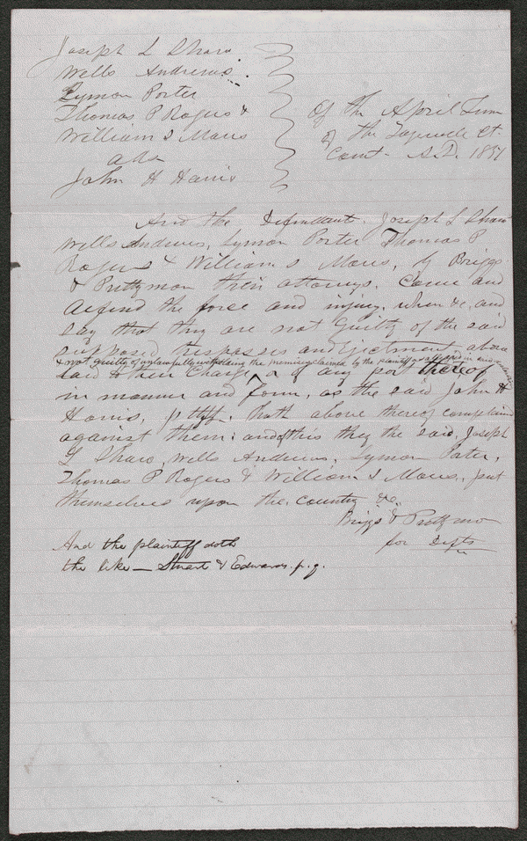
Plea in Harris v. Shaw et al, [Law papers].
Summary: Sentence at bottom appears to be in Lincoln's hand.
Digital ID
http://hdl.loc.gov/loc.rbc/lprbscsm.scsm1597

Slide 7
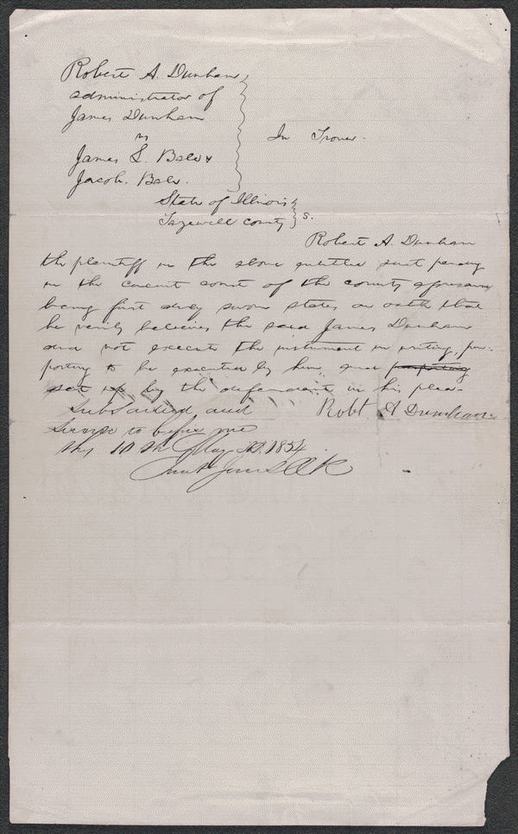
Affidavit in Dunham v. Bale & Bale, [Law papers].
Summary: Robert Dunham, as administrator of James Dunham's estate, retained Lincoln and sued James Bale and Jacob Bale in an action of trover. Dunham dismissed his suit against the Bales. Lincoln and his co-counsel received $10 for their legal services.
Digital ID
http://hdl.loc.gov/loc.rbc/lprbscsm.scsm1575

Slide 8
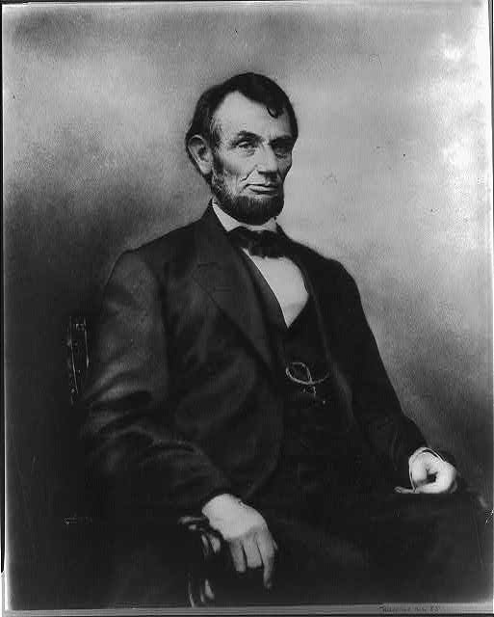
[Abraham Lincoln, three-quarter length portrait, seated, facing right; hair parted on Lincoln's right side]
Creator: Anthony Berger, photographer
Digital file :
http://hdl.loc.gov/loc.pnp/cph.3a07486

Slide 9
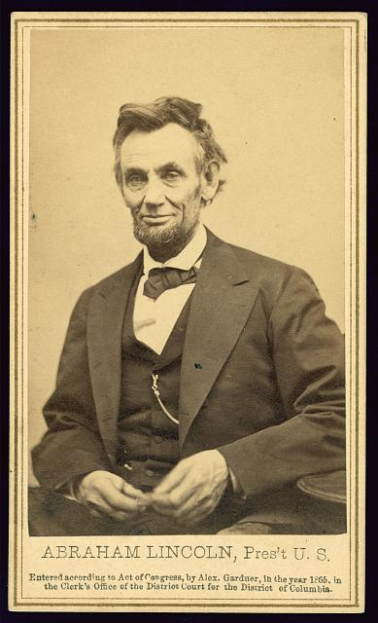
Abraham Lincoln, Pres't U.S.
Summary: Photograph from the last formal portrait sitting, Feb. 5, 1865, in Washington, D.C. "One of five poses taken by Gardner ten weeks before the President was assassinated." (Source: Ostendorf, p. 219)
Digital ID: http://hdl.loc.gov/loc.pnp/ppmsca.19215

Slide 10
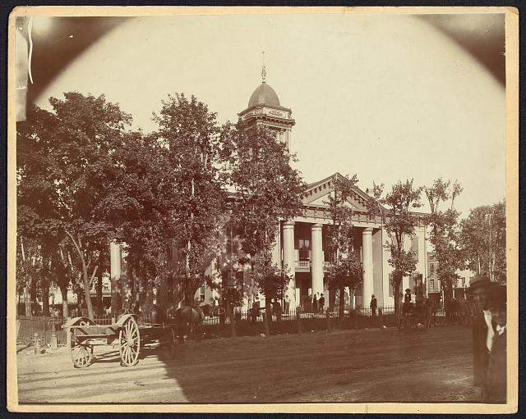
The Coles County Court House in Charleston, Ills.,
Summary: Photograph showing courthouse with people and horse-drawn wagons in front.
Digital file http://hdl.loc.gov/loc.pnp/ppmsca.19197

Slide 11
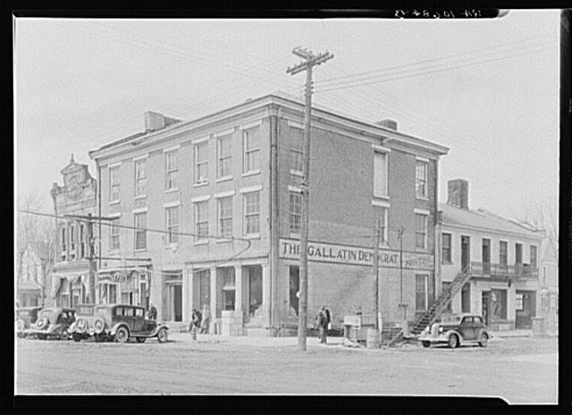
The Posey Building
The Posey Building of Shawneetown, Illinois, in which Abraham Lincoln and Robert Ingersoll had law offices
Digital File
http://hdl.loc.gov/loc.pnp/fsa.8c51242

Slide 12
Wordle

