Slide 1
Lincoln Project
By: Kody Downes
11/19/12
7th Hour

Slide 2
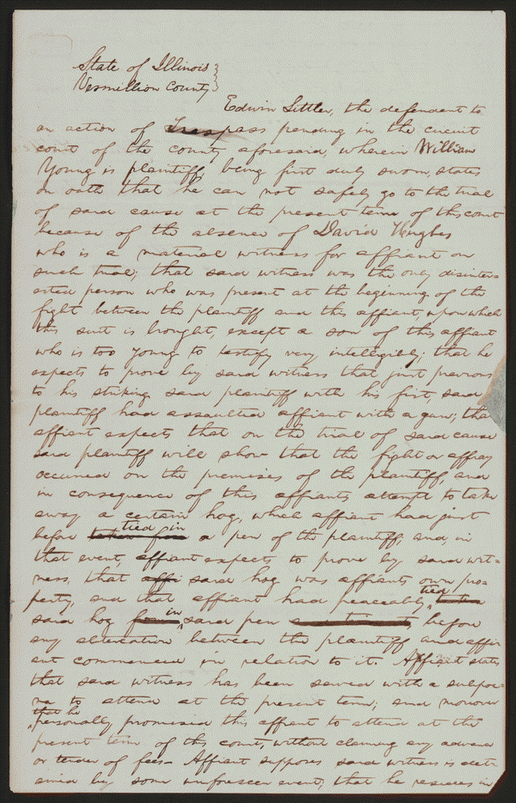
Young v. Littler
Created/Published – May, 1850
Vermilion County, Illinois
Summary – Young sued Littler for $1,000 for assault and battery. The fight occurred on Young's property after Littler claimed that a hog belonged to him. Littler, represented by Lincoln, pleaded self-defense and claimed that Young had tried to assault him with a gun and a club. Young died, and his attorney abated the case.
Digital ID – lprbscsm scsm1440
http://hdl.loc.gov/loc.rbc/lprbscsm.scsm1440

Slide 3
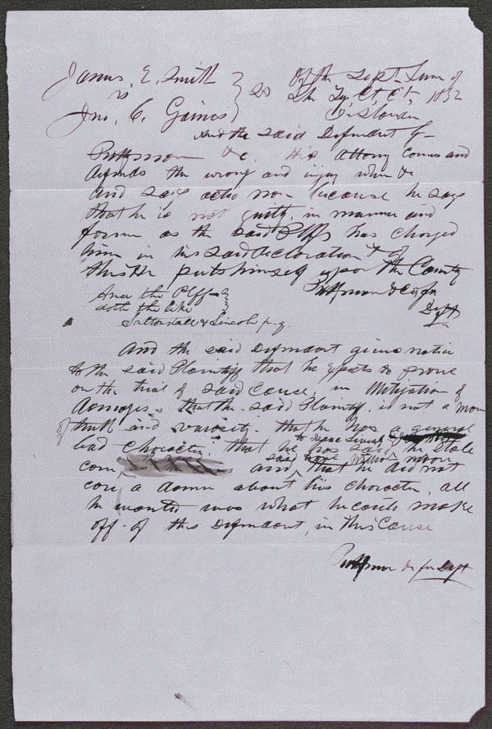
Smith v. Gaines
Created/Published – September 18, 1852
Summary – Gaines claimed that Smith stole some of his corn. Smith retained Lincoln and sued Gaines in an action of trespass on the case for slander seeking $1,000 in damages. Gaines pleaded not guilty, but a jury found for Smith and awarded $100.
Digital ID – lprbscsm scsm1537
http://hdl.loc.gov/loc.rbc/lprbscsm.scsm1537

Slide 4
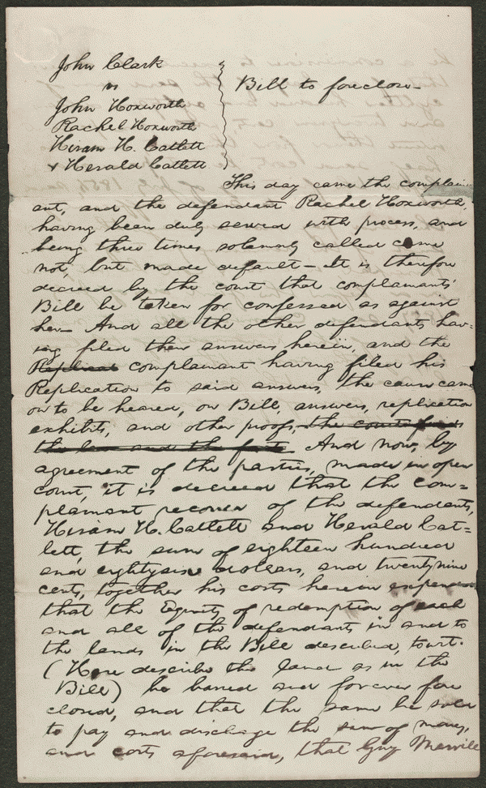
Clark v. Hoxworth et al
Created/Published – c. 1855
Summary: In 1846, John Hoxworth and his wife, Rachel Hoxworth, gave Clark ten $140 promissory notes ($1400), and secured them by a mortgage on 240 acres of land. Hoxworth later conveyed the same land to Hiram Catlett and Herald Catlett. After the Hoxworths failed to pay, Clark retained Lincoln and sued the Hoxworths and the Catletts. The court continued the case because Lincoln made an error in describing the mortgaged land in the bill of complaint. Rachel Hoxworth later defaulted, and the court ordered the Catletts to pay Clark $1,886.29. The court continued the case against John Hoxworth until dismissing it in 1867.
Digital ID – lprbscsm scsm1459
http://hdl.loc.gov/loc.rbc/lprbscsm.scsm1459

Slide 5
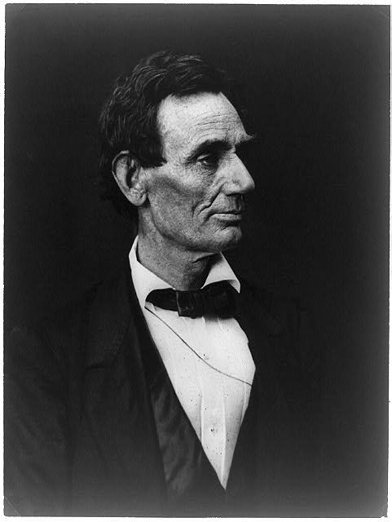
Title – Abraham Lincoln, presidential candidate, half-length portrait, facing right
Creator(s) – Hesler, Alexander, 1823-1895, photographer
Date Created/Published – [photo taken in 1860 and printed later, ca. 1900?]
Bookmark –http://www.loc.gov/pictures/item/2009630667/
Summary – Photo of Lincoln made from a negative taken in Springfield, Illinois, by Alexander Hesler on June 3, 1860. One of several poses from that day. "Wrote Lincoln's law partner, William H. Herndon, 'There is the peculiar curve of the lower lip, the lone mole on the right cheek, and a pose of the head so essentially Lincolnian; no other artist has ever caught it.'" (Source: Ostendorf, p. 46) George B. Ayres bought Hesler's studio and later made prints from the Lincoln negatives.

Slide 6
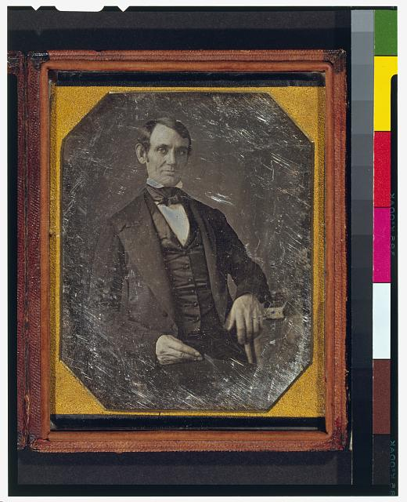
Title – Abraham Lincoln, Congressman-elect from Illinois. Three-quarter length portrait, seated, facing front
Creator(s) – Shepherd, Nicholas H., photographer
Date Created/Published – [Springfield, Ill., 1846 or 1847]
Bookmark –
http://www.loc.gov/pictures/item/2004664400/
Summary – This daguerreotype is the earliest-known photograph of Abraham Lincoln, taken at age 37 when he was a frontier lawyer in Springfield and Congressman-elect from Illinois. (Source: Ostendorf, p. 4)

Slide 7
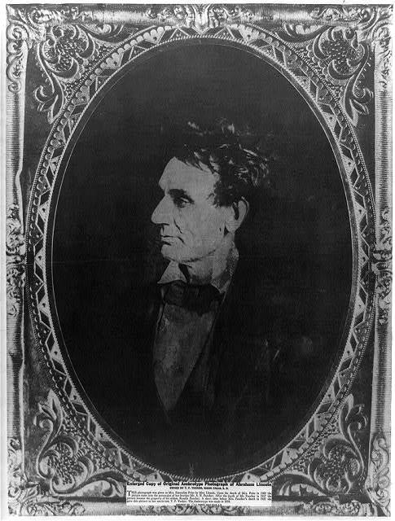
Title – Abraham Lincoln, immediately prior to Senate nomination, Chicago, Illinois
Creator(s) – Hesler, Alexander, 1823-1895, photographer
Date Created/Published – 1857 February 28, printed later
Bookmark –
http://www.loc.gov/pictures/item/2008678332/
Summary –Abraham Lincoln, head-and-shoulders portrait, facing right. According to Ostendorf, this portrait by Hessler was copied during Lincoln's campaign and further distributed.

Slide 8
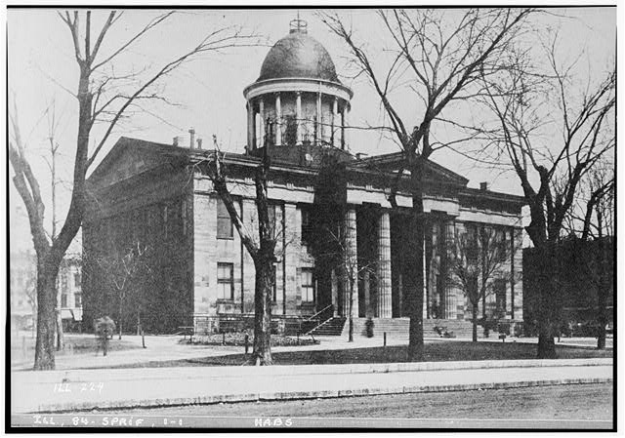
Title – Old State House, Springfield, Sangamon County, IL
Other Title – Sangamon County Courthouse
Third State Capitol
Creator(s) – Historic American Buildings Survey, creator
Date Created/Published – Documentation compiled after 1933
Bookmark –
http://www.loc.gov/pictures/item/il0202/
Summary – place where lincoln practiced law.

Slide 9
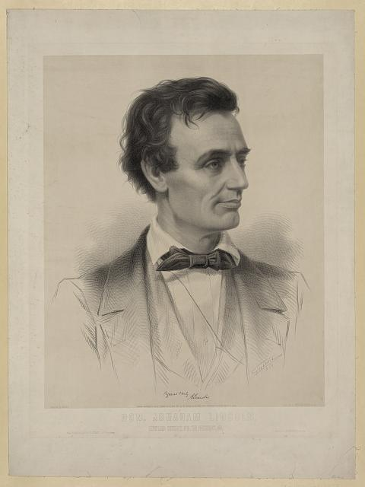
Title – Hon. Abraham Lincoln, Republican candidate for the presidency, 1860 / Grozelier ; painted by Hicks ; lith. by L. Grozelier, Boston.
Creator(s) – Grozelier, Leopold, 1830-1865, lithographer
Date Created/Published –New York : Published by W. Schaus, 629 Broadway, c1860 (Boston : Printed at J.H. Bufford's)
Bookmark –
http://www.loc.gov/pictures/item/99405224/
Summary – Print showing Abraham Lincoln, head-and-shoulders portrait, facing right. Thomas Hicks painted a portrait of Lincoln at his office in Springfield specifically for this lithograph.

Slide 10
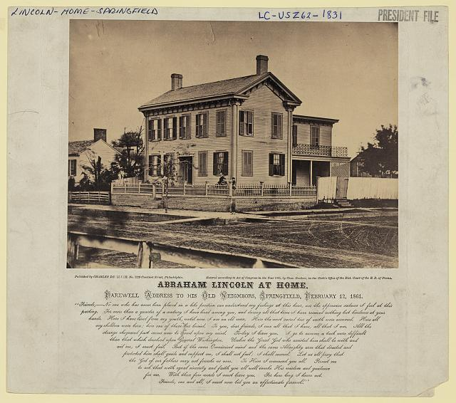
Title – Abraham Lincoln at home
Creator(s) – Whipple, John Adams, 1822-1891, photographer
Date Created/Published – [1860, c1865]
Bookmark –
http://www.loc.gov/pictures/item/2009630661/
Summary – Photo shows the house where Abraham Lincoln lived in Springfield, Illinois, with presidential candidate Abraham Lincoln standing on the terrace, with his sons Willie and Tad. (Source: Ostendorf, p. 56-9.)

Slide 11
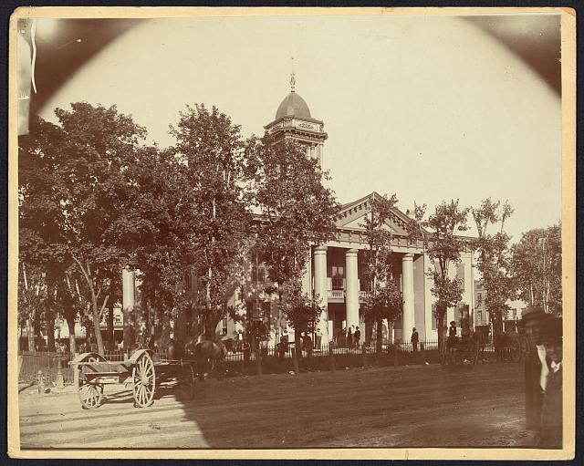
Title - The Coles County Court House in Charleston, Ills., in which Lincoln often practiced law and before which he made a short speech in the evening after his fourth joint debate with Douglas, Sept. 18, 1858
Date Created/Published - [between 1860 and 1898?]
Bookmark - http://www.loc.gov/pictures/item/2008680974/
Summary: Photograph showing courthouse with people and horse-drawn wagons in front.

Slide 12
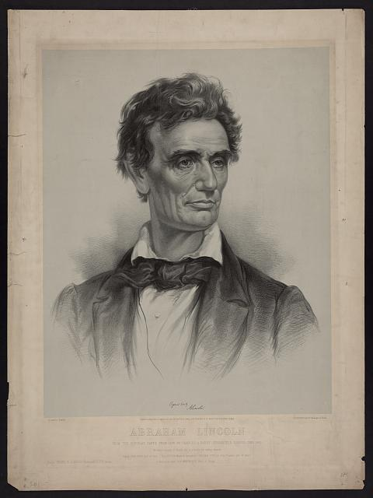
Title - Abraham Lincoln from a portrait taken from life by Charles A. Barry, Springfield, Illinois, June 1860 / on stone by J.E. Baker ; J.H. Bufford's Lith. 313 Washington St. Boston.
Creator(s) - J.H. Bufford's Lith.,
Date Created/Published - Boston : Thayer & Eldridge, Publishers for N.E. States, c1860 (Boston : J.H. Bufford's Lith. 313 Washington St.)
Bookmark - http://www.loc.gov/pictures/item/2006680102/
Summary - Print showing Abraham Lincoln, head-and-shoulders portrait, facing right.

Slide 13
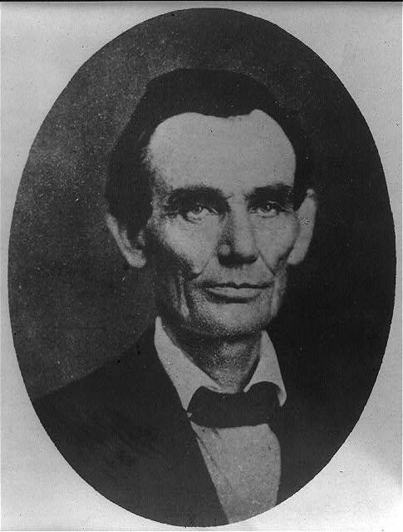
Title - [Abraham Lincoln while a traveling lawyer, taken in Danville, Illinois
Creator(s) - Joslin, Amon T., photographer
Date Created/Published - 1857 May 27 [printed later]
Bookmark - http://www.loc.gov/pictures/item/2008678328/
Summary - Photo as a lawyer.

Slide 14
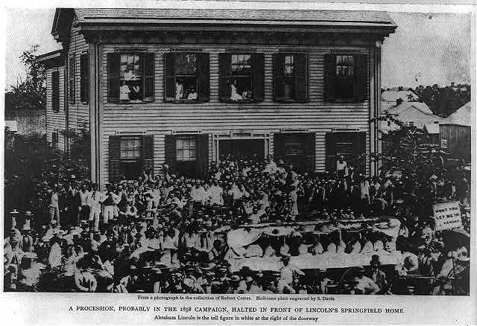
Title - [Abraham Lincoln at his home in Springfield, Illinois, with a large crowd of people gathered outside after a Republican rally, August 8, 1860]
Creator(s) - Shaw, William, photographer
Date Created/Published - [between 1900 and 1930]
Bookmark - http://www.loc.gov/pictures/item/2009630655/
Summary – Group of people at Lincoln’s house in Springfield after a republican rally

Slide 15
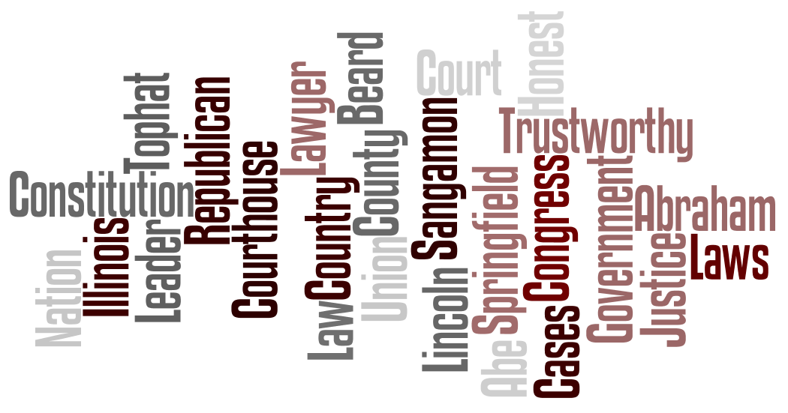
Wordle

