Slide 1
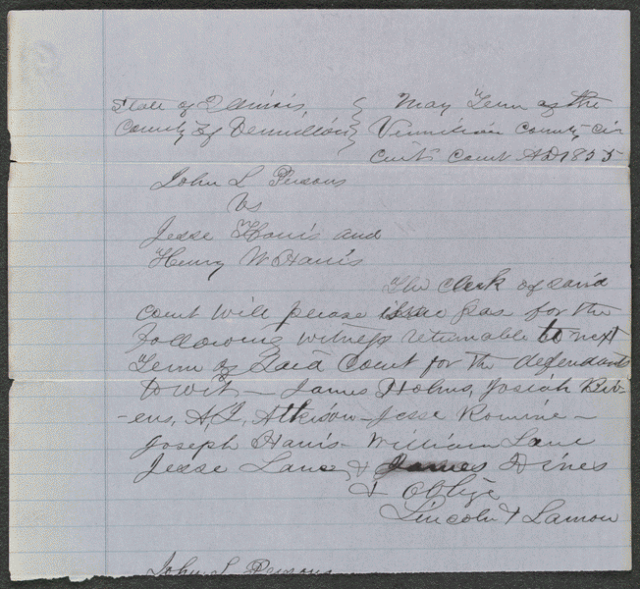
lprbscsm scsm1446 http://hdl.loc.gov/loc.rbc/lprbscsm.scsm1446
Summary: In 1854, Persons agreed to rent an eighty-acre farm to Jesse Harris and Henry Harris in return for one-third of the corn crop. After the Harrises failed to plant any corn, Persons sued for breach of contract, seeking $400 in damages. The jury found for Persons and awarded $45. Lincoln represented the Harrises.

Slide 2
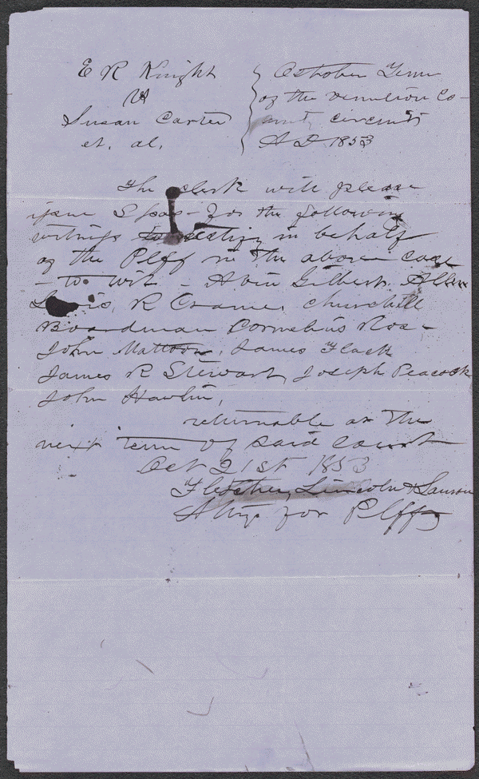
lprbscsm scsm1564 http://hdl.loc.gov/loc.rbc/lprbscsm.scsm1564
Summary: Knight retained Lincoln and sued the heirs of Washington Carter to settle a partnership. Carter and Knight had been partners in selling land and livestock and in farming. The court appointed three commissioners to partition the estate's 615 acres. The commissioners assigned dower to Carter's widow, Susan Boardman; gave Knight one-half of the land; and partitioned the remaining land in equal shares for Carter's three minor heirs.

Slide 3
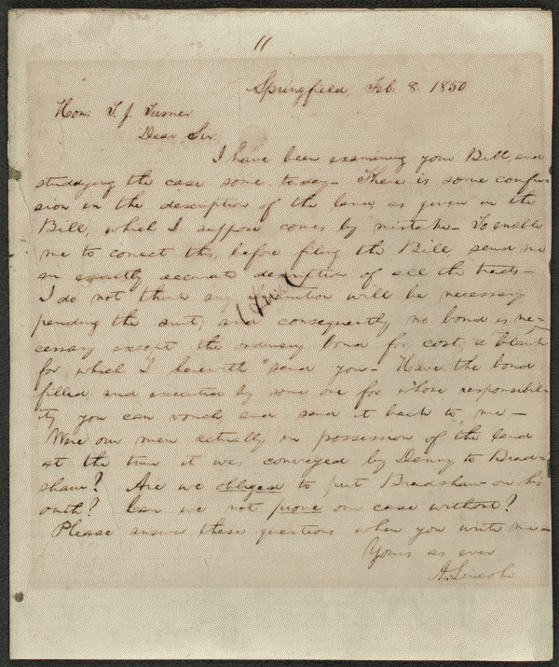
http://memory.loc.gov/cgi-bin/query/D?scsmbib:2:./temp/~ammem_10Wt::
Notes
Provenance Note: October 3, 1961 note on transcription: This is the last letter I sold to Mr. Stern. I sold it the day he died. King Hostick.
Provenance Note: This letter is listed in the Collected Works of Abraham Lincoln. In the Collected Works they identify it as a case in the United States District Court in which Lincoln was involved.

Slide 4
