Slide 1
Abraham Lincoln
By LeRoy Rosenohm

Slide 2
- Abraham Lincoln to Thomas J. Turner in Kemper v. Adams & Bovey, [Law papers].
http://hdl.loc.gov/loc.rbc/lprbscsm.scsm1602
Author/Creator
Author: Lincoln, Abraham
Created/Published
February 08, 1850
Springfield, Illinois
Provenance Note: October 3, 1961 note on transcription: This is the last letter I sold to Mr. Stern. I sold it the day he died. King Hostick.
Provenance Note: This letter is listed in the Collected Works of Abraham Lincoln. In the Collected Works they identify it as a case in the United States District Court in which Lincoln was involved.

Slide 4
Attorney's Notes in People v. McGregor & Lawrence, [Law papers].
http://hdl.loc.gov/loc.rbc/lprbscsm.scsm1488
Author/Creator
Author: Lincoln, Abraham
Created/Published
October 29, 1858
Illinois
Notes
Appears to be in Lincoln's hand.
Summary: The state's attorney indicted McGregor for forgery. Lawrence signed as a surety on McGregor's recognizance bond. McGregor failed to appear, and the court ruled that McGregor had forfeited the recognizance. The state's attorney sued McGregor and Lawrence to recover the $100 penalty on the bond. Lawrence retained Lincoln and claimed that there was a variance between the record of judgment and the writ of scire facias. The court quashed the writ of scire facias and continued the case. The resolution of the case is unknown.

Slide 6
Amended Replication in Kellogg v. Crain, [Law papers].
http://hdl.loc.gov/loc.rbc/lprbscsm.scsm1374
Author/Creator
Author: Lincoln, Abraham
Created/Published
January 23, 1836
Notes
Appears to be in Lincoln's hand.
Summary: Kellogg and Lewis Crain dissolved their business partnership, but Crain owed Kellogg $16,000 to pay off the business's debts. Crain died before paying, and Kellogg sued James Crain, who served as surety for Lewis Crain, in an action of debt for $16,000. The court granted a change of venue to Peoria County, but the court there remanded the case back to Tazewell County. Kellogg retained Lincoln but failed to appear, and the court dismissed the case. Kellogg motioned to reinstate the case because he was ill and could not attend court. The court set aside the dismissal and ruled for Kellogg for $16,000.

Slide 8
• [Abraham Lincoln, Congressman-elect from Illinois. Three-quarter length portrait, seated, facing front]
http://hdl.loc.gov/loc.pnp/cph.3g02439
Title: [Abraham Lincoln, Congressman-elect from Illinois. Three-quarter length portrait, seated, facing front]
Creator(s): Shepherd, Nicholas H., photographer
Date Created/Published: [Springfield, Ill., 1846 or 1847]
Summary: This daguerreotype is the earliest-known photograph of Abraham Lincoln, taken at age 37 when he was a frontier lawyer in Springfield and Congressman-elect from Illinois. (Source: Ostendorf, p. 4)
Notes:
Attributed to Nicholas H. Shepherd, based on the recollections of Gibson W. Harris, a law student in Lincoln's office from 1845 to 1847. (Source: Gibson William Harris, "My Recollections of Abraham Lincoln," Women's Home Companion (November 1903), 9-11.) Robert Lincoln, son of the President, thought the photo was made in either St. Louis or Washington during his father's term in Congress.

Slide 10
Abraham Lincoln while a traveling lawyer, taken in Danville, Illinois
Digital ID http://hdl.loc.gov/loc.pnp/cph.3a18603
Title: [Abraham Lincoln while a traveling lawyer, taken in Danville, Illinois
Creator(s): Joslin, Amon T., photographer
Date Created/Published: 1857 May 27 [printed later]
Notes:
Illus. in: The Photographs of Abraham Lincoln / Frederick Hill Meserve. New York, Privately printed, 1911, p. 43.
Original photograph: The original ambrotype is at the Illinois State Historical Library.
Ostendorf, no. 3
Meserve, no. 2

Slide 12
Digital ID-http://hdl.loc.gov/loc.pnp/cph.3c21969
• Title: Lincoln the lawyer / Frederick T. Stuart.
• Creator(s): Stuart, Frederick T., 1837-1913, etcher
• Summary: Abraham Lincoln, head-and-shoulders portrait, facing right.
• Notes:
o Etching after a painting(?) by Hessler.

Slide 13
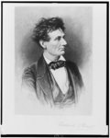

Slide 14
[Mary Todd Lincoln, wife of Abraham Lincoln. Three-quarter length portrait, seated, facing front]
Digital ID: (digital file from color film copy transparency) cph 3g06189 http://hdl.loc.gov/loc.pnp/cph.3g06189
Creator(s): Shepherd, Nicolas H., photographer
Date Created/Published: [1846 or 1847]

Slide 15
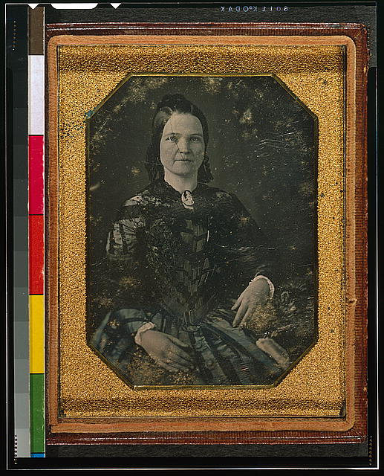

Slide 16
Home of Abraham Lincoln
• Date Created/Published: [no date recorded on shelflist card]
• Digital ID: (b&w film copy neg.) cph 3a05803 http://hdl.loc.gov/loc.pnp/cph.3a05803

Slide 17
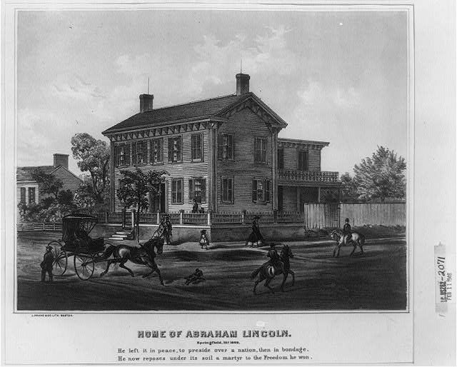

Slide 18
• Title: Mrs. Abraham Lincoln
• Date Created/Published: [between 1855 and 1865]
•Digital ID: (digital file from original neg.) cwpbh 01023 http://hdl.loc.gov/loc.pnp/cwpbh.01023

Slide 19
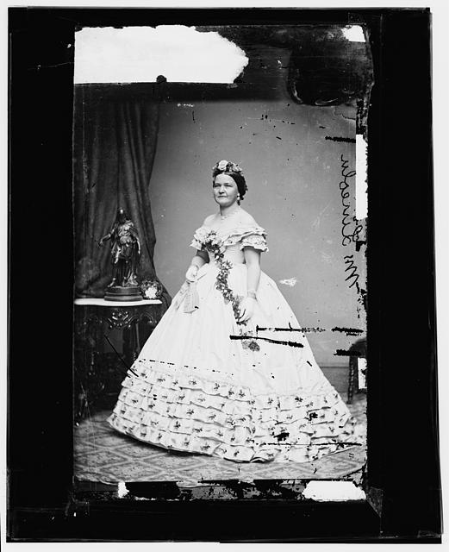

Slide 20
[Abraham Lincoln, half-length portrait, facing right]
• Date Created/Published: [probably 1858, printed later]
• Summary: Photo shows Abraham Lincoln in an image that was widely reproduced on presidential campaign ribbins in 1860. Lincoln reportedly liked the photograph and often signed prints for admirers. (Source: Ostendorf, p. 29)
• Notes:
o Original photograph (an ambrotype?) probably by Roderick M. Cole, Peoria, Illinois, or Preston Butler of Springfield, Illinois.
o Digital ID: (digital file from b&w film copy neg.) cph 3a09457 http://hdl.loc.gov/loc.pnp/cph.3a09457

Slide 21
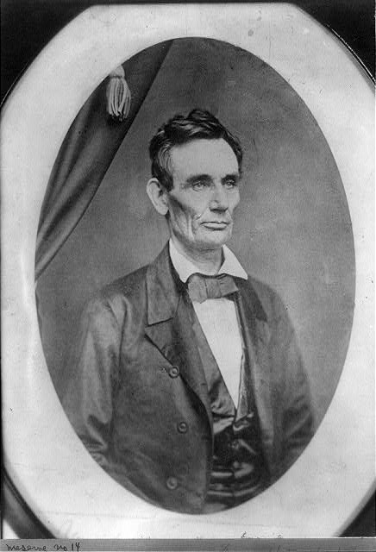

Slide 22
Court house
Date Created/Published: New York : The Albertype Co., c1897.
Summary: Print showing exterior view of the courthouse in Lincoln, Nebraska; includes a bust portrait of Abraham Lincoln, facing right, in oval, in upper right corner.
Digital ID: (digital file from original item) ppmsca 19594 http://hdl.loc.gov/loc.pnp/ppmsca.19594

Slide 23
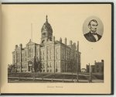

Slide 24
The Posey Building of Shawneetown, Illinois, in which Abraham Lincoln and Robert Ingersoll had law offices
Creator(s): Lee, Russell, 1903-1986, photographer
Date Created/Published: 1937 Apr.
Digital ID: (intermediary roll film) fsa 8c51242 http://hdl.loc.gov/loc.pnp/fsa.8c51242

Slide 25
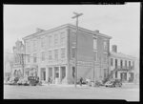

Slide 26
An old grocery building and the Posey Building where Abraham Lincoln and Robert Ingersoll had law offices. Shawneetown, Illinois
Creator(s): Lee, Russell, 1903-1986, photographer
Date Created/Published: 1937 Apr.
Digital ID: (intermediary roll film) fsa 8c51243 http://hdl.loc.gov/loc.pnp/fsa.8c51243

Slide 27
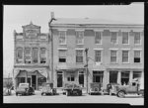

Slide 28
