Slide 1
Abraham Lincoln
Meredith Fahey

Slide 2
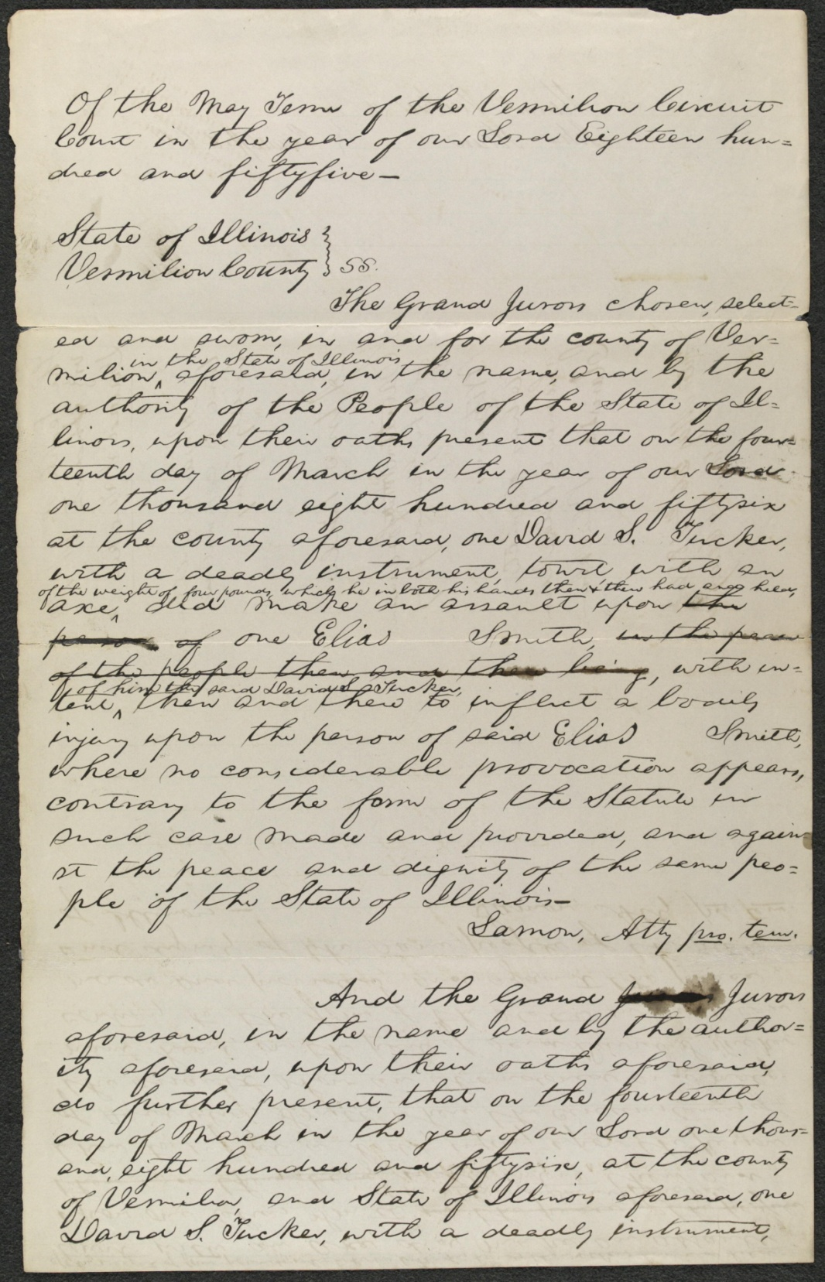
Created/Published
May 26, 1856 Vermilion County, Illinois
Notes
Appears to be in Lincoln's hand.
Summary: The state's attorney indicted Tucker for assaulting Smith with a four-pound axe. Tucker pleaded guilty, and the court fined him $75. Lincoln wrote the indictment for state's attorney Lamon.
Digital ID
lprbscsm scsm1468 http://hdl.loc.gov/loc.rbc/lprbscsm.scsm1468

Slide 3
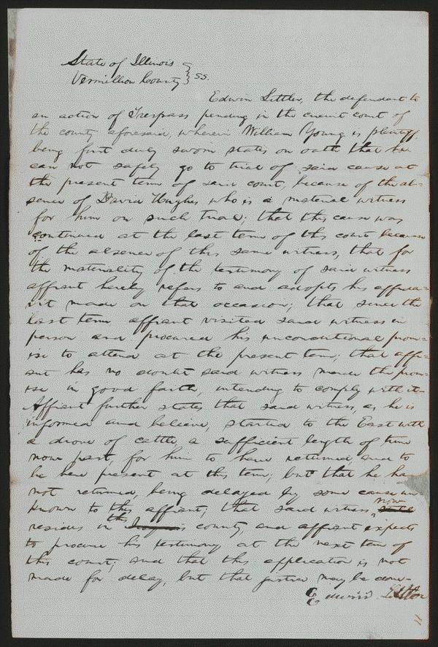
Created/Published
October 21, 1850 Vermilion County, Illinois
Notes
Summary: Young sued Littler for $1,000 for assault and battery. The fight occurred on Young's property after Littler claimed that a hog belonged to him. Littler, represented by Lincoln, pleaded self-defense and claimed that Young had tried to assault him with a gun and a club. Young died, and his attorney abated the case.
Digital ID
lprbscsm scsm1443 http://hdl.loc.gov/loc.rbc/lprbscsm.scsm1443

Slide 4
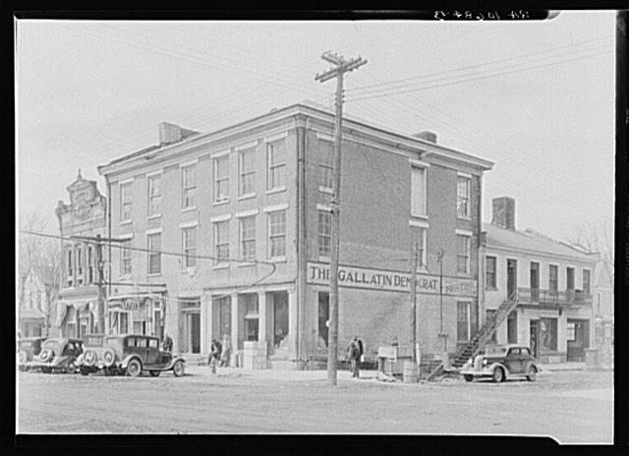
Title: The Posey Building of Shawneetown, Illinois, in which Abraham Lincoln and Robert Ingersoll had law offices
Creator(s): Lee, Russell, 1903-1986, photographer
Date Created/Published: 1937 Apr
http://www.loc.gov/pictures/item/fsa1998022486/PP
/

Slide 5
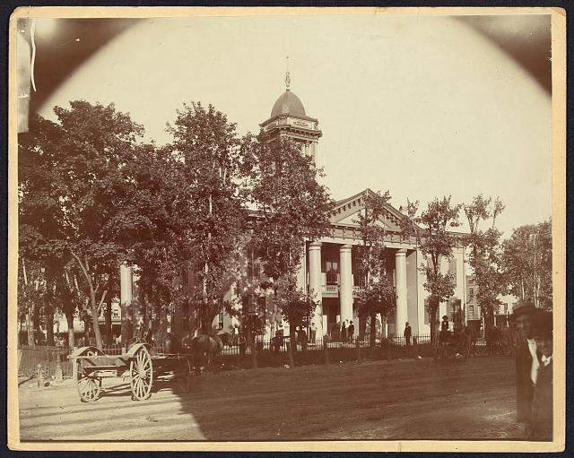
Title: The Coles County Court House in Charleston, Ills., in which Lincoln often practiced law and before which he made a short speech in the evening after his fourth joint debate with Douglas, Sept. 18, 1858
Date Created/Published: [between 1860 and 1898?] http://www.loc.gov/pictures/item/2008680974/

Slide 6
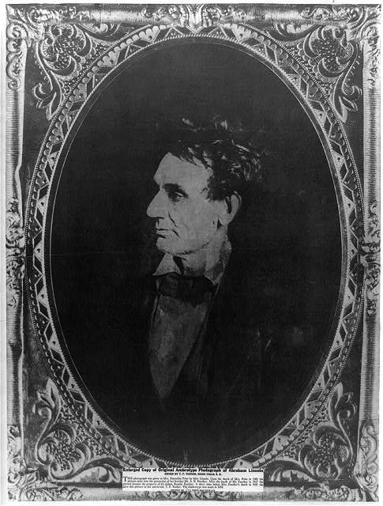
Title: [Abraham Lincoln, immediately prior to Senate nomination, Chicago, Illinois]
Creator(s): Hesler, Alexander, 1823-1895, photographer
Date Created/Published: [1857 February 28, printed later]
http://www.loc.gov/pictures/item/2008678332/

Slide 7
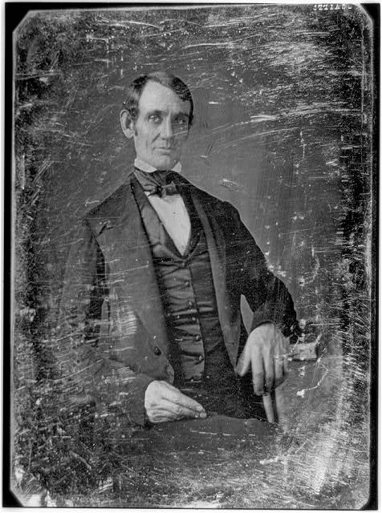
Title: [Abraham Lincoln, Congressman-elect from Illinois. Three-quarter length portrait, seated, facing front]
Creator(s): Shepherd, Nicholas H., photographer
Date Created/Published: [Springfield, Ill., 1846 or 1847]
http://www.loc.gov/pictures/item/2004664400/

Slide 8
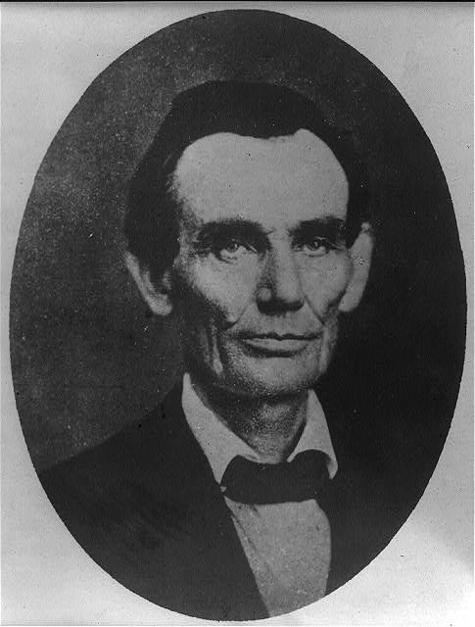
Title: [Abraham Lincoln while a traveling lawyer, taken in Danville, Illinois
Creator(s): Joslin, Amon T., photographer
Date Created/Published: 1857 May 27 [printed later]
http://www.loc.gov/pictures/item/2008678328/

Slide 9
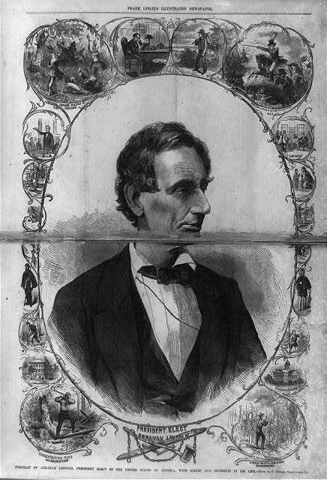
Title: President elect, Abraham Lincoln Portrait of Abraham Lincoln, President Elect of the United States of America, with scenes and incidents in his life -- phot. by P. Butler, Springfield, Ill.
Date Created/Published: 1861 March 9.
http://www.loc.gov/pictures/item/2003674537/

Slide 10
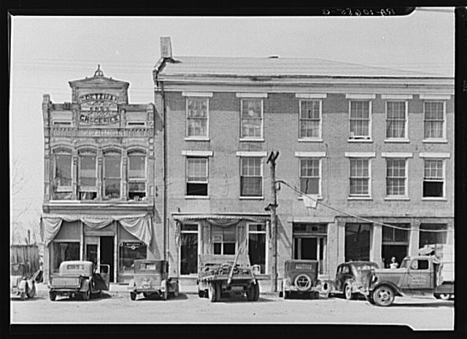
Title: An old grocery building and the Posey Building where Abraham Lincoln and Robert Ingersoll had law offices. Shawneetown, Illinois
Creator(s): Lee, Russell, 1903-1986, photographer
Date Created/Published: 1937 Apr. http://www.loc.gov/pictures/item/fsa1998022487/PP/

Slide 11
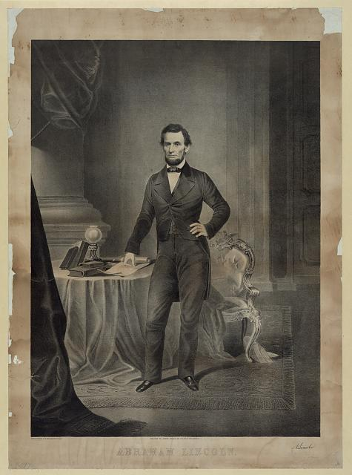
Title: Abraham Lincoln / Herline & Hensel, lith. 632 Chestnut St., Phila.
Creator(s): Herline & Hensel.,
Date Created/Published: Philadelphia : Published by Joseph Hoover, 108 Sth. 8th St., [between 1860 and 1865]
http://www.loc.gov/pictures/item/2006677676/

Slide 12
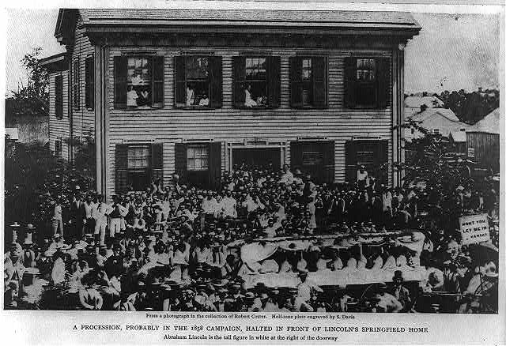
Title: [Abraham Lincoln at his home in Springfield, Illinois, with a large crowd of people gathered outside after a Republican rally, August 8, 1860]
Creator(s): Shaw, William, photographer
Date Created/Published: [between 1900 and 1930]
http://www.loc.gov/pictures/item/2009630655/

Slide 13
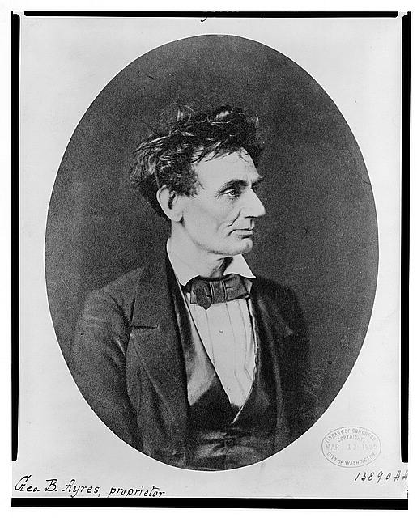
Title: [Abraham Lincoln: Immediately prior to Senate nomination, Chicago, Illinois]
Creator(s): Hesler, Alexander, 1823-1895, photographer
Date Created/Published: [1857 February 28, printed later]
http://www.loc.gov/pictures/item/98504484/

