Slide 1
Lincoln Law

Slide 2
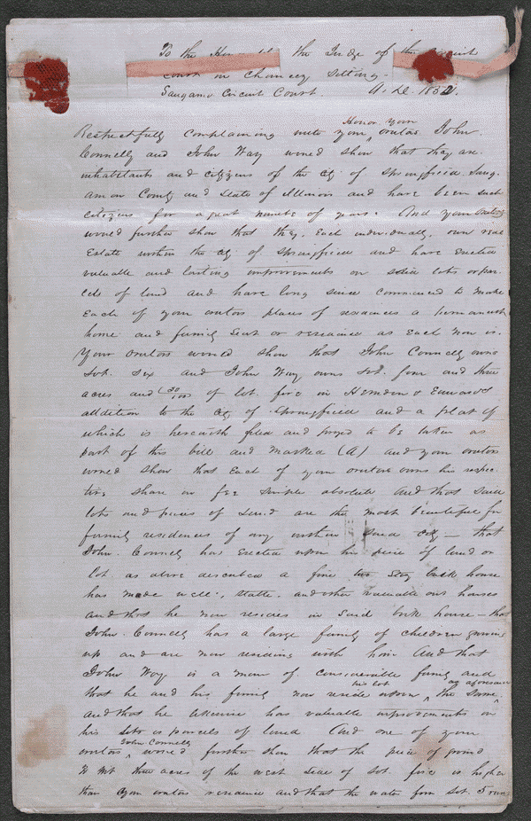
Connelly and Way retained Lincoln and Herndon and sued Van de Velde, Kavanaugh, and Myers in an action for an injunction. Connelly and Way owned two lots with residences and out buildings in Herndon and Edwards's addition to Springfield, Illinois. Way agreed to sell Myers three acres for $50. Myers intended to plant a garden on the land. However, Myers had the deed made out to Kavanaugh, who sold the land to Bishop Van de Velde of the Chicago diocese. Connelly and Way sued for an injunction after they discovered that Van de Velde intended to use the property as a cemetery for Springfield Catholics. The complainants charged that the proposed cemetery created a nuisance. Connelly claimed that the burial ground would be within forty feet of his residence, and both complainants charged that drainage from the intended cemetery would contaminate their wells.
Digital ID-lprbscsm scsm1532 http://hdl.loc.gov/loc.rbc/lprbscsm.scsm1532

Slide 3
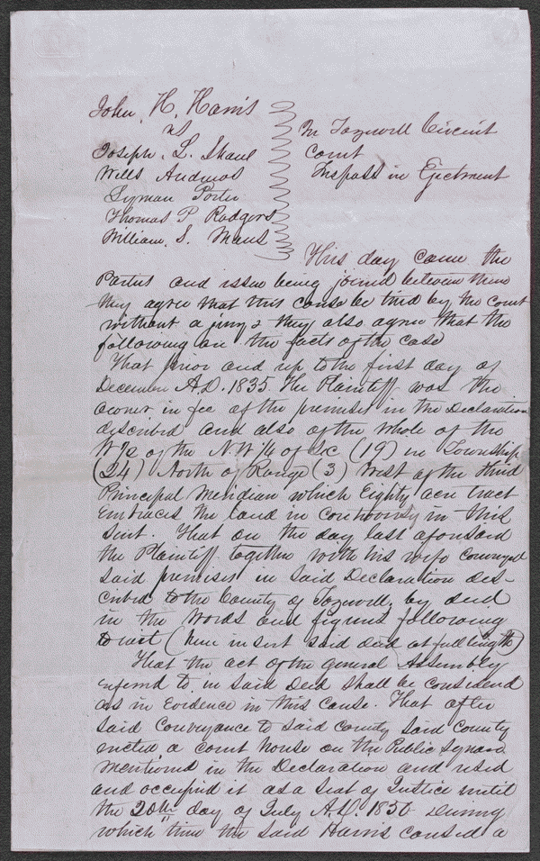
In 1835, Harris donated twenty acres of land in Tremont, Illinois, to Tazewell County for the erection of the county courthouse. In 1849, the legislature authorized the removal of the county seat to Pekin, Illinois, and specified that the Tremont courthouse be used for education. Harris retained Lincoln and sued to recover the property from the school trustees, but the circuit court ruled for the trustees. Harris appealed to the Illinois Supreme Court, and Lincoln argued that the land had been given on the condition that it be used as the county seat. The supreme court rejected Lincoln's argument and affirmed the judgment. Justice Trumbull ruled that Harris had given the land unconditionally, but had "the land been granted upon condition that it should be used for a particular purpose, it would unquestionably have reverted to the donor when it ceased to be thus used.“
Digital ID-lprbscsm scsm1525 http://hdl.loc.gov/loc.rbc/lprbscsm.scsm1525

Slide 4
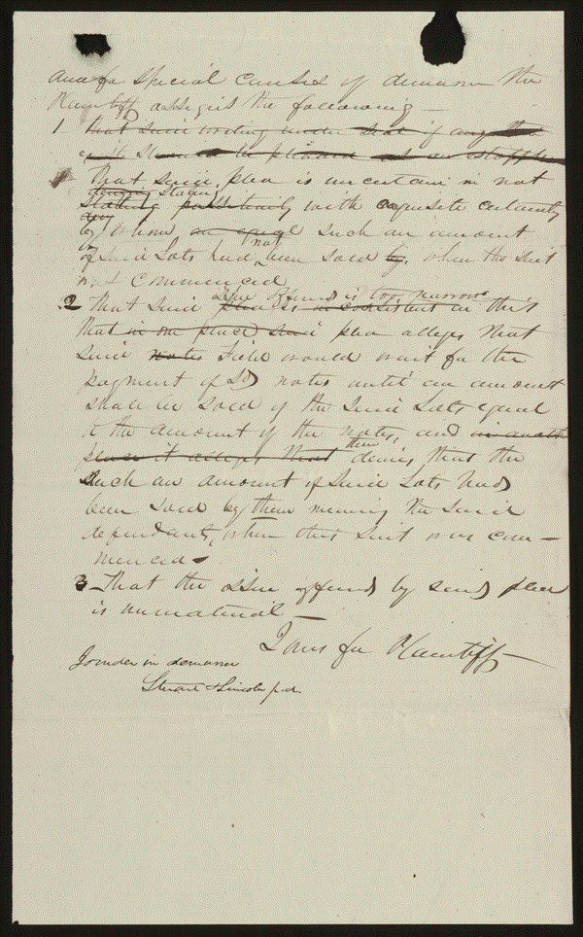
In 1837, Averill and Low purchased sixty town lots in Pekin, Illinois, from Field for $700 and gave two promissory notes of $400 and $300 in payment. The parties further agreed that Averill and Low would give half the proceeds from the sale of their sixty lots to Field and that Field would pay Averill and Low half of the proceeds from the sale of sixty additional lots. Field also agreed to wait for payment of the notes, in disregard of specified due dates, until Averill and Low had sold enough lots to pay the notes in full. Field assigned the $400 note to Dow, who sued after Averill and Low failed to pay by the due date. Averill and Low retained Stuart and Lincoln, who used the written contract as evidence to prove that there had been no breach of contract. The court ruled for Averill and Low, and Dow appealed to the Illinois Supreme Court. Averill and Low retained Lincoln for the appeal, and Lincoln moved to dismiss the appeal because Dow had failed to assign his errors according to the rule of the court. The supreme court accepted the motion and dismissed the appeal.
Digital ID-lprbscsm scsm1383 http://hdl.loc.gov/loc.rbc/lprbscsm.scsm1383

Slide 5
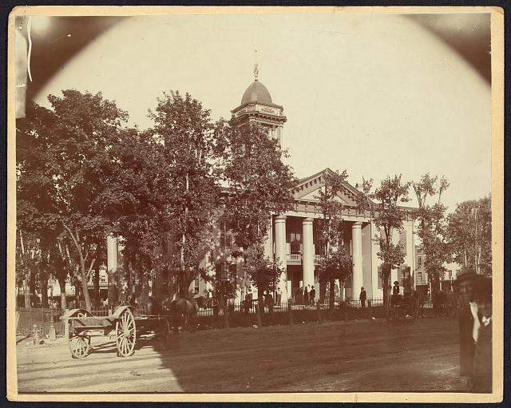
The Coles County Court House in Charleston, Ills., in which Lincoln often practiced law and before which he made a short speech in the evening after his fourth joint debate with Douglas, Sept. 18, 1858 http://www.loc.gov/pictures/item/2008680974/

Slide 6
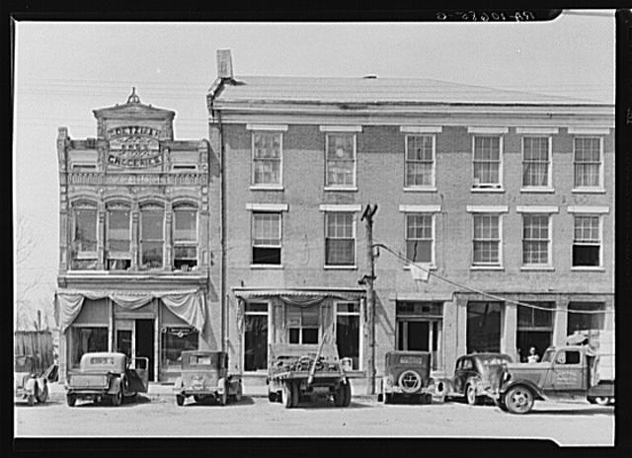
An old grocery building and the Posey Building where Abraham Lincoln and Robert Ingersoll had law offices. Shawnee town, Illinois
Lee, Russell, 1903-1986, photographer . Created/Published: 1937 Apr.
http://www.loc.gov/pictures/item/fsa1998022487/PP/

Slide 7
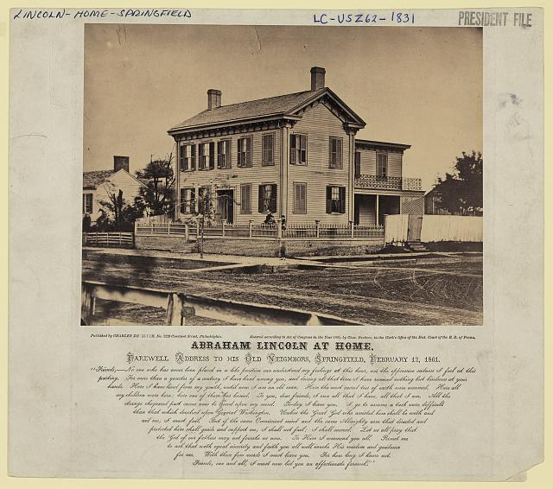
Photo shows the house where Abraham Lincoln lived in Springfield, Illinois, with presidential candidate Abraham Lincoln standing on the terrace, with his sons Willie and Tad. Whipple, John Adams, 1822-1891, photographer
http://www.loc.gov/pictures/item/2009630661/

Slide 8
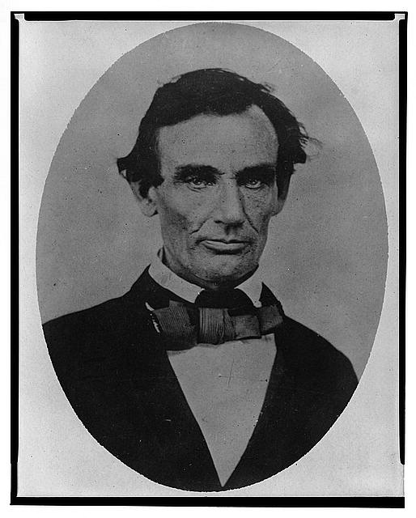
taken in Pittsfield, Illinois, two weeks before the final Lincoln-Douglas debate in Lincoln's unsuccessful bid for the Senate, October 1, 1858 Jackson, Calvin, fl. 1858-1882, photographer http://www.loc.gov/pictures/item/98504517

Slide 9
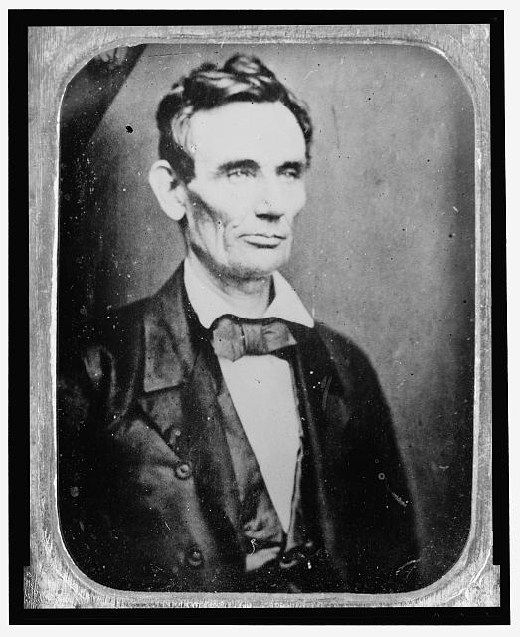
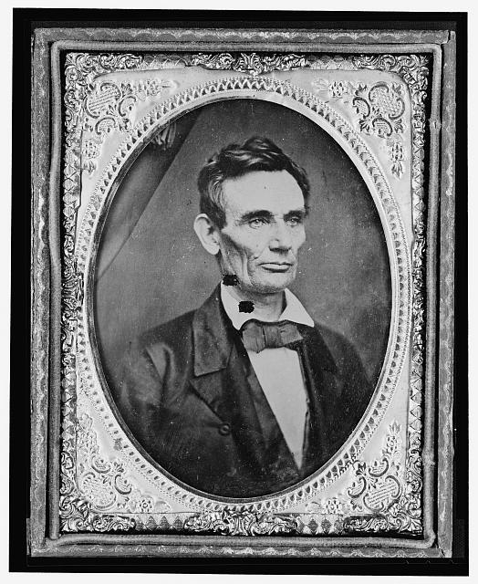
Photo shows Abraham Lincoln in an image that was widely reproduced on presidential campaign ribbons in 1860. Lincoln reportedly liked the photograph and often signed prints for admirers. probably 1858, copied laterhttp://www.loc.gov/pictures/item/2009630652/

Slide 10
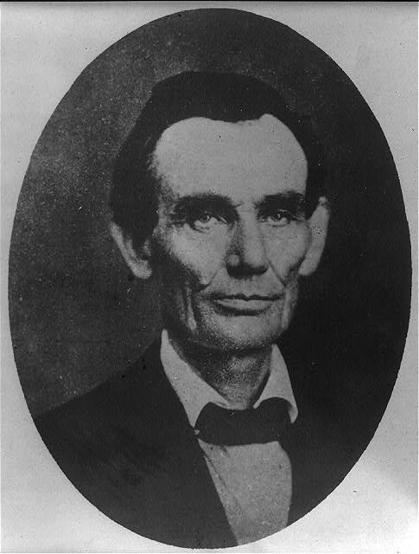
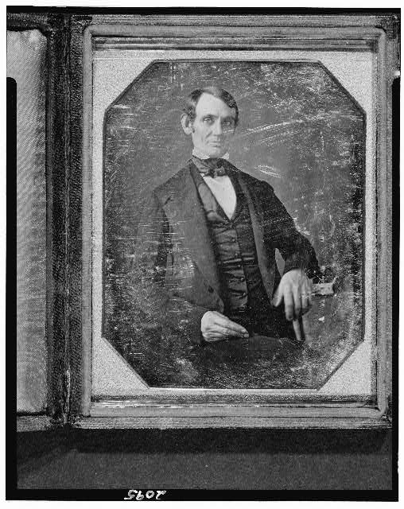
Abraham Lincoln, Congressman-elect from Illinois. Shepherd, Nicholas H., photographer This daguerreotype is the earliest-known photograph of Abraham Lincoln, taken at age 37 when he was a frontier lawyer in Springfield and Congressman-elect from Illinois. http://www.loc.gov/pictures/item/2004664400/
Abraham Lincoln while a traveling lawyer, taken in Danville, Illinois Joslin, Amon T.,photographer Springfield, Ill., 1846 or 1847 http://www.loc.gov/pictures/item/2008678328/

