Slide 1
Lincoln and The Law
By: Rebekah Schultz

Slide 2
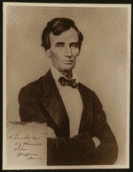
[Reproduction print of Lincoln with signature insert at lower left.]
http://hdl.loc.gov/loc.rbc/lprbscsm.scsm0930

Slide 3
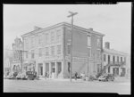
The Posey Building of Shawneetown, Illinois, in which Abraham Lincoln and Robert Ingersoll had law offices
http://hdl.loc.gov/loc.pnp/fsa.8c51242

Slide 4
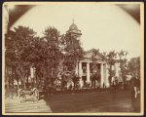
Title: The Coles County Court House in Charleston, Ills., in which Lincoln often practiced law and before which he made a short speech in the evening after his fourth joint debate with Douglas, Sept. 18, 1858
Date Created/Published: [between 1860 and 1898?]
Summary: Photograph showing courthouse with people and horse-drawn wagons in front
http://www.loc.gov/pictures/item/2008680974/

Slide 5
Title: William Henry Herndon, 1818-1891
http://www.loc.gov/pictures/item/2004668443/

Slide 6
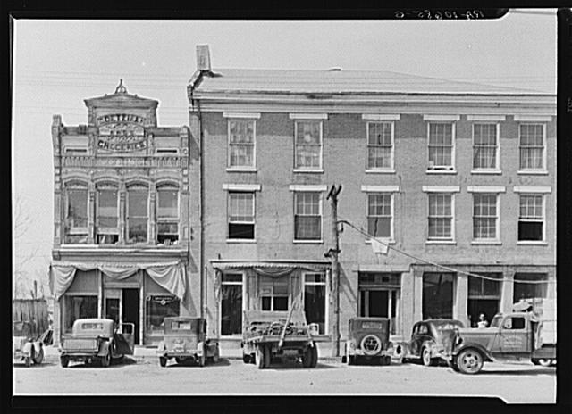
An old grocery building and the Posey Building where Abraham Lincoln and Robert Ingersoll had law offices. Shawneetown, Illinois
http://www.loc.gov/pictures/item/fsa1998022487/PP/

Slide 7
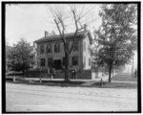
Lincoln's residence, Springfield, Ill
http://www.loc.gov/pictures/item/det1994014868/PP/

Slide 8
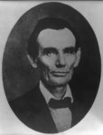
Title: [Abraham Lincoln while a traveling lawyer, taken in Danville, Illinois
Creator(s): Joslin, Amon T., photographer
http://www.loc.gov/pictures/item/2008678328/

Slide 9
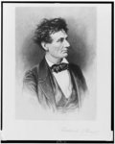
Title: Lincoln the lawyer / Frederick T. Stuart.
http://www.loc.gov/pictures/item/98517810/

Slide 10
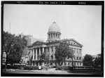
HISTORIC AMERICAN BUILDINGS SURVEY CLARK BULLARD, PHOTOGRAPHER JULY 13, 1935. VIEW FROM SOUTH EAST - Old State House, Springfield, Sangamon County, IL
http://www.loc.gov/pictures/item/il0202.photos.064077p/

Slide 11
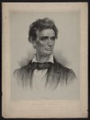
Title: Abraham Lincoln from a portrait taken from life by Charles A. Barry, Springfield, Illinois, June 1860 / on stone by J.E. Baker ; J.H. Bufford's Lith. 313 Washington St. Boston.
Creator(s): J.H. Bufford's Lith.,
http://www.loc.gov/pictures/item/2006680102/

Slide 12
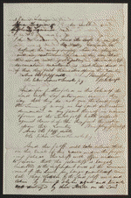
Court Case
Summary: Sherer sued Lawrence in JP court in an action of forcible detainer, to evict him from the Jordan farm, one-and-a-half miles west of Georgetown. The jury granted the eviction. Lawrence appealed to the circuit court, and Sherer retained Lincoln. The court ruled for Sherer and granted a writ of restitution.
http://hdl.loc.gov/loc.rbc/lprbscsm.scsm1437

Slide 13
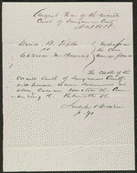
Court Case
Summary: Browning allegedly seduced fourteen-year-old Mary Tipton, and she gave birth to an illegitimate child. David Tipton retained Lincoln and Herndon and sued Browning for seduction because Tipton lost the services of his daughter while she was pregnant. Tipton requested $5,000 in damages. Tipton later dismissed the case.
http://hdl.loc.gov/loc.rbc/lprbscsm.scsm1485

Slide 14
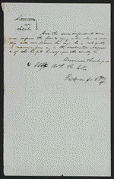
Court Case
Summary: Saltonstall allegedly took a piece of iron and assaulted Selak. Selak was incapacitated for five weeks and was unable to transact any business. He also spent a great deal of money to restore his health. Selak sued Saltonstall in an action of trespass seeking $500. Saltonstall retained Lincoln and pleaded not guilty. A jury found for Selak and awarded $15 in damages.
http://hdl.loc.gov/loc.rbc/lprbscsm.scsm1442

Slide 15
Wordle

