Slide 1
Abraham Lincoln
Illinois Lawyer

Slide 2
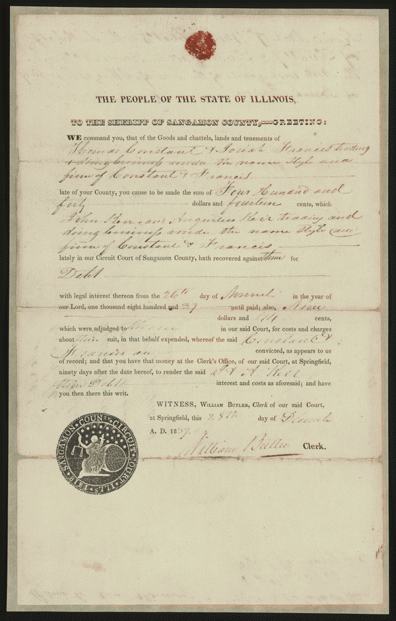
Lawsuit- Constant & Francis vs. John and Augustus Kerr and Company
Digital ID: lprbscsm scsm1386 http://hdl.loc.gov/loc.rbc/lprbscsm.scsm1386
Constant and Francis gave John and Augustus Kerr and Company a promissory note for $522.55 but failed to pay. John and Augustus Kerr and Co. retained Stuart and Lincoln and sued Constant and Francis in an action of assumpsit to recover the debt. Constant and Francis failed to appear, and the court ruled for John and Augustus Kerr and Co. and awarded $440.14 in damages. The court sold three lots in Athens, Illinois, that Francis owned to John and Augustus Kerr and Co. for $300 to satisfy the judgment.

Slide 3
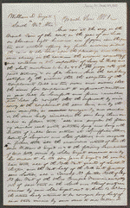
Enyart vs. McAtee
Digital ID: lprbscsm scsm1516 http://hdl.loc.gov/loc.rbc/lprbscsm.scsm1516
Enyart retained Lincoln and Herndon and sued McAtee to set aside a land sale. Enyart charged that McAtee used terror and intoxication to persuade him to sell ninety acres of land, valued at $1,000, to McAtee for $350. The court ruled for Enyart, voided the deed, and ordered McAtee to re-convey the property to Enyart. McAtee appealed to the Illinois Supreme Court, which affirmed the judgment. Chief Justice Treat stated that, as a general rule, the courts did not set aside land conveyances because of an inadequate price. A chancery court "will not rescind an executed contract merely because the consideration was inadequate." However, Treat reasoned, "fraud, mistake, or undue influence" were proper grounds for annulling a land sale. Treat believed that McAtee exercised "fraudulent practices" and "undue influence" through terror and intoxication to obtain Enyart's land. Treat recounted that McAtee pressured Enyart to sell the land and to flee the area to avoid imprisonment. The state's attorney had indicted Enyart for stealing a pair of shoes, but Enyart had paid bail. At that point, Treat stated, McAtee took advantage of Enyart's youth and weak mind, plied him with liquor, pressured him to sell at the unfair price, and even offered to plan an escape route. "Finally," Treat wrote, "under the combined influence of intoxication and fear," Enyart sold the land. Treat concluded: "It is very evident that but for these expedients the purchase could not have been effected....Barely competent at any time to transact business discreetly, and peculiarly disqualified on that occasion by intoxication and terror, he [Enyart] was completely in the power of the defendant." Treat voided the deed because of McAtee's "improper influences" and "fraudulent practices," not because of the inadequate price.

Slide 4
Abraham Lincoln
[1857 February 28, printed later]
Digital ID: http://www.loc.gov/pictures/item/2008678332/

Slide 5
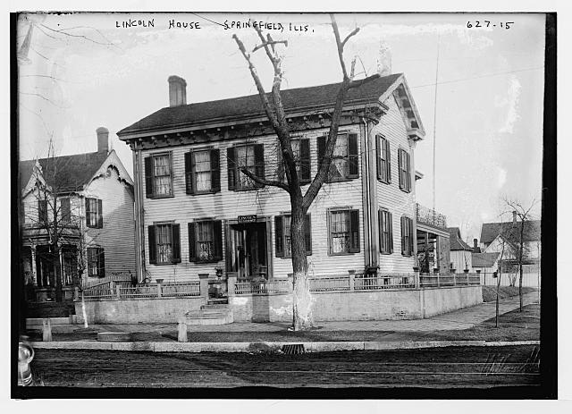
Abraham Lincoln’s House
Lincoln House, exterior, Springfield, Ill.
Digital ID: (digital file from original neg.) ggbain 03052 http://hdl.loc.gov/loc.pnp/ggbain.03052

Slide 6
Lincoln Reading to his son.
Lincoln reading the Bible to his son
Digital ID: http://www.loc.gov/pictures/item/2008680205/

Slide 7
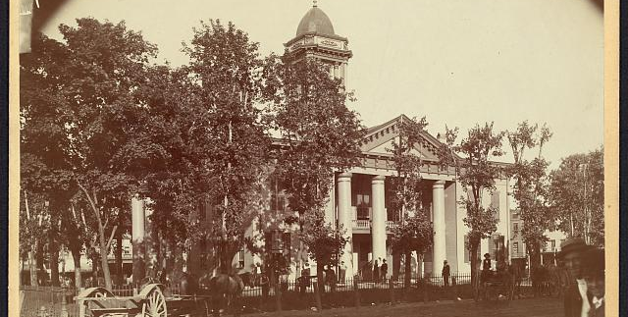
Coles County Court House
Charleston, Ills., where Lincoln often practiced law and before which he made a short speech in the evening after his fourth joint debate with Douglas, Sept. 18, 1858
Digital ID: http://www.loc.gov/pictures/item/2008680974/

Slide 8
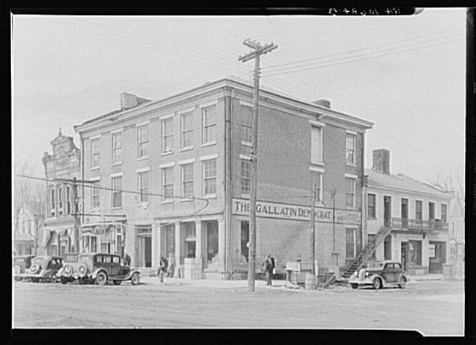
The Posey Building of Shawneetown, Illinois, in which Abraham Lincoln and Robert Ingersoll had law offices
Digital ID: http://www.loc.gov/pictures/item/fsa1998022486/PP/

Slide 9
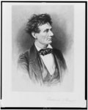
Lincoln the lawyer
Stuart, Frederick T., 1837-1913
Digital ID: (b&w film copy neg.) cph 3c21969 http://hdl.loc.gov/loc.pnp/cph.3c21969
Taken in 1865

Slide 10
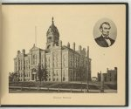
Abraham Lincoln Couthouse
New York : The Albertype Co., c1897. Digital ID:
http://www.loc.gov/pictures/item/2009630142/

Slide 11
House In Coles County
Digital ID: (b&w film copy neg.) cph 3b02670 http://hdl.loc.gov/loc.pnp/cph.3b02670

