Slide 1
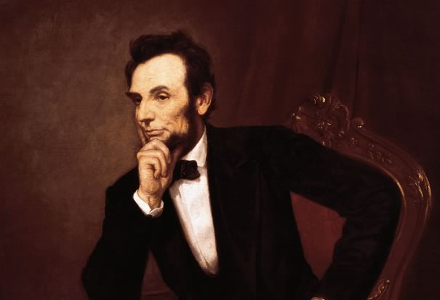
Abraham Lincoln

Slide 2
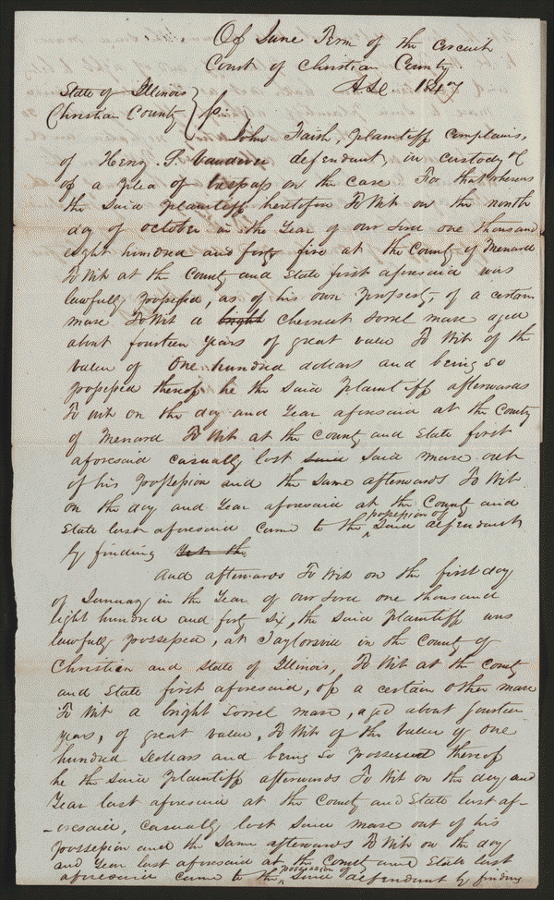
*Title: Declaration, Praecipe in Faith v. Vandeveer, [Law papers].
* Author/Creator:
Author: Abraham Lincoln Author: William Henry Herndon
*Summary: Faith retained Lincoln and Herndon and sued Vandeveer to recover a horse, seeking $100 in damages. Faith claimed that he owned the horse and that Vandeveer refused to return it. The court dismissed the case for lack of prosecution.
*Digital ID
lprbscsm scsm1430 http://hdl.loc.gov/loc.rbc/lprbscsm.scsm1430

Slide 3
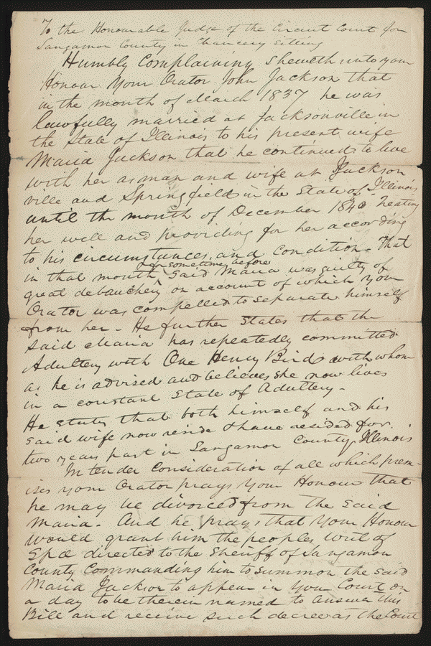
*Title: Bill for Divorce in Jackson v. Jackson, [Law papers].
*Author/Creator
Author: Abraham Lincoln Author: .Stephen T. Logan
*Summary: John Jackson retained Logan and Lincoln and sued Maria Jackson for divorce on the grounds of adultery. The court ruled for John Jackson and granted the divorce.
*Digital ID:
lprbscsm scsm1406 http://hdl.loc.gov/loc.rbc/lprbscsm.scsm1406

Slide 4
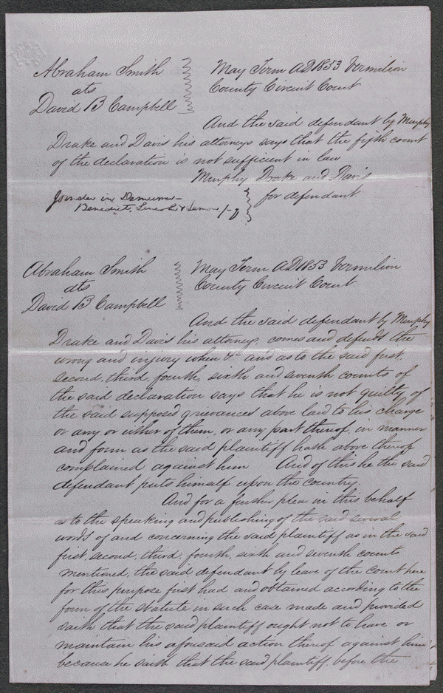
*Item Title
Demurrer, Plea in Smith v. Campbell, [Law papers].
*Author/Creator
Author: Murphy, Attny Author: Drake, Attrny Author: Davis, Attny
*Summary: Campbell sued Smith in an action of slander and requested $2,000 in damages. Campbell, the state's attorney, claimed that Smith publicly accused him of drunkenness, neglect of duty, and collusion by purposefully drawing defective indictments through which grocery owners might escape punishment for unlawfully selling liquor in quantities of less than one quart. Smith pleaded not guilty, but the jury found for Campbell and awarded $450. Smith appealed to the Illinois Supreme Court on the grounds that the verdict contradicted the evidence. The court dismissed the appeal after Smith failed to file the court record on time. Lincoln represented Campbell in the trial and the appeal
*Digital ID
lprbscsm scsm1554 http://hdl.loc.gov/loc.rbc/lprbscsm.scsm1554

Slide 5
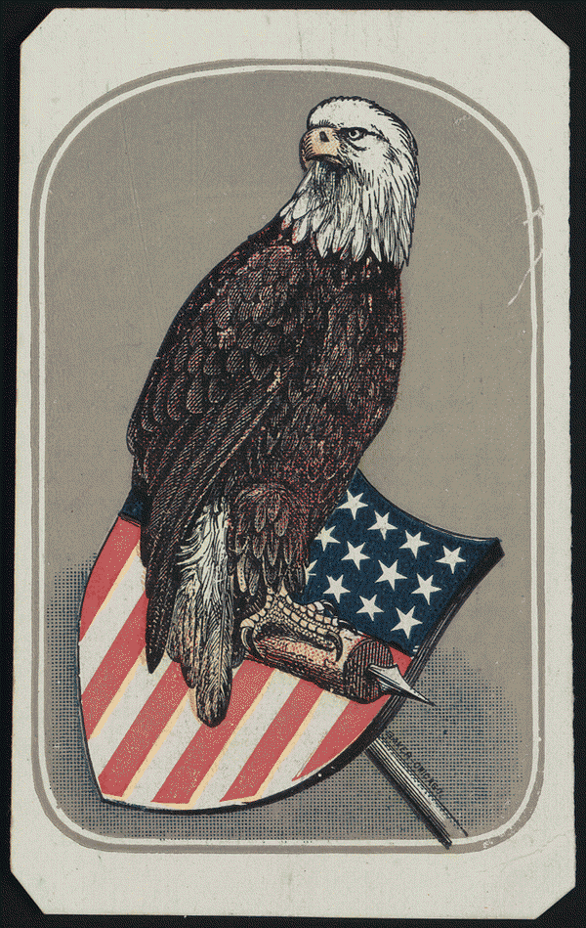
*Item Title
The new picture of the eagle.
*Created/Published
May 30, 1865 Chicago, Illinois Sewell & Spalding
*Digital ID
lprbscsm scsm0514 http://hdl.loc.gov/loc.rbc/lprbscsm.scsm0514

Slide 6
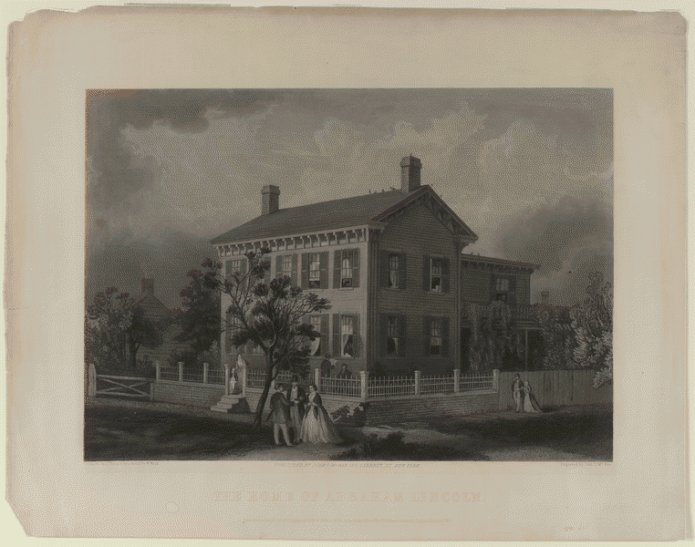
*Item Title
The home of Abraham Lincoln, [in Springfield, Illinois].
*Author/Creator
Engraver: John C. McRae Artist: Paul Dixon Artist: Waud Ward
*Digital ID
lprbscsm scsm0658 http://hdl.loc.gov/loc.rbc/lprbscsm.scsm0658

Slide 7
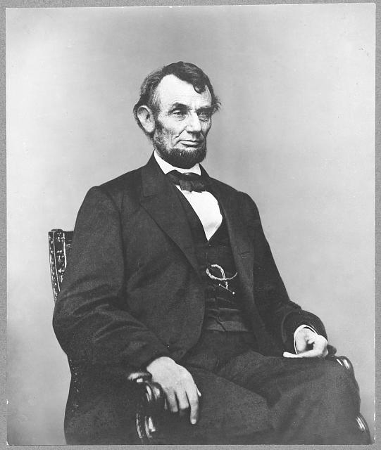
*Title: [Abraham Lincoln, three-quarter length portrait, seated, facing right; hair parted on Lincoln's right side]
*Other Title: [Five dollar bill portrait of Abraham Lincoln]
*Creator: Anthony Berger, photographer
*Notes:
*Portrait used for the engraved bust of Lincoln that appeared on the United States five dollar bill for many years, from 1914 to 2007.
*Published in: Lincoln's photographs: a complete album / by Lloyd Ostendorf. Dayton, OH: Rockywood Press, 1998, p. 176-7.
*Bookmark This Record: http://www.loc.gov/pictures/item/2009630693/

Slide 8
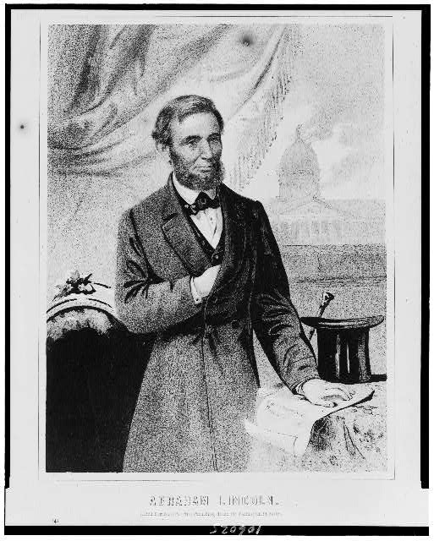
*Title: Abraham Lincoln
*Creator(s): Bufford, John H., lithographer
*Date Created/Published: Boston : Issued from Bufford's Publishing House, [c1862]
http://www.loc.gov/pictures/item/92519554/

Slide 9
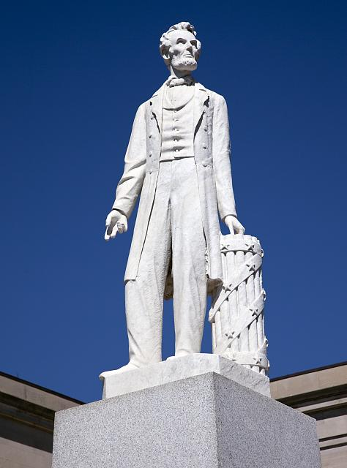
*Title: Abraham Lincoln statue at the Old District Courthouse, Indiana Ave. between 6th and 7th St., NW, Washington, D.C.
*Creator(s): Highsmith, Carol M., 1946-, photographer
http://www.loc.gov/pictures/item/2010641722/

Slide 10
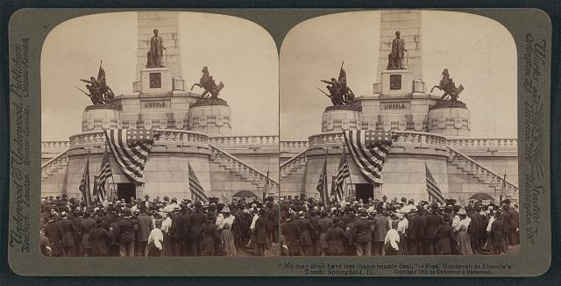
*Title: "No man shall have less than a square deal," - Pres. Roosevelt at Lincoln's Tomb, Springfield, Ill.
*Creator(s): Underwood & Underwood, publisher
http://www.loc.gov/pictures/item/2010647460/

Slide 11
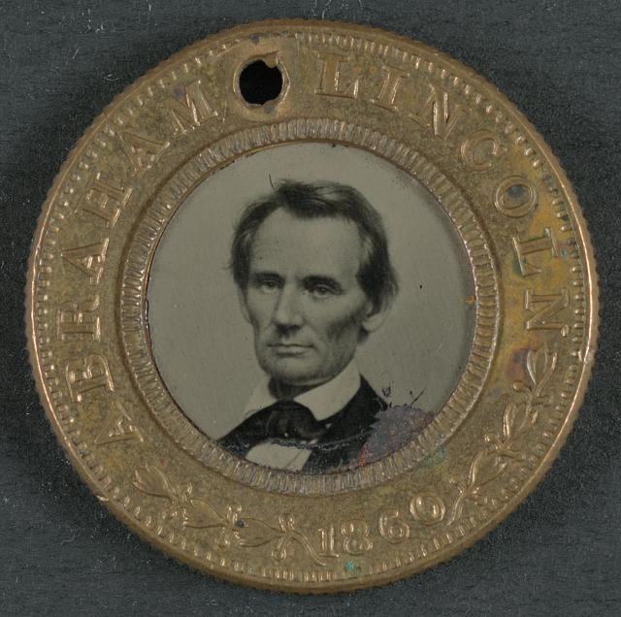
Title: [Abraham Lincoln-Hannibel Hamlin campaign button for 1860 presidential election]
Created/Published: 1860.
http://www.loc.gov/pictures/item/2011647968/

Slide 12
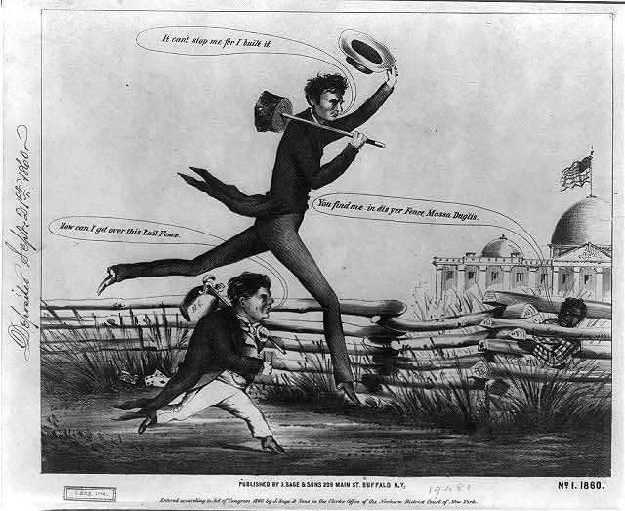
· Title: [Lincoln & Douglas in a presidential footrace]. No. 1, 1860
· Related Names: J. Sage & Sons.
· Date Created/Published: Buffalo, N.Y. : Published by J. Sage & Sons, 1860.
http://www.loc.gov/pictures/item/2008661608/

Slide 13
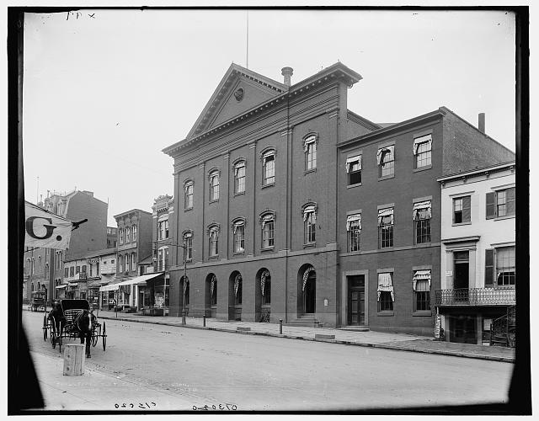
· Title: [Old Ford's Theater, where Lincoln was assassinated]
· Related Names: Detroit Publishing Co. , publisher
http://www.loc.gov/pictures/item/det1994014332/PP/

