Slide 1
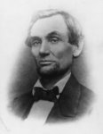
LINCOLN
Taylor Riston

Slide 2
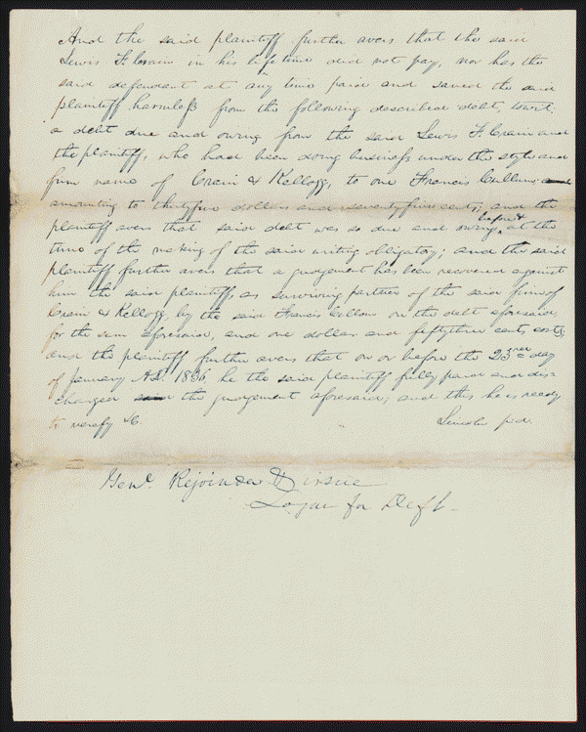
Kellogg vs. Crain
Author/Creator
Author: Lincoln, Abraham
Created/Published
January 23, 1836
Notes
Appears to be in Lincoln's hand.
Summary: Kellogg and Lewis Crain dissolved their business partnership, but Crain owed Kellogg $16,000 to pay off the business's debts.
Crain died before paying, and Kellogg sued James Crain, who served as surety for Lewis Crain, in an action of debt for $16,000.
The court granted a change of venue to Peoria County, but the court there remanded the case back to Tazewell County.
Kellogg retained Lincoln but failed to appear, and the court dismissed the case.
Kellogg motioned to reinstate the case because he was ill and could not attend court.
The court set aside the dismissal and ruled for Kellogg for $16,000.
Digital ID
lprbscsm scsm1374 http://hdl.loc.gov/loc.rbc/lprbscsm.scsm1374

Slide 3
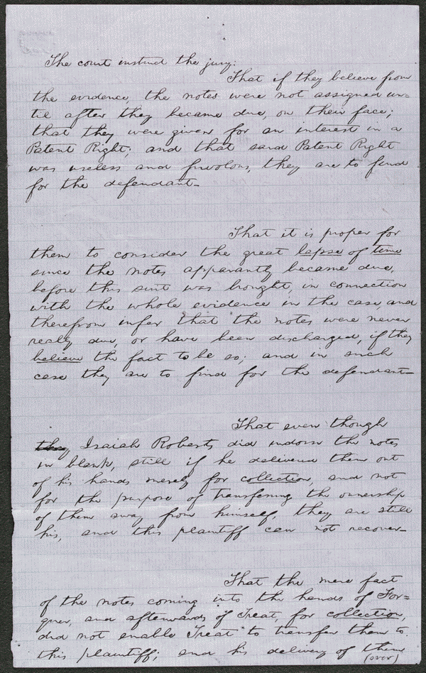
Roberts vs. Harkness
Created/Published
n. d.
Notes
Appears to be in Lincoln's hand.
Summary: Harkness gave Isaiah Roberts three promissory notes in 1834 totaling $1,080. Isaiah assigned the notes to Henry Roberts, who sued Harkness in the Peoria County Circuit Court after Harkness failed to pay. Harkness argued that Roberts for $1,440 sold him an idea for an invention to manufacture bricks. Harkness refused to pay because he discovered that the invention was useless, which broke the consideration of the promissory notes. The court granted a change of venue to Tazewell County Circuit Court, and Harkness retained Lincoln. The first jury failed to reach a verdict, but a second jury found for Harkness. Roberts motioned for a new trial, but the court overruled the motion.
Digital ID
lprbscsm scsm1466 http://hdl.loc.gov/loc.rbc/lprbscsm.scsm1466

Slide 4
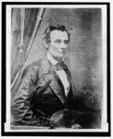
Title: [Abraham Lincoln, half-length portrait, facing right]
Creator(s): German, Charles S., photographer
Date Created/Published: [1858 Sept. 23, printed later]
digital file from b&w film copy neg., rectangle cropped above elbow http://hdl.loc.gov/loc.pnp/cph.3a55055

Slide 5
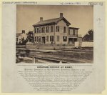
Summary: Photo shows the house where Abraham Lincoln lived in Springfield, Illinois, with presidential candidate Abraham Lincoln standing on the terrace, with his sons Willie and Tad. (Source: Ostendorf, p. 56-9.)
digital file from original http://hdl.loc.gov/loc.pnp/ppmsca.23724
Title: Abraham Lincoln at home
Creator(s): Whipple, John Adams, 1822-1891, photographer
Date Created/Published: [1860, c1865]

Slide 6
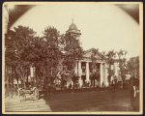
Title: The Coles County Court House in Charleston, Ills., in which Lincoln often practiced law and before which he made a short speech in the evening after his fourth joint debate with Douglas, Sept. 18, 1858
Date Created/Published: [between 1860 and 1898?]
Date Created/Published: [between 1860 and 1898?]
Notes:
Title from item.
Accession box no. DLC/PP-1972:140
digital file from original http://hdl.loc.gov/loc.pnp/ppmsca.19197

Slide 7
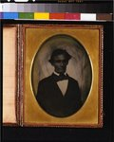
Summary: Photograph showing Abraham Lincoln taken in Pittsfield, Illinois, after delivering a speech.
Title: [Abraham Lincoln, head-and-shoulders portrait, facing slightly left, taken in Pittsfield, Illinois, two weeks before the final Lincoln-Douglas debate in Lincoln's unsuccessful bid for the Senate, October 1, 1858]
digital file from color film copy transparency http://hdl.loc.gov/loc.pnp/cph.3g13901
Creator(s): Jackson, Calvin, fl. 1858-1882, photographer

Slide 8
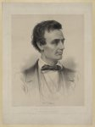
Title: Hon. Abraham Lincoln, Republican candidate for the presidency, 1860 / Grozelier ; painted by Hicks ; lith. by L. Grozelier, Boston.
Creator(s): Grozelier, Leopold, 1830-1865, lithographer
digital file from original print http://hdl.loc.gov/loc.pnp/pga.00380
Summary: Print showing Abraham Lincoln, head-and-shoulders portrait, facing right. Thomas Hicks painted a portrait of Lincoln at his office in Springfield specifically for this lithograph.

Slide 9
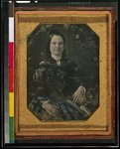
Title: [Mary Todd Lincoln, wife of Abraham Lincoln. Three-quarter length portrait, seated, facing front]
Creator(s): Shepherd, Nicolas H., photographer
Date Created/Published: [1846 or 1847]
digital file from color film copy transparency http://hdl.loc.gov/loc.pnp/cph.3g06189

Slide 10
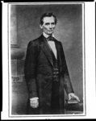
Title: [Abraham Lincoln, candidate for U.S. president, three-quarter length portrait, before delivering his Cooper Union address in New York City] / Brady, N.Y.
Creator(s): Brady, Mathew B., ca. 1823-1896, photographer
Date Created/Published: 1860 February 27 [printed later
digital file from b&w film copy neg. http://hdl.loc.gov/loc.pnp/cph.3a09102

